Slide 1
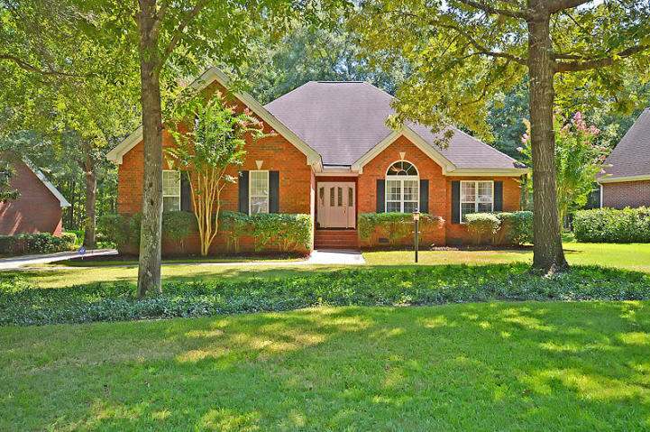
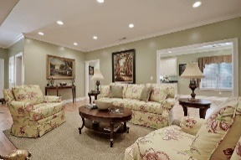
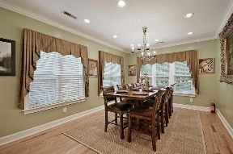
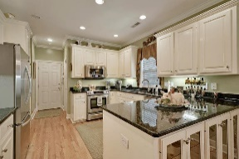
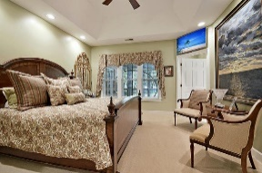
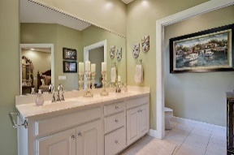
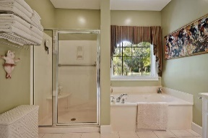
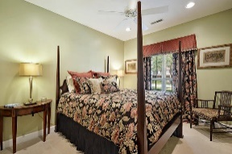
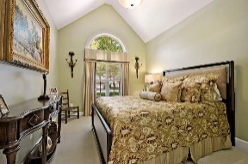
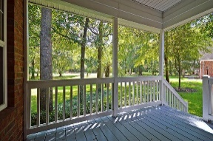
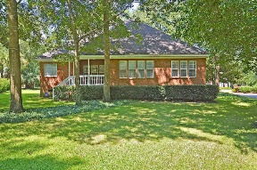
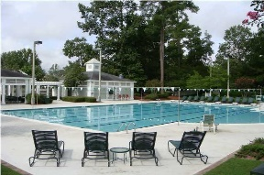



One story Living in Coosaw Creek
8614 W Fairway Woods Dr
Coosaw Creek Country Club
North Charleston, SC 29420
MLS# 16022086
$335,000
3 Bedrooms | 2 Baths | 2,349 sf
This beautiful one story, golf course home is move in ready and perfect for someone looking for a smaller home in Coosaw Creek. The home features 3 bedrooms and 2 full bathrooms, large bonus room over the garage, separate dining room, family room AND sunroom overlooking the golf course. No worries about golf balls as this home is behind the 16th tee box with great views from the back deck, sunroom and dining room. The family room has a gas fireplace, wood floors and ample lighting. The kitchen is spacious with plenty of cabinetry! Wood floors throughout the first floor! The home also features a finished FROG which can be used as a media room, toy room, man cave, you name it! The master bedroom has a large walk in closet and great views of the golf course. The master bath offers dual vanities, large shower and separate jetted tub. There are two more bedrooms on the first floor and a full bath. Buyers will notice a laundry room with utility sink, two car side entry garage, central vacuum system and much more. Short drive to Boeing, Bosch, Mercedes, AFB and Airport - convenience galore! Coosaw Creek offers an excellent clubhouse, restaurant and bar, neighborhood pool with food service and award winning swim team, tennis courts, basketball courts and playground. Unlimited golf for all household members with this full golf membership! Come see this home today!!
Larry & Kathy Mazalatis
Larry Cell 843-693-0529
Kathy Cell 843-693-0159
Office 843-871-9133
AGENTOWNED PREMIERE GROUP | 1800 TROLLEY RD | SUMMERVILLE, SC 29485

