Slide 1
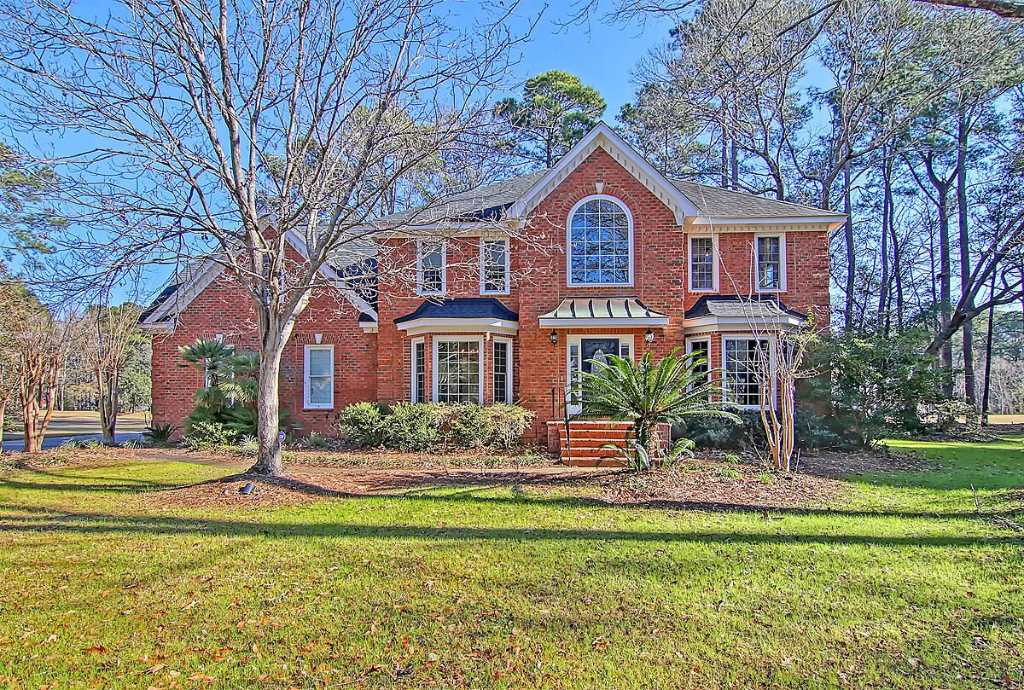
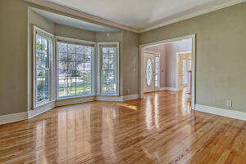
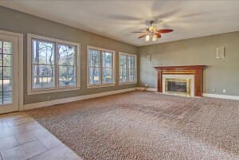
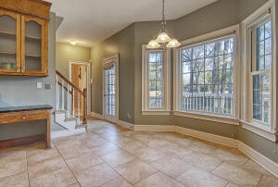
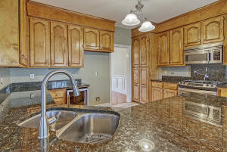
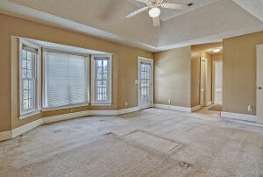
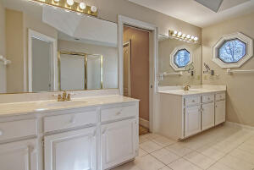
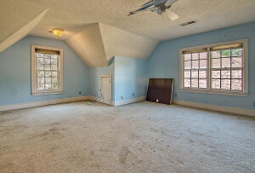
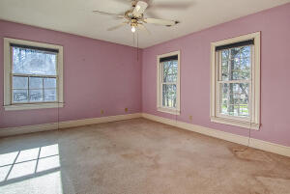
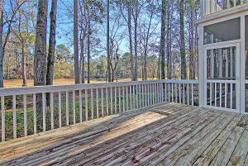
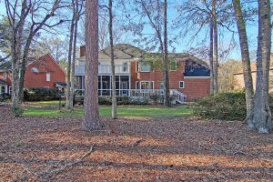
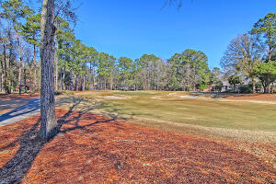
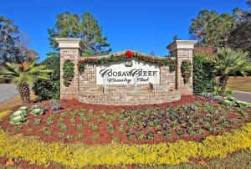
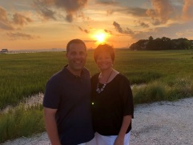

Gated Community On The Golf Course!!
8614 Arthur Hills Circle
Coosaw Creek Country Club
North Charleston, SC 29420
MLS# 22001991
$449,900
4 Bedrooms | 3½ Baths | 3,235 sf
Welcome home to 8614 Arthur Hills Circle in the gated golf course community of Coosaw Creek! This home is ready for you to make it your own! This custom built home offers 4 bedrooms and 3.5 baths. Enter in to the two story foyer, with a large living room to your right, that can easily be a home office. To your left is the dining room which is perfect for entertaining and right off the kitchen. Both of these rooms have large bay windows which provides tons of natural light. The kitchen has a gas range, pot filler, beverage center, desk space and a large eat in kitchen area. The kitchen overlooks the family room, all offering great views of the backyard and golf course. Off the living room is the huge screened in porch and deck area perfect for grilling. Head upstairs to the large master suite that has its own private porch, a master bathroom with dual vanities, oversized shower, jetted tub and two walk in closets. Back in the hall, there are two good sized bedrooms and a full bath. Down the hall is the laundry room, then a huge FROG with a full bath that can be a fourth bedroom, game room, media room...you name it! Head down the second staircase right outside this room and you are back to the kitchen! This home has so much to offer! And so does Coosaw Creek! The neighborhood has 24 hour 7 day a week gated security, unlimited golf for all household members, and the location, wow...close to it all! Boeing, Bosch, AFB, Mercedes, Volvo are all a short drive away. Come live the good life in a golf course community that has tons of activities and events, great food in the restaurant, great community pool with an award winning swim team, tennis courts, pickle ball courts and the most beautiful golf course you'll ever play on!
Larry & Kathy Mazalatis
Larry Cell 843-693-0529
Kathy Cell 843-693-0159
Office 843-871-9133
AGENTOWNED PREMIERE GROUP | 1800 TROLLEY RD | SUMMERVILLE, SC 29485

