Slide 1
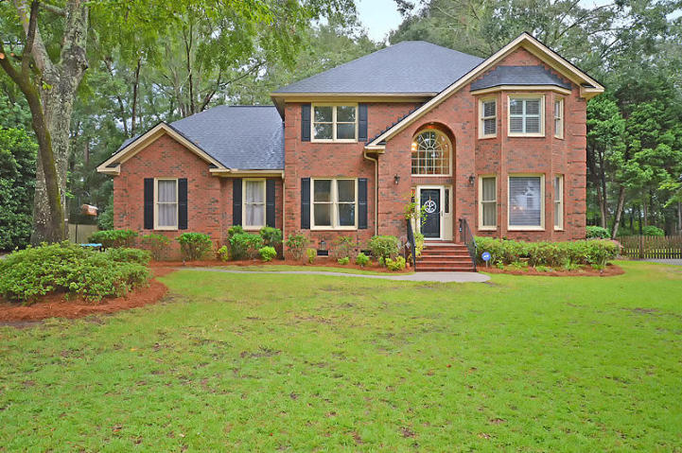
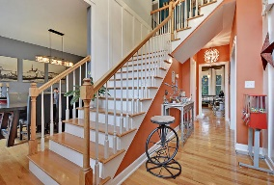

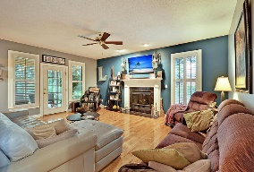
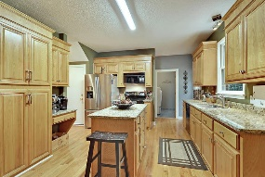
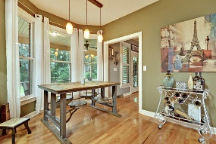
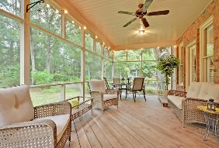
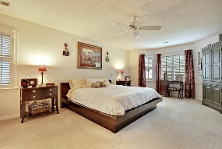
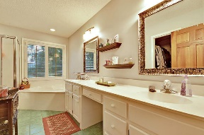
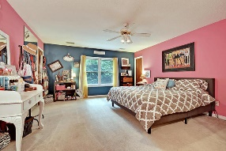
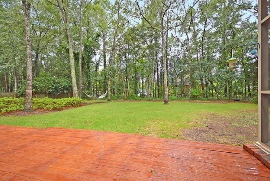
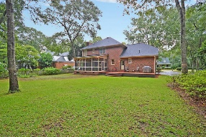



Gated Golf Course Community Beauty!
8615 W Fairway Woods Dr
Coosaw Creek Country Club
North Charleston, SC 29420
MLS# 17022598
$375,000
4 Bedrooms | 2½ Baths | 2,756 sf
Look no further, this is the home for you! Located in the gorgeous gated golf course community of Coosaw Creek, this home is just waiting for you! Upon entering you'll immediately notice all the great touches and upgrades throughout. There is a formal living room to your right that can be used as an office, even having French doors for added privacy. The dining room is a great size for entertaining and right off the kitchen. The family room offers a gas fireplace, wood floors and access to a large screened in porch. The kitchen offers tons of cabinet space and island. Upstairs, you'll find a very large master bedroom. The Master bathroom has dual vanities, separate tub and walk in closet.
Two more good sized bedrooms are located upstairs as well as another full bathroom in the hall. The huge bonus room can be a 4th bedroom, media room, game room, so many options! There is Tons of storage off this room! Take the second staircase back downstairs and you'll have the laundry room and access to the super clean and organized oversized two car garage. Back outside, the backyard is a great size with tons of privacy and a wooded buffer. This home is move in ready!! The neighborhood has 24 hour 7 day a week gated security, unlimited golf for all household members, and the location, wow...close to it all! Boeing, Bosch, AFB, Mercedes are all a short drive away. Come live the good life in a golf course community that has tons of activities and events, great food in the restaurant, great community pool with an award winning swim team, and the most beautiful golf course you'll ever play on!
Larry & Kathy Mazalatis
Larry Cell 843-693-0529
Kathy Cell 843-693-0159
Office 843-871-9133
AGENTOWNED PREMIERE GROUP | 1800 TROLLEY RD | SUMMERVILLE, SC 29485

