Slide 1
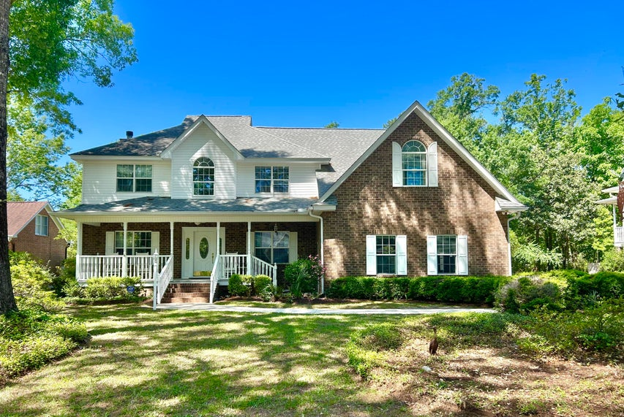
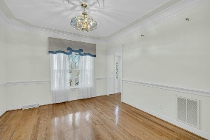
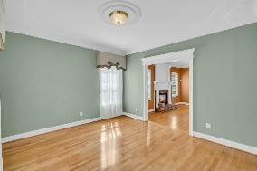
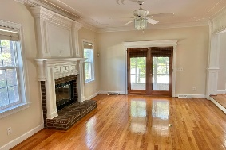
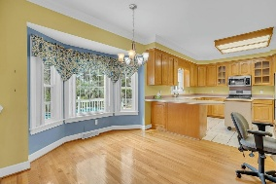
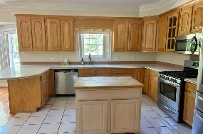
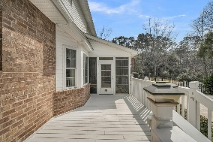
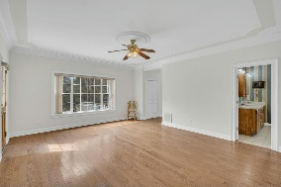
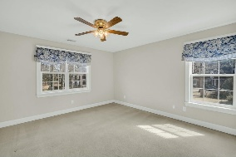
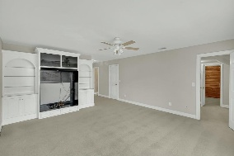
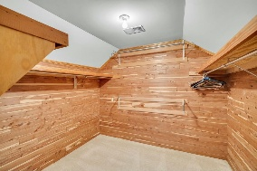
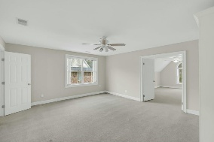
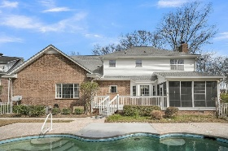
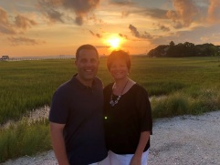

Gated Community Home Ready for You To Make It Your Own!!
8615 Arthur Hills Circle
Coosaw Creek Country Club
North Charleston, SC 29420
MLS# 25005324
$659,000
4 Bedrooms | 3½ Baths | 3,800 sf
Welcome to 8615 Arthur Hills in the beautiful gated golf course community of Coosaw Creek Country Club! This home is priced right and gives you the perfect opportunity to put your finishing touches on it and truly making it your own. Upon entering from the large front porch, a perfect spot to relax, to your left will be the formal living room. Step down from here in to the family room complete with a fireplace and access to the sunroom. Overlooking the family room is the kitchen which offers a large eat in area, desk space, ample cabinetry and a pantry. The dining room is a great size, perfect for entertaining. The primary bedroom is also on the first floor and gives you access to the back deck, multiple closets and a bathroom with dual sinks, separate shower and tub. Look out back for a relaxing view of your built in pool and pond views. It's your own private oasis! Head upstairs where you will find two large bedrooms with a full bath in the hall. Then down the hall is a great flex space, that would make a perfect home office. Off of this room is a walk up attic! The storage in this home is amazing! Continue down the hall to a huge bonus room, with multiple closets off of it, including a beautiful cedar closet, its own full bathroom. Off of this room is another large room that could serve as an additional bedroom or flex space. The possibilities are endless! You'll never struggle to find storage in this home! Coosaw Creek is a great place to live! The neighborhood has 24 hour 7 day a week gated security, unlimited golf for all household members, and the location, wow...close to it all! Boeing, Bosch, AFB, Mercedes, Volvo are all a short drive away. Come live the good life in a golf course community that has tons of activities and events, great food in the restaurant, great community pool with an award winning swim team, tennis courts, pickle ball courts and the most beautiful golf course you'll ever play on! Located in the Dorchester District 2 school zone, your high school student can walk to school! This neighborhood has gate entry to the campus. Also in walking distance is a brand new public library and aquatics center!! Don't miss your chance to make this house your dream house!
Larry & Kathy Mazalatis
Larry Cell 843-693-0529
Kathy Cell 843-693-0159
mazteamrealty@gmail.com
AGENTOWNED REALTY | 1800 TROLLEY RD | SUMMERVILLE, SC 29485

