Slide 1

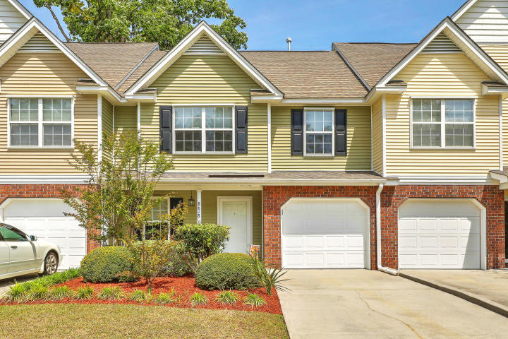
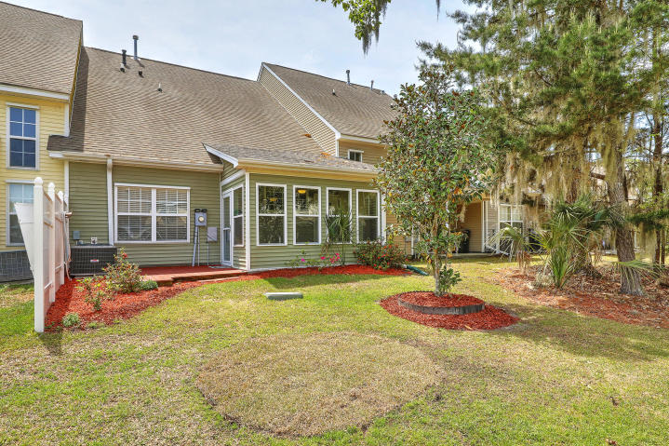
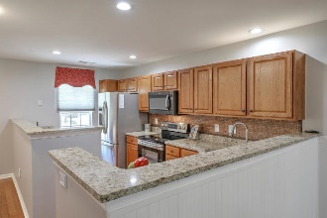
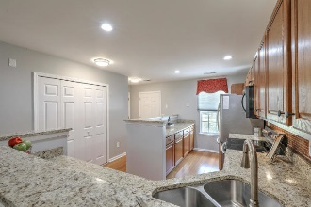
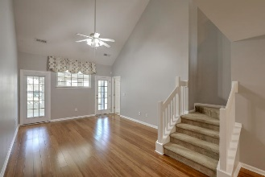
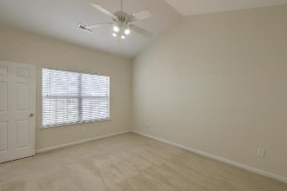
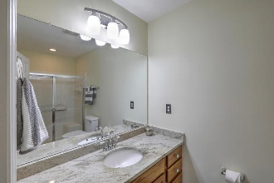
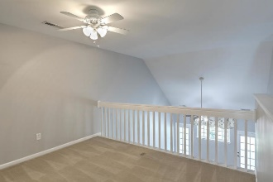
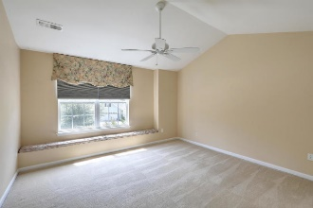
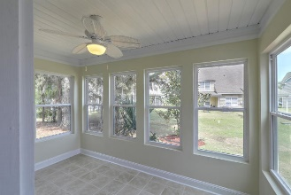
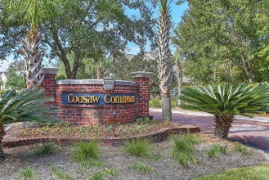
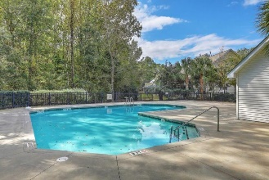


JUST LISTED!! Pristine Coosaw Commons Townhome Open House Sat 12-2 and Sun 12-3
8618 Grassy Oak Trail
Coosaw Commons | N Charleston, SC 29420 | MLS# 19010459 | $187,500
This pristine townhome, located in DD2 school district, is perfect for the buyer who wants more free time, lots of space and less yard work! Features of this spacious 3BR/2.5B + loft home include**New Bamboo floors in main living area**New Sunroom which is a lovely retreat for an evening BBQ or glass of wine** Bright and light open floor plan with custom trim and high ceilings offering lots of natural light**Well appointed kitchen with recessed lighting, ample cabinet and counter space, granite counters and S/S appliances**Roomy first floor master suite with his/hers closets and lovely updated bathroom with porcelain tile floors**Upstairs you have two large bedrooms, a full updated bath and loft which is great for office or play/media room**NEW AC and NEW ductwork in attic with pull down aluminum ladder. Other features in the is meticulously maintained home include:
Tankless Water Heater
One car garage with newly painted walls, newly epoxied floor and heavy duty shelves
Parking for three additional cars on parking pad
Conveniently located near Boeing, Bosch, Charleston Air Force Base and all interstates as well as shopping, restaurants and medical facilities. Don't miss this one!
Make this home yours today!
Desiree Maurer Office - (843) 416-2000
Mobile - (843) 327-9010 desiree.maurer1@gmail.com
www.yourcharlestonhousesearch.com
Keller Williams Realty 496 Bramson Ct Ste 200 Mt. Pleasant, SC 29464

