Slide 1
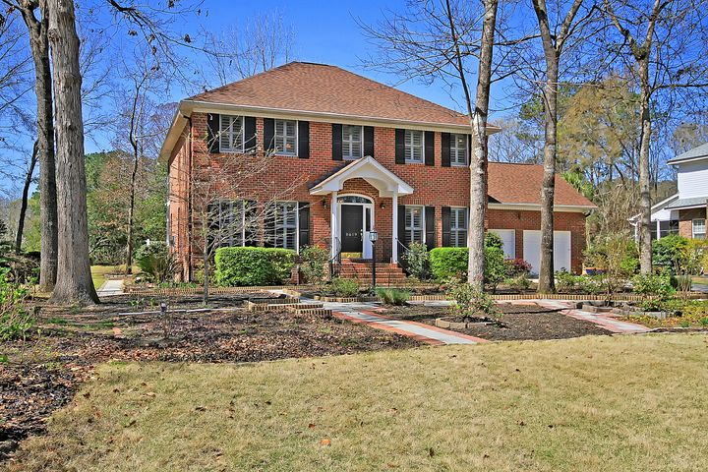
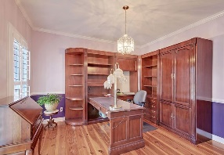
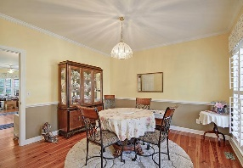
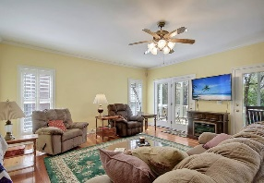
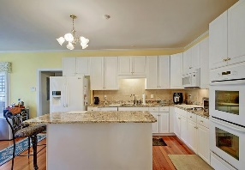
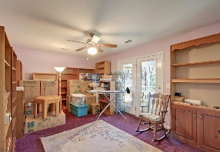
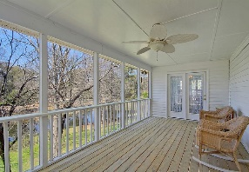
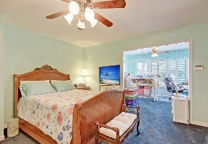
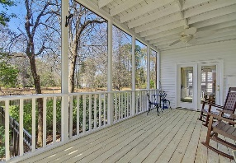
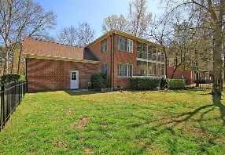
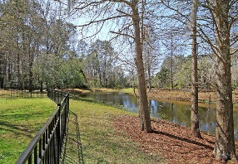
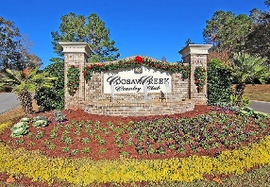
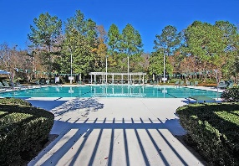
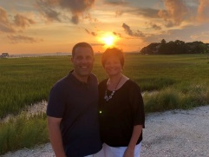

Lovely Home In Gated Golf Course Community!
8619 Arthur Hills Circle
Coosaw Creek Country Club
North Charleston, SC 29420
MLS# 21007677
$429,000
3 Bedrooms | 2½ Baths | 2,974 sf
Welcome to 8619 Arthur Hills Circle located in the gated golf course community of Coosaw Creek. This home offers lovely pond views which can be enjoyed from the double screened in back porches. Upon entering, you'll immediately notice the gorgeous heart pine floors. The dining room is to your right and is a great size for entertaining. The formal living room is to your left and would make a perfect home office. The kitchen has an island, new granite countertops, new appliances, double oven, large eat in kitchen area, pantry, a built in desk and plenty of storage. Off the kitchen is a staircase that leads up to the frog. The frog is a great flex space which has attic storage off of it. Back downstairs off of the kitchen is the family room. This room has built in cabinetry and access to the first floor screened in porch. Open up the back doors and enjoy the view! Head upstairs to find the huge master suite! This bedroom offers a large seating area that could be a nursery, home office or gym. You can walk right outside your master bedroom and sit on the screened in porch! Off the bedroom is the master bathroom which has two walk in closets right outside of it, a separate large shower stall and jetted tub. Back out in the hall you'll find two more bedrooms and a full bath. The bedroom in the rear of the home also has access to the second floor screened in porch. This home has been well maintained. New roof 2016, plantation shutters, updated faucets and vanities in bathrooms, fenced in yard. The neighborhood has 24 hour 7 day a week gated security, unlimited golf for all household members, and the location, wow...close to it all! Boeing, Bosch, AFB, Mercedes are all a short drive away. Come live the good life in a golf course community that has tons of activities and events, great food in the restaurant, great community pool with an award winning swim team, tennis courts, basketball courts, playground and the most beautiful golf course you'll ever play on!
Larry & Kathy Mazalatis
Larry Cell 843-693-0529
Kathy Cell 843-693-0159
Office 843-871-9133
AGENTOWNED PREMIERE GROUP | 1800 TROLLEY RD | SUMMERVILLE, SC 29485

