Slide 1
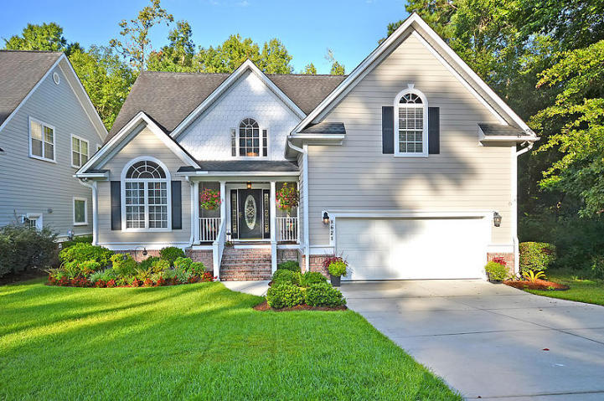
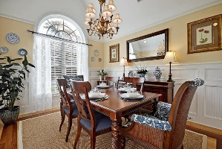
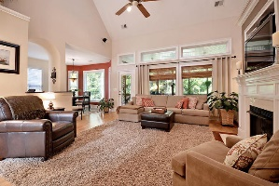
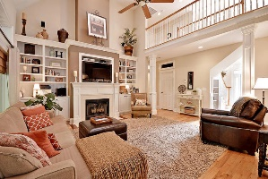
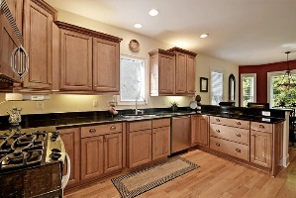
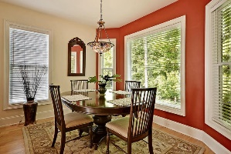
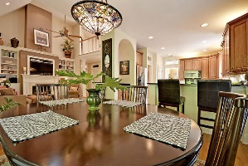
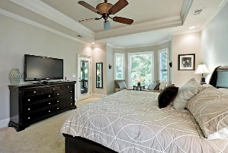
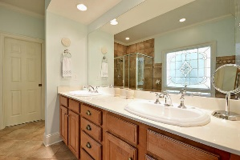
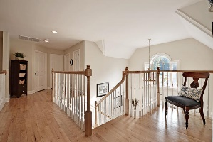
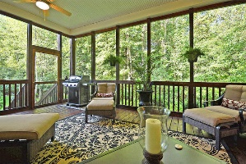
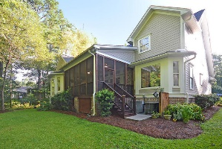
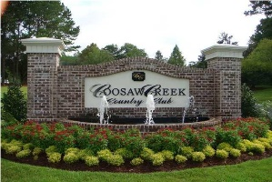


Coosaw Creek Living At It's Best!
8621 Woodland Walk
Coosaw Creek Country Club
North Charleston, SC 29420
MLS# 15022082
$369,000
4 Bedrooms | 3½ Baths | 3,015 sf
Get ready to be WOWED! This gorgeous, custom built home is located in the gated golf course community of Coosaw Creek Country Club! No detail has been left out in this gem of a home! Curb appeal galore with lovely landscaping and both a well maintained exterior and interior, (outside painted in 2013). This home is ready for you to move right in! Wood floors with detailed inlay design, transom windows above doorways, custom trim package in many of the rooms, built in cabinetry, the builder has thought of it all! Walk in to a warm, vaulted foyer offering an abundance of natural light. To your left you'll find the stunning dining room with vaulted ceiling, dimming lights and wainscoting trim work three quarters the way up the wall. Great room for entertaining! The kitchen is a cook's delight, with a gas cooktop, convectional oven, plenty of counter space, breakfast bar, spacious pantry, large eat in kitchen area and plenty of cabinets for storage. The living room has a gas fireplace, built in shelving and cabinets, wood floors and solatubes in the ceiling to brighten the area with natural light. The master bedroom is conveniently located on the first floor with a seating area, tray ceiling, a great master bath and access to the screened in back porch. The master bath is complimented with a jetted tub, separate shower, dual vanities and large walk in closet. Upstairs you'll find a bedroom with it's own full bath and large walk in closet. Perfect for guests or a second master. Two more bedrooms, one could be used as a bonus room, as well as a full bath, complete the upstairs. Tons of storage in this home and every closet has a light! Want to relax? Head to the huge, private screened in porch. The wooded backyard makes a perfect setting! This community is unique to the area and is conveniently located just minutes from Bosch, Boeing and the Air Force Base! From the moment you drive through the 24 hour a day manned security gate, you are taken aback by the beauty of this neighborhood. Gorgeous golf course as well as a very active clubhouse with an amazing restaurant make this neighborhood one of the most sought after in the area! Come see this home today!
Larry & Kathy Mazalatis
Larry Cell 843-693-0529
Kathy Cell 843-693-0159
Office 843-871-9133
AGENTOWNED PREMIERE GROUP | 1800 TROLLEY RD | SUMMERVILLE, SC 29485

