Slide 1
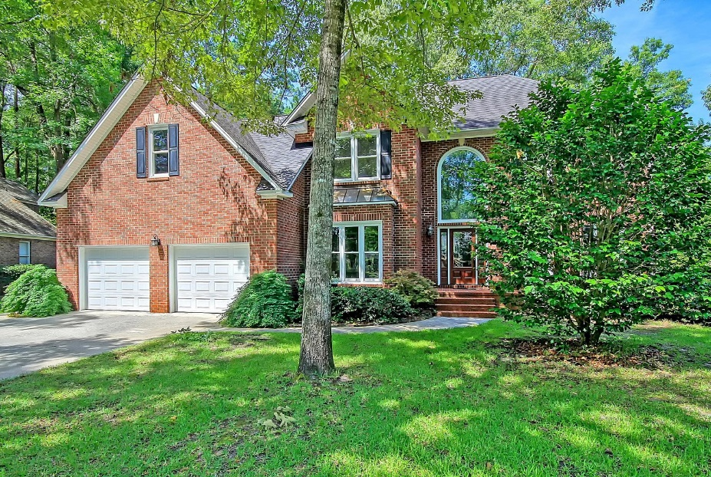
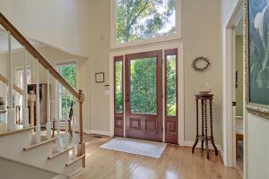
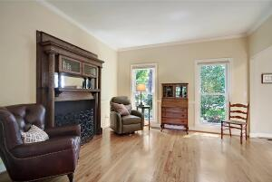
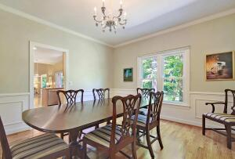
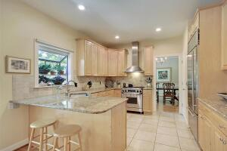
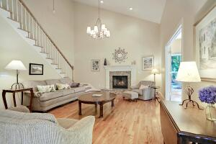
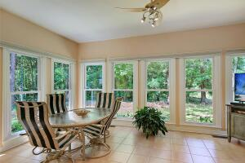
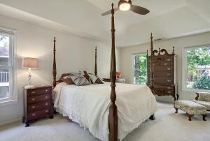
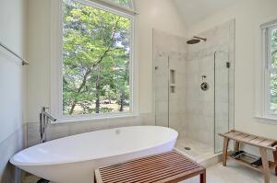
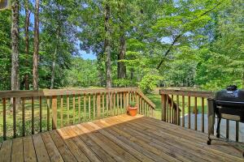
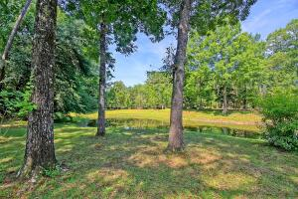
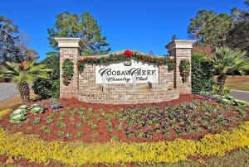
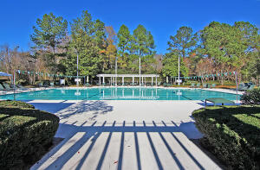
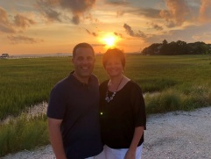

Gated Golf Course Community!
8623 Arthur Hills Circle
Coosaw Creek Country Club
North Charleston, SC 29420
MLS# 22016683
$639,000
5 Bedrooms | 3 Baths | 3,212 sf
Welcome home to 8623 Arthur Hills Circle in the gated golf course community of Coosaw Creek Country Club! This home and this neighborhood are exactly what you've been waiting for! Be impressed the moment you step foot in this beauty of a home! The two story foyer is so welcoming and you'll immediately notice the wood flooring throughout the first floor as well as all the natural light. To your left is a first floor bedroom, currently being used as an office, with a full bathroom connected. To your right is the formal living room. Through french doors you enter the dining room that's a perfect size for entertaining. The kitchen is your next stop and it is sure to impress! Granite countertops, gas range, Sub Zero refrigerator!! There is a breakfast bar as well as a large eat in kitchen area. The kitchen overlooks the family room which has a fireplace and a second staircase. Off of the family room is the lovely sunroom. A peaceful setting with wooded views as well as pond views. A perfect spot to relax after a long day! Head upstairs and you'll find the large primary suite. The bathroom has dual vanities, large shower and a bathtub you'll never want to get out of! There are three more bedrooms upstairs all with large closets as well as another full bathroom in the hallway. This home is a must see! Dorchester District 2 schools, a short drive to Bosch, Boeing, Mercedes and the airport, Coosaw Creek has so much to offer! Unlimited golf green fees for all household members, tennis courts, basketball courts, pickle ball courts, playground and a super active Club with tons of special events, restaurant and clubs. This neighborhood has it all!
Larry & Kathy Mazalatis
Larry Cell 843-693-0529
Kathy Cell 843-693-0159
Office 843-871-9133
AGENTOWNED PREMIERE GROUP | 1800 TROLLEY RD | SUMMERVILLE, SC 29485

