Slide 1
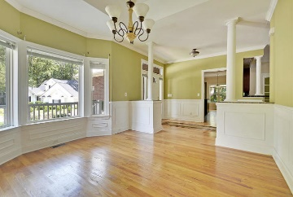
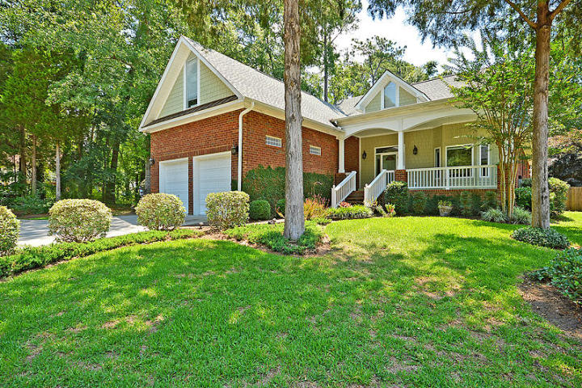
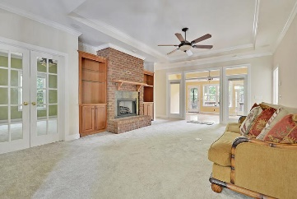
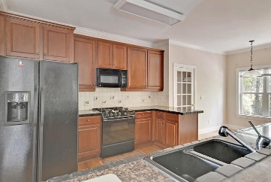
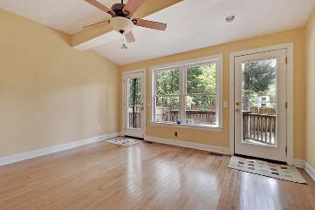
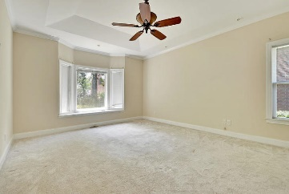
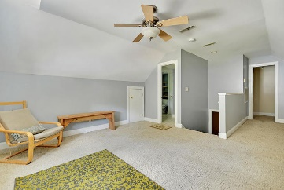
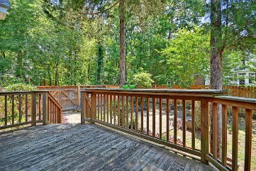
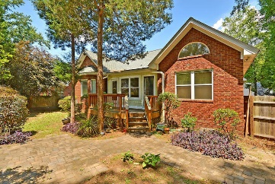

8624 Woodland Walk Coosaw Creek Country Club · North Charleston, SC 29407 MLS# 20015574 · $330,000
Ashborough on Lake w/Dock only $375,000
Short Sale Deal!
Seller will pay buyer's agent $5,000 at closing
with accepted offer by noon June 7, 2019!
Short SALE Opportunity on a Great cul-de-sac location in the gorgeous gated community of Coosaw Creek! Brick home with decorative Shaker Shingles has 3BRs and 3 Full baths. Upstairs includes a BR suite with full bath and walk-in closet. This was a custom home with great finishes. Home has study,and a huge master BR with multiple closets. Large master BA has a garden tub, Sunroom deck! Lots of upgrades.
PLEASE take note do your homework upfront this is a short sale and there is no guarantee the bank will approve the sale. Short sales take a long time to complete. The home appears to be in wonderful condition, but it is being sold as-is. The seller will not make any repairs whatsoever. Please do as much due diligence as you can before entering into a sales contract with the sellers. We have hired a professional short sale negotiator to work with the lien holders.
Stan Huff
843-670-2835 stan.huff@agentowned.com
Jill Marcacci
843-297-5590 jill@agentowned.com
www.agentownedrealty.com
AgentOwned Realty Co. Preferred Group, Inc. | 824 Johnnie Dodds Blvd | Mt Pleasant, SC 29464

