Slide 1
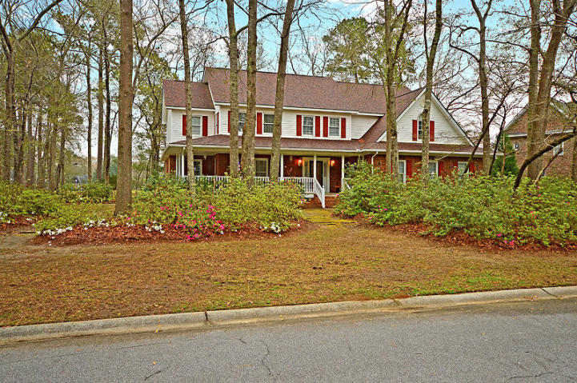
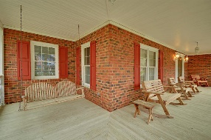
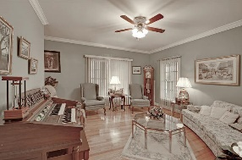
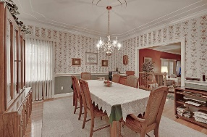
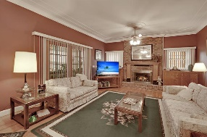
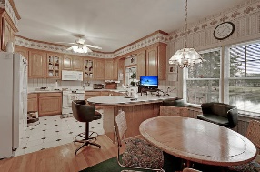
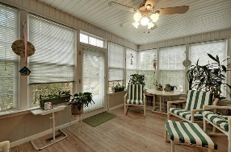
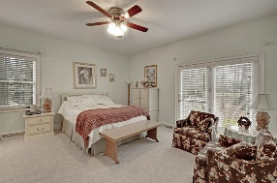
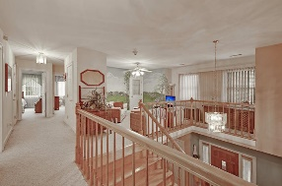
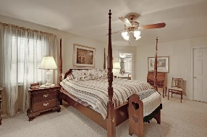
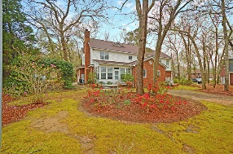
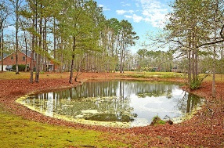
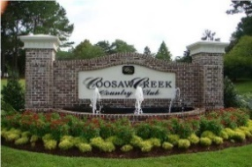


Dual Masters on the Golf Course!
8630 Arthur Hills Circle
Coosaw Creek Country Club
North Charleston, SC 29420
MLS# 19006749
$449,900
4 Bedrooms | 3½ Baths | 3,800 sf
Get ready for the perfect floor plan! This well built, custom home on the golf course boasts two master suites!! Brand new roof, newer HVAC's, this home is ready for you to make it your own! Curb appeal galore, when you pull up you'll immediately notice the gorgeous azaleas and the huge front porch. Upon entering the home, you'll immediately notice the beautiful hardwood floors, wide staircase and welcoming foyer. To your left is a large formal living room that could be used as an office. The dining room is a perfect size for entertaining. The sunken family room has a gas fireplace and access to the sunroom. The kitchen has a breakfast bar and eat in area that also gives you access to the sunroom which overlooks a pond and the golf course. The first floor master has a full bath as well as access to the backyard. Upstairs you'll find a loft area that could be a second family room. Two bedrooms upstairs both with very large closets, share a jack and jill bathroom. There is a large laundry room upstairs as well with plenty of cabinet space providing extra storage. The second master bedroom is located on the second floor and has a full bath with dual vanities, separate tub and shower and large closet space. This home has so much to offer and no detail was left out when it was built. It has central vacuum, storage galore, a garage built with steel beams, so no annoying columns in the garage! Come see this home today as well as Coosaw Creek! The neighborhood has 24 hour 7 day a week gated security, unlimited golf for all household members, and the location, wow...close to it all! Boeing, Bosch, AFB, Mercedes are all a short drive away. Come live the good life in a golf course community that has tons of activities and events, great food in the restaurant, great community pool with an award winning swim team, and the most beautiful golf course you'll ever play on!
Larry & Kathy Mazalatis
Larry Cell 843-693-0529
Kathy Cell 843-693-0159
Office 843-871-9133
AGENTOWNED PREMIERE GROUP | 1800 TROLLEY RD | SUMMERVILLE, SC 29485

