Slide 1
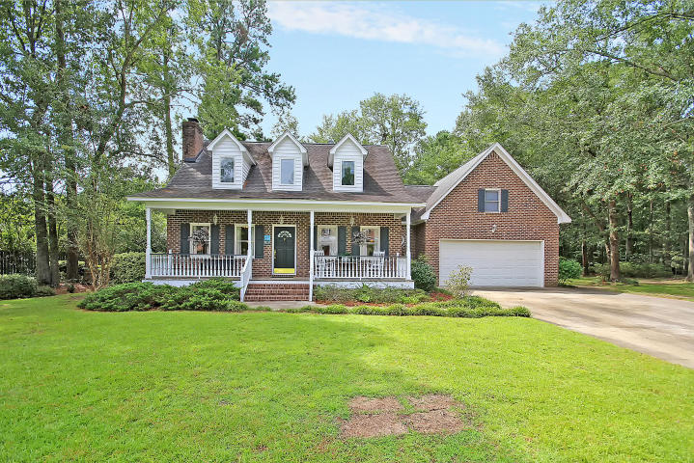
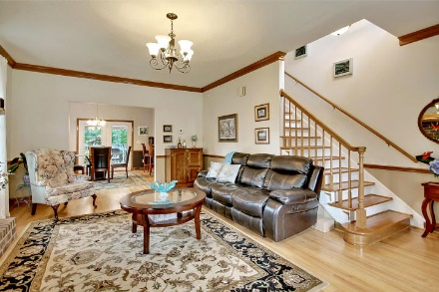
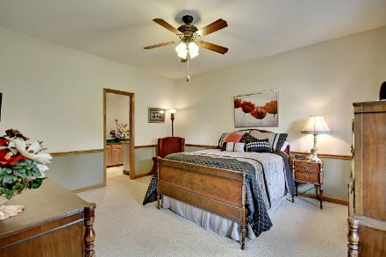
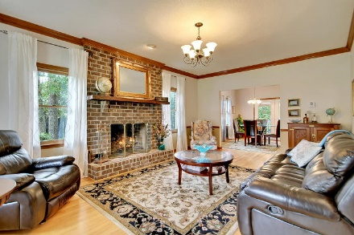
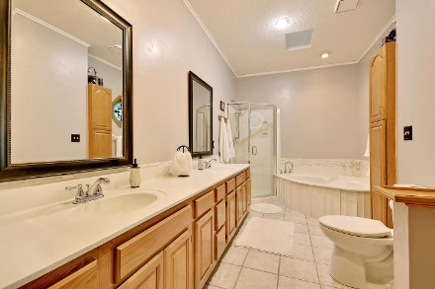
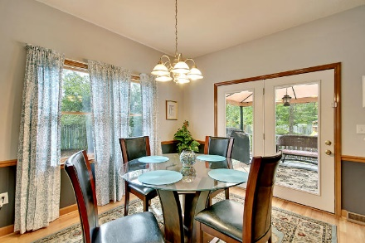
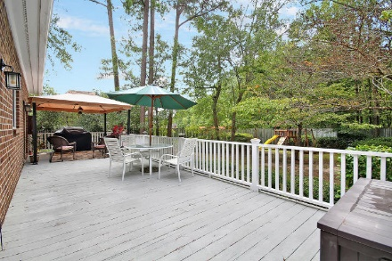
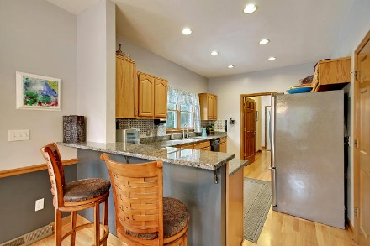
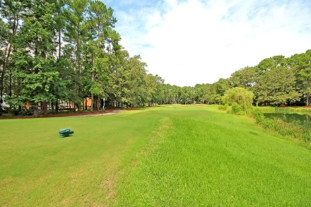
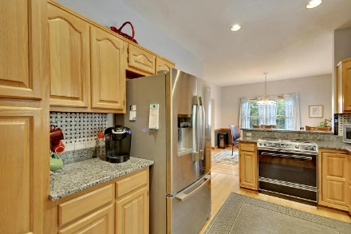
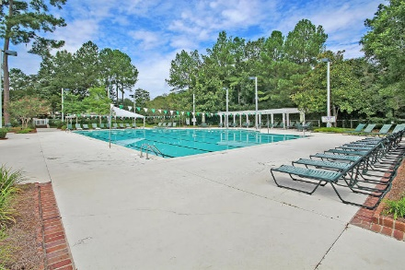
Price Reduced!
Supreme Golf Club Community! Super New Low Price!
8639 Arthur Hills Circle Coosaw Creek Country Club ~ N Charleston ~ MLS# 17024616 ~ $309,900
Pristine 3 bedroom, 2.5 bath executive home on a private, wooded DOUBLE LOT (3/4 acre) in an ultra-exclusive, gated community with its own world-class Arthur Hills Golf Course.
This custom-built home possesses the craftsmanship simply not available in new home construction yet the recently-added architectural roof and updated HVAC systems, granite and numerous upgrades provide all of the advantages of a new home. Entering the home from the front Southern porch an open floor plan unfolds with an easy flow from the great room with a roaring fireplace to the expansive eat-in chef’s kitchen with granite.
A large-expansive back deck overlooks a private backyard oasis. The first-floor luxurious Master Bedroom with a spa-like Master Bath enables complete “first floor living” if so desired. This superb, gated golf-course community is accompanied by Dorchester School District 2 award-winning educational opportunities and a location convenient to Boeing, Bosch, the new Mercedes and Volvo Plants, the airport, a short drive to the sun-kissed area beaches as well as historic downtown Charleston.
All of this can be yours for the BEST VALUE IN GREATER CHARLESTON!
Chip Walsh chip@mattoneillteam.com 843-822-4663

