Slide 1
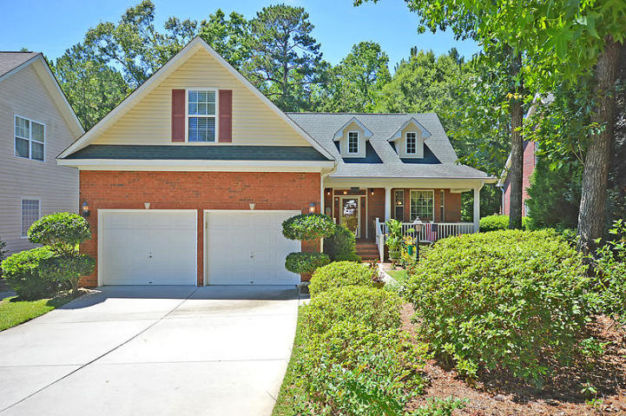
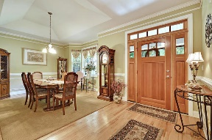
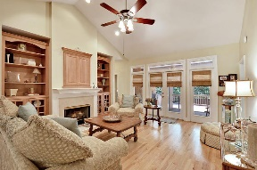
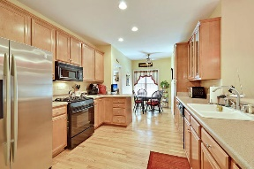
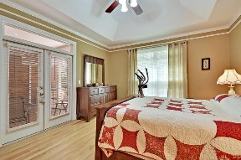
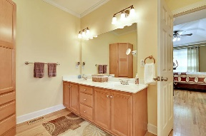
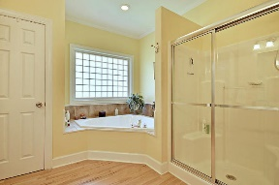
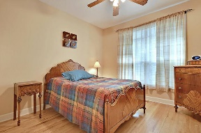
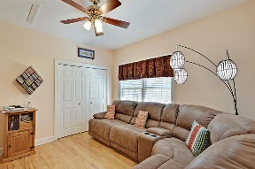
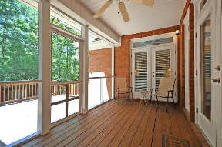
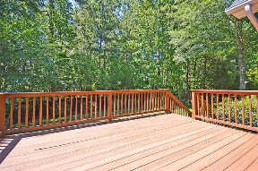
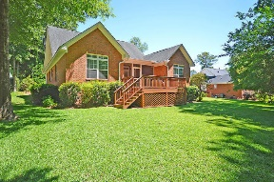



Lowest Priced Home in Gated Community!!
8641 Woodland Walk
Coosaw Creek Country Club
North Charleston, SC 29420
MLS# 17015098
$289,900
3 Bedrooms | 2½ Baths | 2,326 sf
Come live the good life in this cul-de-sac home in the gated golf course community of Coosaw Creek! Looking for low maintenance living? This is the house for you! All bedrooms are on the first floor and there's a bonus room upstairs with a full bath - perfect for guests! Walk in and immediately notice the beautiful wood floors. There's a great sized dining room, perfect for entertaining! The kitchen overlooks the family room and offers tons of cabinet space and an eat in kitchen area. The living room has built in custom cabinetry and a gas fireplace. Off the living room via French doors, is a large screened in porch, which can also be accessed from the master suite. The master has two closets, a large master bath with dual vanities, and lovely views of the private, wooded backyard.
On the other side of the home, are two more good sized bedrooms and a full bath. There is even pull down attic storage in one of the bedrooms! This home has it all! Lawn irrigation, a whole house generator, newer hot water heater...move right in! The neighborhood has 24 hour 7 day a week gated security, unlimited golf for all household members, and the location, wow...close to it all! Boeing, Bosch, AFB, Mercedes are all a short drive away. Come live the good life in a golf course community that has tons of activities and events, great food in the restaurant, great community pool with an award winning swim team, and the most beautiful golf course you'll ever play on!
Larry & Kathy Mazalatis
Larry Cell 843-693-0529
Kathy Cell 843-693-0159
Office 843-871-9133
AGENTOWNED PREMIERE GROUP | 1800 TROLLEY RD | SUMMERVILLE, SC 29485

