Slide 1
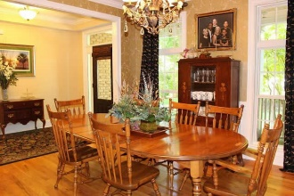
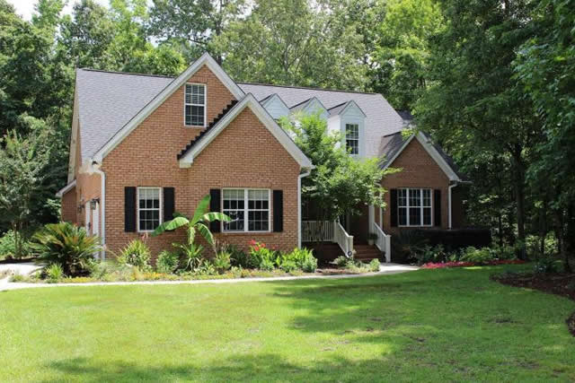
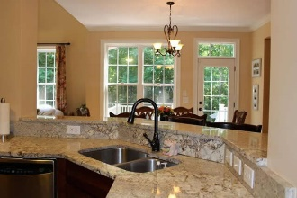
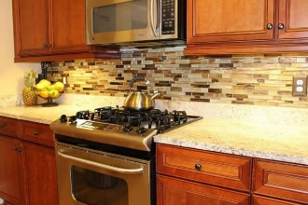
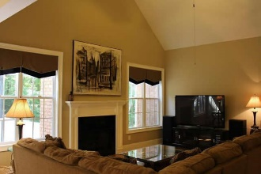
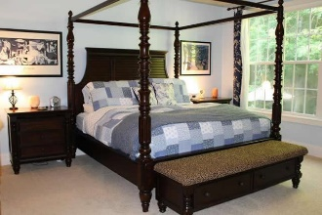
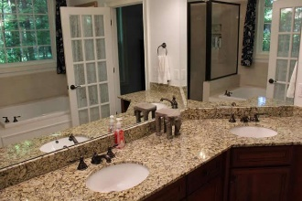
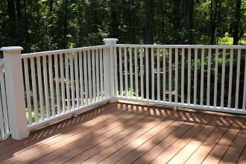
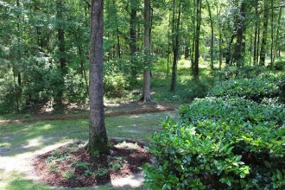
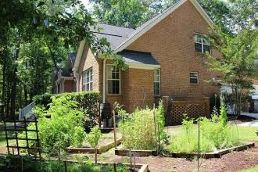



NEW IN COOSAW CREEK - A MUST SEE!
8642 McChune Court
North Charleston | MLS# 18007773 | $489,900
Charleston’s best kept secret is waiting for you in a gated, luxury golf country club community! This stunning all brick custom design Frank Betz home is in impeccable condition filled with upgrades galore making it move in ready! This wonderful home is located on one of the best cul-de-sac lots in all of Coosaw for its secluded private setting yet only a short walking distance to the elite pool and clubhouse! Spacious open floor plan is perfect for entertaining featuring TWO gas fireplaces both located in the family keeping rooms adjoining the kitchen, which is the heart of the home. You will immediately notice the gleaming hardwood flooring starting at the front door and is sure to impress! This beautifully painted home is meticulously maintained and shows like a model home offering lots of crown molding, soaring ceilings, custom cabinetry and shelving throughout. Media package includes sound system and highspeed Ethernet in every room for optimal streaming experience. It also has an oversized foyer that opens to a beautiful formal dining room with a classic Walt Disney Signature wallpaper "Enchanting" from Cinderella. Spectacular kitchen with gorgeous granite countertops, 42" custom cabinets that provide plenty for storage, under cabinet lighting, gas range, stainless steel package, lots of countertop space while cooking or entertaining, large pantry, eat-in-kitchen that opens to a huge family room or outside deck. The Master Suite is more like a private retreat offering vaulted and tray ceilings with up lighting, massive walk in closet and private access to attic that is like a room all of its' own, master bathroom has raised vanity with double sinks, granite countertops, separate 5' shower and tub. Another bedroom is located on first floor or can be used as a den. This highly sought after neighborhood offers Dorchester II School District. The neighborhood is conveniently located to dining and shopping, parks, Bosch, Boeing, I-26, Historic Downtown Summerville, AFB, Charleston Int'l Airport or you can choose to dine at your Neighborhood Country Club! This fantastic home is an amazing value and won't last long! Schedule to see this one today!
Gina Brammer, Realtor
(843) 437-7828
ginabrammer1@gmail.com
AgentOwned Premiere Group | 1800 Trolley Rd | Summerville, SC 29485

