Slide 1
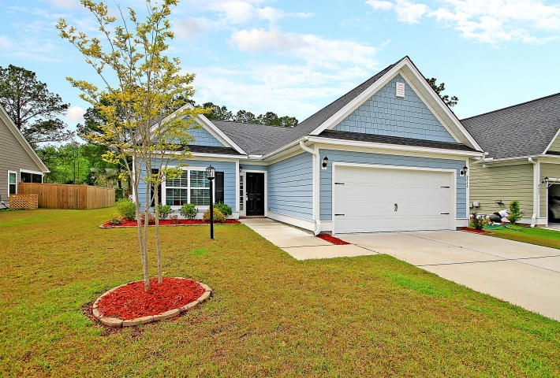
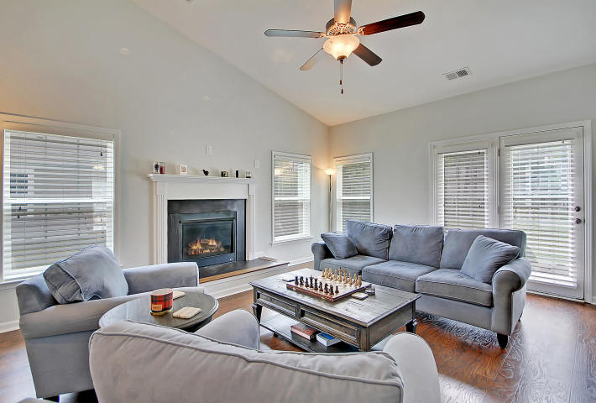
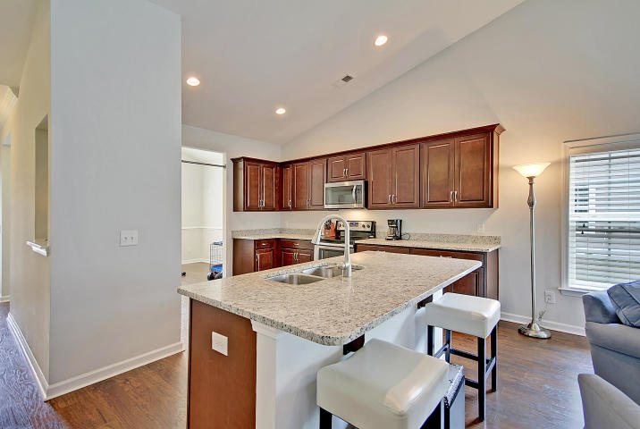
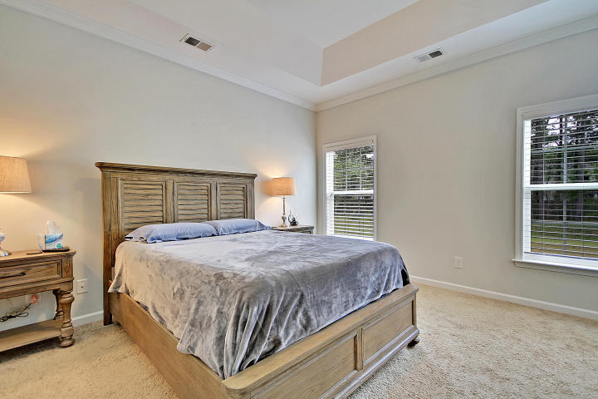
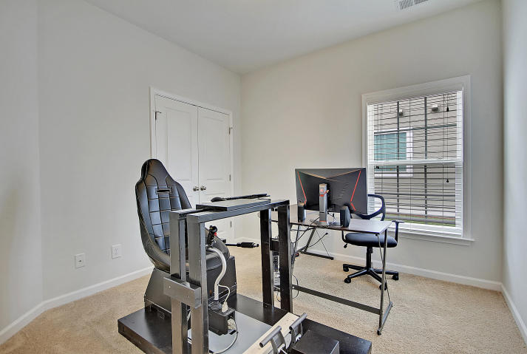
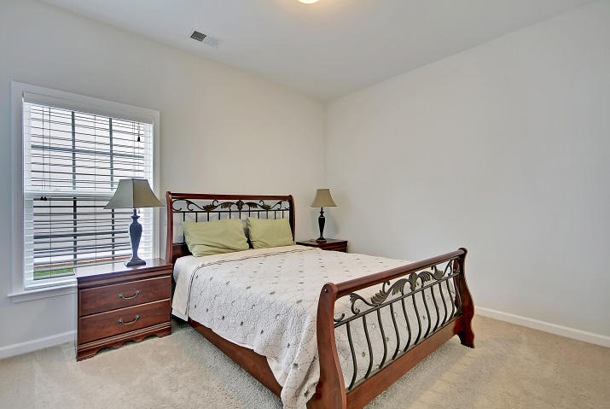
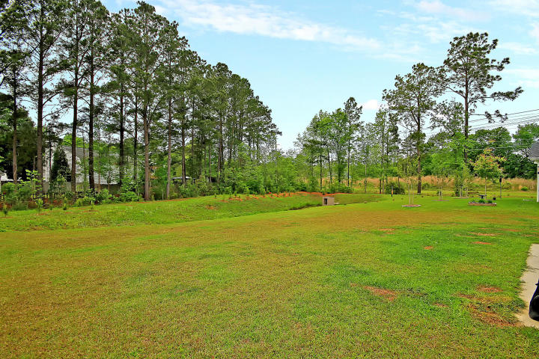
Indigo Palms ~ New Price!
Price Reduced!
8644 Sentry Circle
North Charleston, SC 29420 ~ MLS# 19010613 ~ $244,999
Located in North Charleston's Indigo Palms, this move-in ready one story home is a no brainer for your new home! The open concept boasts laminate floors, a high cathedral ceiling in the living room with a slate fireplace as the center piece, a granite kitchen with breakfast bar seating at the center island, nickel plumbing fixtures, stainless steel appliances and a vaulted ceiling and chair rail molding in the formal dining room. The master suite features a tray ceiling, walk-in closet and en-suite bath with a dual vanity and walk-in shower. The backyard patio is a great spot to enjoy the outdoors and this location is just a quick walk to the community pool and playground. You'll also love being conveniently located to shopping, dining and 26. Schedule your showing today!
Additional features include:
Faux wood blinds throughout
Large backyard
Gas line available for outdoor grill/kitchen
Multiple nozzles in the master shower
Book your showing today!
Susanna Lee susanna@mattoneillteam.com 843-870-9960

