Slide 1
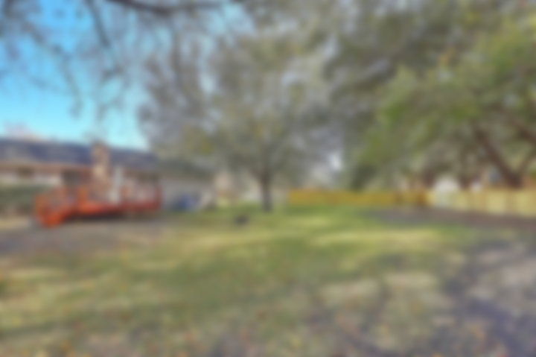
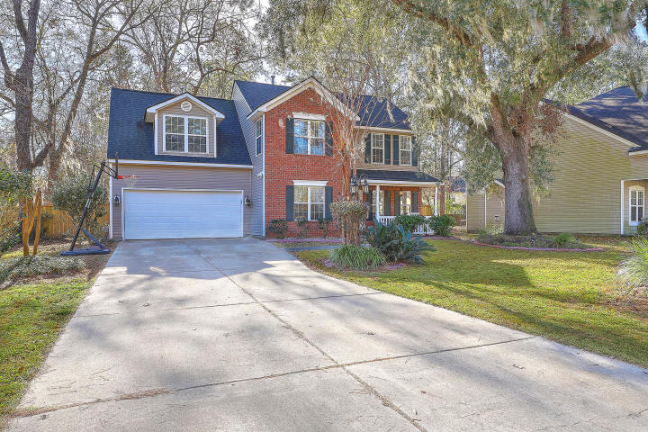
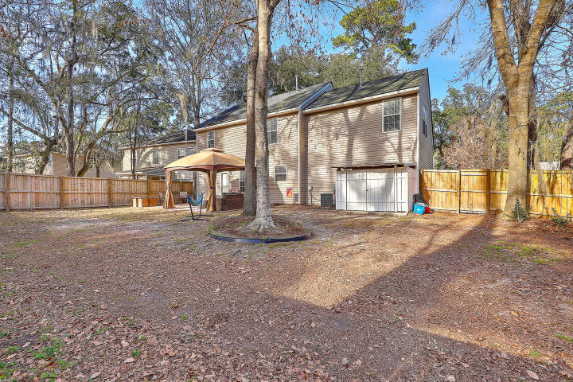
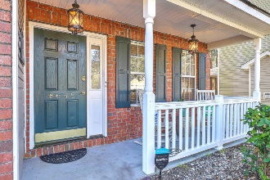
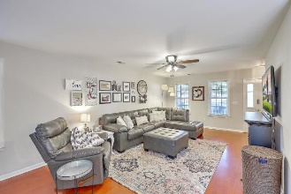
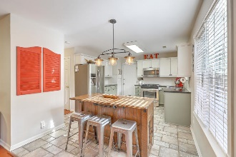
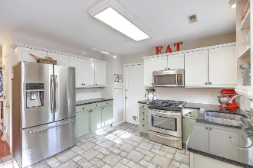
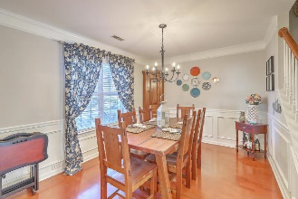
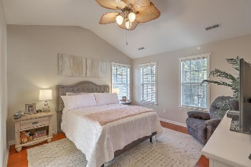
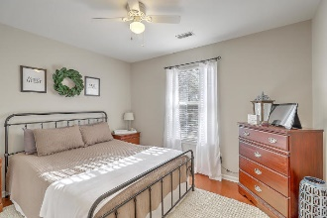
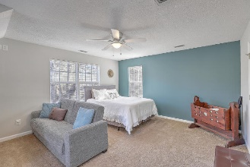
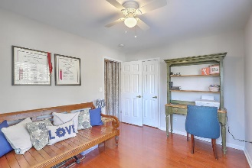
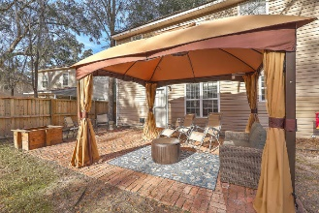


Stunner in Whitehall Subdivision!
Open House Saturday 12-3 and Sunday 2-4!
8645 Hickory Creek Lane
Whitehall | North Charleston, SC 29420 | MLS# 20000968 | $269,975
Located in the desirable Whitehall subdivision and the DORCH II SCHOOLS, this charming home sets itself apart from the rest with its long driveway, deep front yard, beautiful mature treed landscaping with irrigation, giving that true southern feel! The spacious family room offers plenty of space to entertain as it flows into the updated eat-in kitchen which features granite countertops, tile backsplash, s/s appliances incl gas range, and plenty of storage! Enjoy those special family meals in your separate dining room. Upstairs, the nicely sized Master Ensuite has vaulted ceilings, generous walk-in closet and dual vanities. Opportunities are endless with the large bonus room which could be a 4th bedroom, media/play room or office! And, two add'l bedrooms and guest bath round out the second floor. Making your way outside, the home has a great, large, fenced yard! With a large, brick patio and lots of room to run, this yard is perfect for pets and entertaining friends and family. Your new home is conveniently situated to 26, 526, shopping, restaurants, Boeing, Charleston International Airport, Joint Base Charleston and even downtown Charleston! Start off your new year right with this home!
Desiree Maurer
Office - (843) 416-2000
Mobile - (843) 327-9010
desiree.maurer1@gmail.com
www.yourcharlestonhousesearch.com
Keller Williams Realty
496 Bramson Ct Ste 200
Mt. Pleasant, SC 29464

