Slide 1
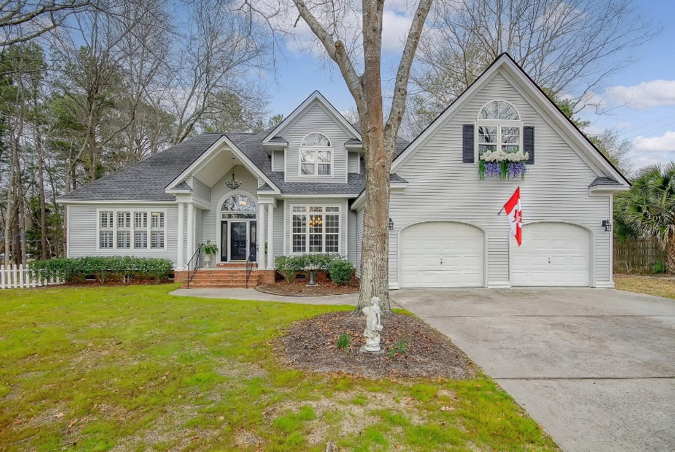
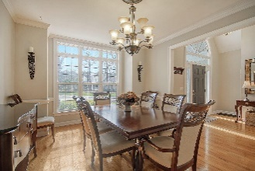
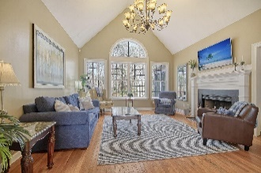
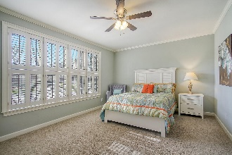
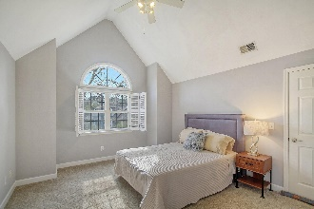
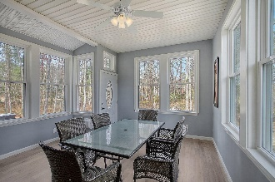
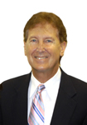

PRICE REDUCED!
$15,000 Agent Bonus
with ratified contract by 4/15/18
8645 Arthur Hills Circle
Coosaw Creek Country Club
North Charleston, SC 29420
MLS# 24006752
$550,000
$12,100 Under
Recent Appraised Value
EXCLUSIVE PERMISSION AFTER BUYER'S AGENT REVIEWS THE HOA FEES!
INCREDIBLE PRICE!
This Spectacular 4 Bedroom, 2.5 bathroom, 2707 sqft, 2 story home is situated on a large landscaped lot and located in the prestigious Gated Community of Coosaw Creek Country Club community and offers golfing, Club House, Community pools, tennis, close to Dorchester District 2 schools, close to Shopping and close to Medical Facilities. This Beautiful home offers freshly painted interior, exclusive wall to wall carpet, classic molding and original wood flooring . There are 3 large bedrooms located upstairs and the spacious master bedroom suite is located on downstairs and includes the holly-wood style bathroom with double vanities, upgrade plumbing fixtures and more! There are several rooms on the main floor including the elegant formal dining room with genuine wood flooring, a bright formal living room with a classic cozy fireplace. There is a large eat-in-kitchen with granite countertops, exclusive wood flooring, stylish lighting fixtures, selected wood cabinets, quality stainless appliances (dishwasher, double oven, microwave, cooktop). There is a French door walk out to the large screened in porch that can be used for relaxing or entertaining. The backyard is large, private and is perfect for gatherings. Bring your check book! Age, square footage, taxes, HOA fees/dues, schools etc are approximate the buyer is to verify any and all information necessary.
William R Everett, Jr
(843) 693-8539– C (843) 576-2701 – O
bill@theeverettgroup.net
RE/MAX Southern Shores, 9209 University Blvd, Charleston, SC 29406

