Slide 1
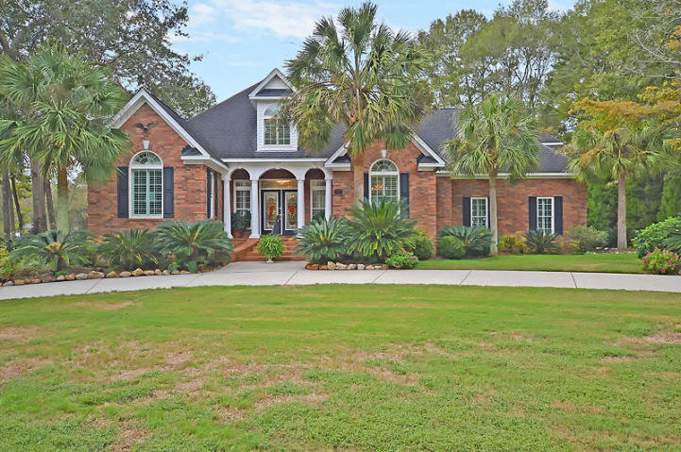
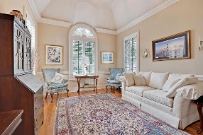
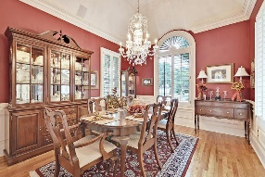
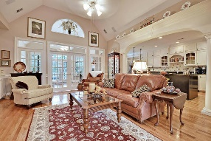
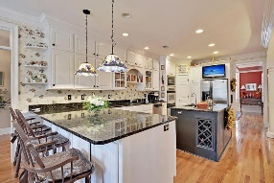
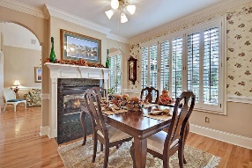
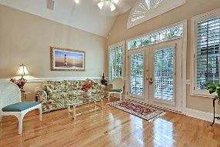
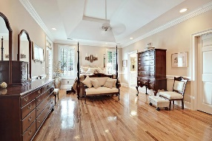
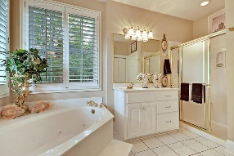
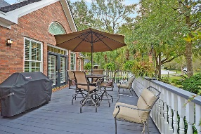
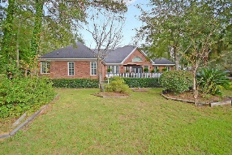
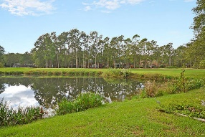



Stunning One Story in Gated Golf Course Community
8648 Arthur Hills Circle
Coosaw Creek Country Club
North Charleston, SC 29420
MLS# 17028037
$485,000
4 Bedrooms | 3½ Baths | 3,400 sf
Get ready to be wowed by this well loved home in the gated golf course community of Coosaw Creek! This home is entirely move in ready! Upon pulling up to the home, you'll automatically fall in love with its curb appeal. Gorgeous landscaping, circular drive, so well maintained! Upon entering, your eyes will immediately be drawn to the stunning hardwood floors. They look brand new! This is a great floor plan that flows beautifully! The large dining room will be to your right, which connects through to the awesome kitchen. This kitchen is a cook's delight! Large island, pantry, breakfast bar, granite countertops, ample custom built cabinetry space, wine rack. This is the kitchen you've been waiting for! It's open to the family room which has a gas fireplace and tons of built in cabinets. Through the family room, you'll enter the sunroom which is separated by french doors. The sunroom has access to the large back deck. In between the sunroom and eat in kitchen area is a double sided fireplace! Walking through the eat in kitchen area, you'll find a very large laundry room with plenty of cabinet storage. Behind the double doors, you'll find the lovely master suite. Also with stunning wood floors, the master suite has access to the outside porch, walk in closet and a large master bathroom. The bathroom has dual vanities, separate tub and master shower, water closet and linen closet. Heading back to the left side of the home, you'll find the formal living room which can also be an office. A half bath in the hall, then two more bedrooms with a full bath in the hall to share. Upstairs is the bonus room. This room can be your 4th bedroom, your guest suite, mother in law suite or game room. It has storage closets off of it as well as a full bathroom of it's own. This house has the perfect floor plan! Step outside and you'll be blown away by the gorgeous golf course and pond views. It's your own little piece of paradise!! Do not miss out on this dream home, come see it today! The neighborhood has 24 hour 7 day a week gated security, unlimited golf for all household members, and the location, wow...close to it all! Boeing, Bosch, AFB, Mercedes are all a short drive away. Come live the good life in a golf course community that has tons of activities and events, great food in the restaurant, great community pool with an award winning swim team, and the most beautiful golf course you'll ever play on!
Larry & Kathy Mazalatis
Larry Cell 843-693-0529
Kathy Cell 843-693-0159
Office 843-871-9133
AGENTOWNED PREMIERE GROUP | 1800 TROLLEY RD | SUMMERVILLE, SC 29485

