Slide 1
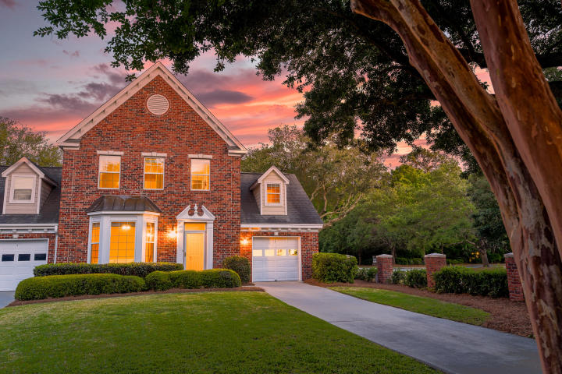



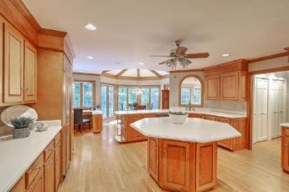
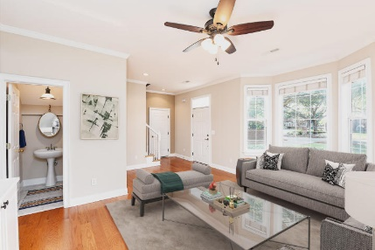



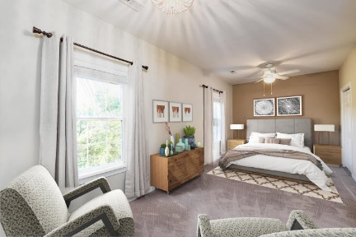

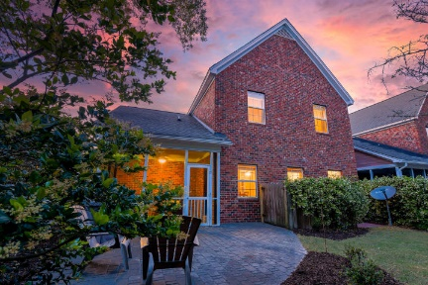
Parkshore Marshfront
Price Reduced $10,000!
Open House Saturday 6/13/2020, 11a - 1p
864 Fountain Lane
Hunter Lake Commons ~ Mt Pleasant ~ MLS# 20012414 ~ $435,000
Unbeatable location in Mount Pleasant!
Here you are close to shopping, dining, area beaches, and downtown Charleston. This spacious townhouse has great curb appeal. As soon as you enter, you'll notice the gleaming hardwood floors, crown molding, and lots of natural light. The lovely family room includes built-in shelves and leads to the eat in kitchen with ample counter and cabinet space and breakfast bar seating. The eat-in area opens to the screened porch and fenced backyard with paver patio.
There are dual master bedrooms upstairs with ensuite bathrooms, plus an additional bedroom/FROG which could make an excellent home office or media room.
Hunter Lake Commons has a great neighborhood pool. This townhouse has it all, so book your showing today!
Colin Spann colin@mattoneillteam.com 864-934-7724

