Slide 1

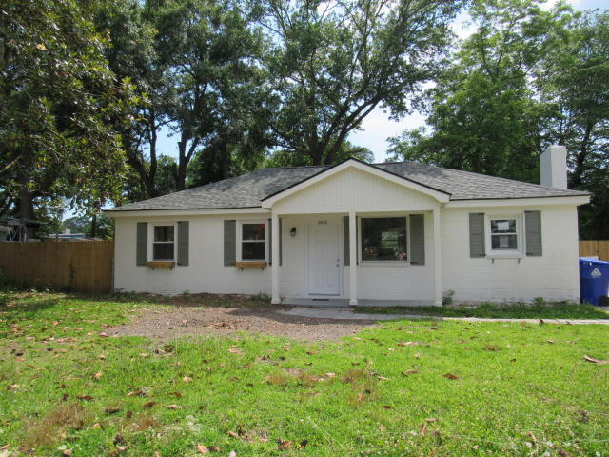
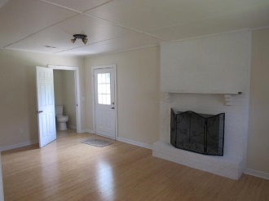
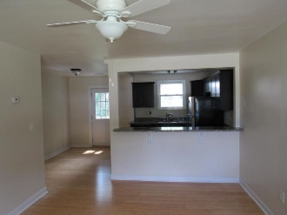
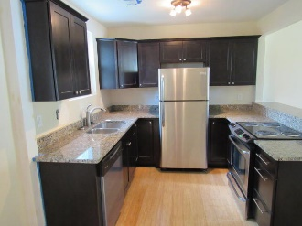
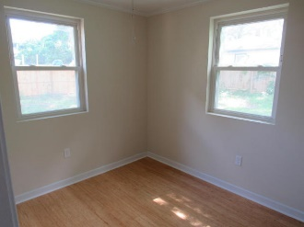
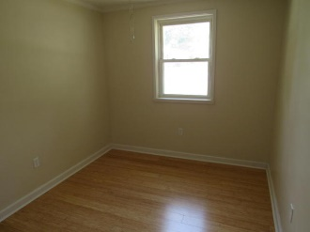
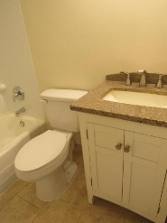
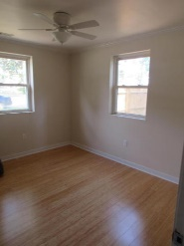
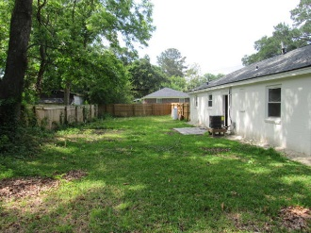
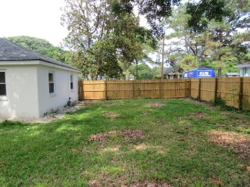
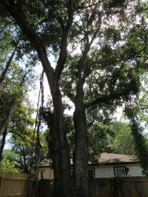


Fully Renovated Home On James Island!
865 Santee Street
Centerville
Charleston, SC 29412
MLS# 16014077
$237,500
1,215 SF
3 Bedrooms :: 1½ Bath
3 bed 1.5 bath house, completely renovated!!! New kitchen cabinets, granite counter tops, new stainless appliances, NEW ROOF, ALL NEW ELECTRIC wiring & new water heater, new bathroom vanities, new wood privacy fence, new bamboo wood floors, newer windows, and NEW air handler. Fireplace in family room. Ceilings fans in all bedrooms.
Looking for a cash flow opportunity? This is it! Want something with a great location needing no maintenance??? this is it! NO HOA! Park you boat in your yard if you want! Walk a block to Ft. Johnson middle school, Folly Beach is a quick 5 minute drive, as is downtown! The location is top notch and you can avoid most of Folly Road traffic!
Eric Draper
(843) 442-7118
eric.draper@gmail.com
www.charlestonrealestategroup.com
Charleston Real Estate Group | 792 Folly Rd. C1 | Charleston, SC 29412

