Slide 1
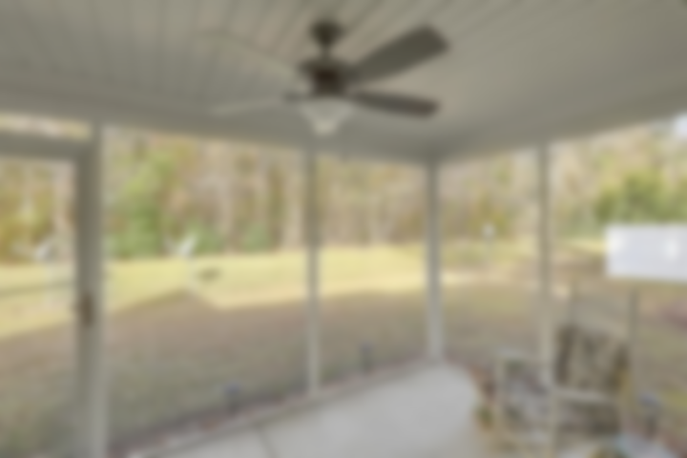
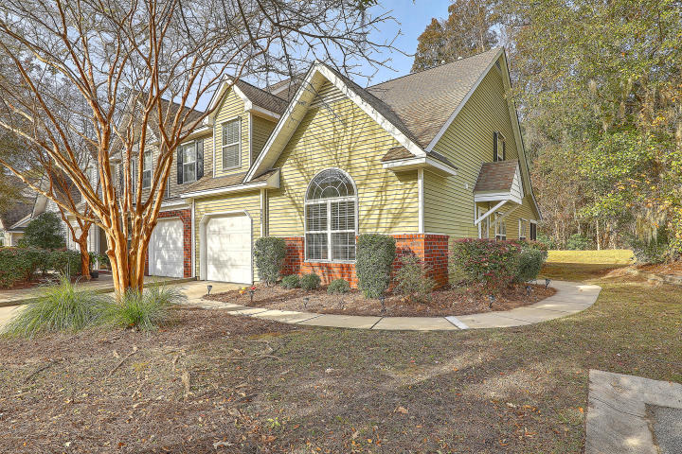
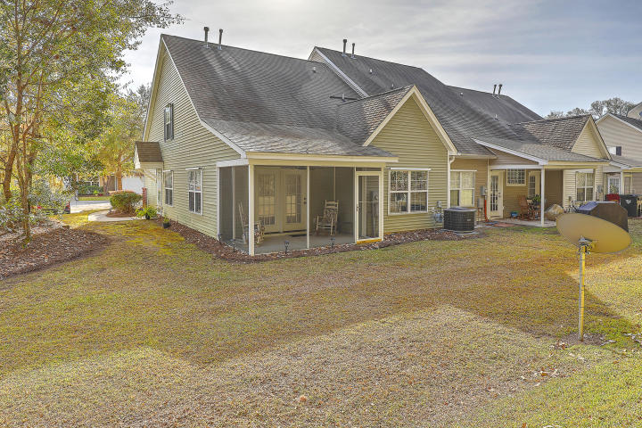
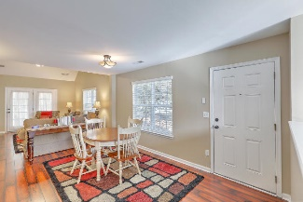
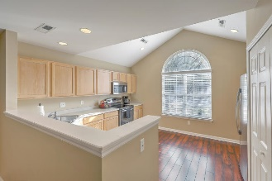
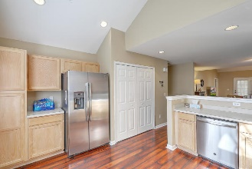
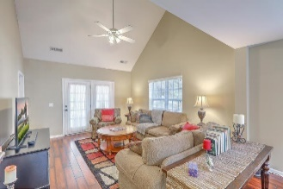
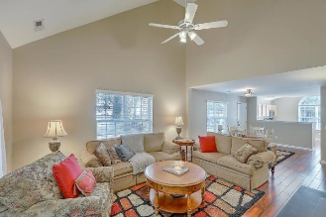
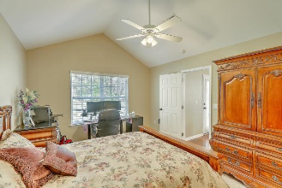
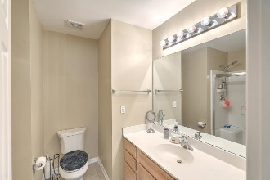
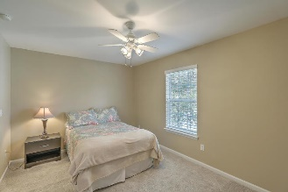
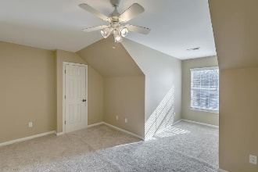
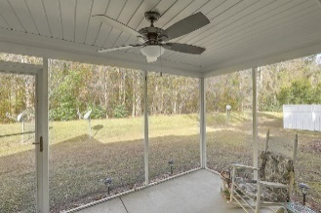


JUST LISTED! Coosaw Commons | Wonderful End Unit Townhome
8667 Grassy Oak Trail
Coosaw Commons | North Charleston, SC 29420 | MLS# 20032441 | $195,975
Perfectly located in this desirable townhome community, this well maintained end unit, which backs to woods, has many upgrades including BRAND NEW HVAC, WATER HEATER, custom blinds and high quality laminate flooring in main living area! The privately situated side entrance leads you into a spacious, open floorplan with a large eat-in kitchen with plentiful cabinet storage and counterspace to the front of the home. Your roomy open concept dining/family room with vaulted ceiling offers plenty of natural light and leads to a screened-in porch with brand new ceiling fan where you can enjoy your morning coffee and the natural habitat surrounding the home. The downstairs Owners Suite has vaulted ceilings and nicely sized walk-in closet. A half bath finishes off the first floor. Upstairs you will find new carpet with upgraded padding and two additional nicely sized bedrooms and full guest bathroom. Experience maintenance free living with provided lawn service, irrigation and a neighborhood pool! Coosaw Commons is minutes from Boeing, Bosch, Mercedes, Joint Base Charleston, retail/dining, medical facilities, golf courses, award winning Dorchester District 2 schools and much, much more! Welcome home!
Video Tour: https://vimeo.com/487356829
Desiree Maurer Office - (843) 416-2000
Mobile - (843) 327-9010 desiree.maurer1@gmail.com
www.yourcharlestonhousesearch.com
Keller Williams Realty 496 Bramson Ct Ste 200 Mt. Pleasant, SC 29464

