Slide 1
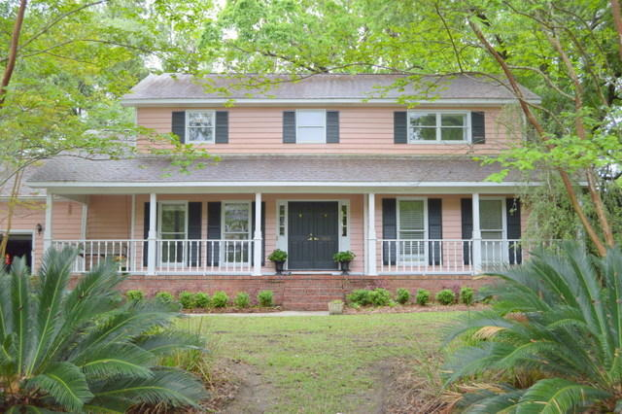
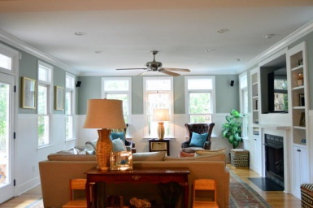
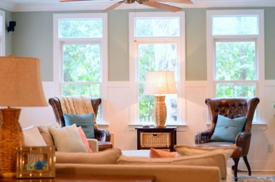
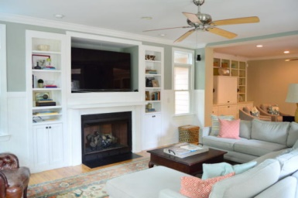
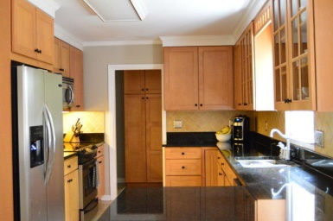
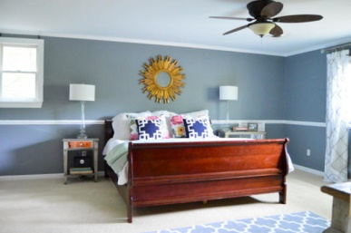
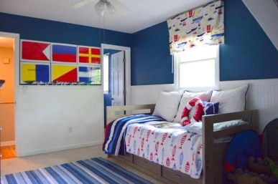
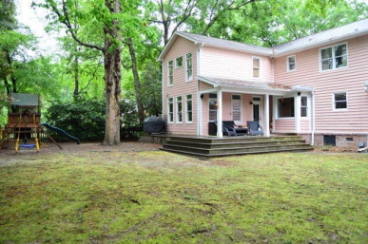
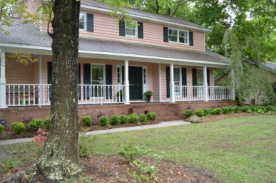


866 Law Lane Snee Farm :: Mount Pleasant :: MLS# 15009882 :: $579,000
MOTIVATED SELLER, BRING ALL OFFERS!
Open House
May 2nd, 12-3
This three bedroom traditional home has beautiful upgrades, and tons of indoor and outdoor living space. A huge double living room is perfect for the family, with a fireplace, walls of windows providing great natural light and accented by refurbished heart pine floors throughout the first floor. The lovely kitchen has shaker style cabinets and black granite countertops, and opens to a cozy breakfast area with a formal dining room adjacent to the kitchen. In the front of the home is a private office space. There is a grand master suite with large, his and hers walk-in closets, separate vanity areas and an exquisite spa-like shower. Two secondary bedrooms and a shared full bathroom are upstairs. An expansive FROG with a separate staircase is ideal for a game room, playroom or guest bedroom. The private, tree-lined backyard is fenced in and offers the perfect place for kids and pets to play, not to mention there is a large deck off the back of the house for an outdoor sitting area or grilling out with friends. Definitely a must see!
Krystine Edwards
843.886.8110 | 843.697.2225
kedwards@carolinaone.com
www.krystineedwards.com
Carolina One Sales Associate · 1503 Palm Boulevard · Isle of Palms, SC 29451

