Slide 1

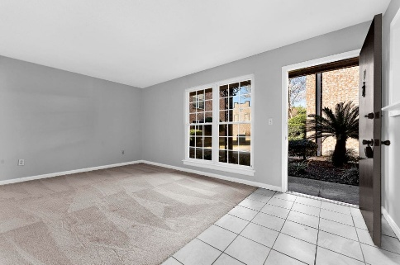
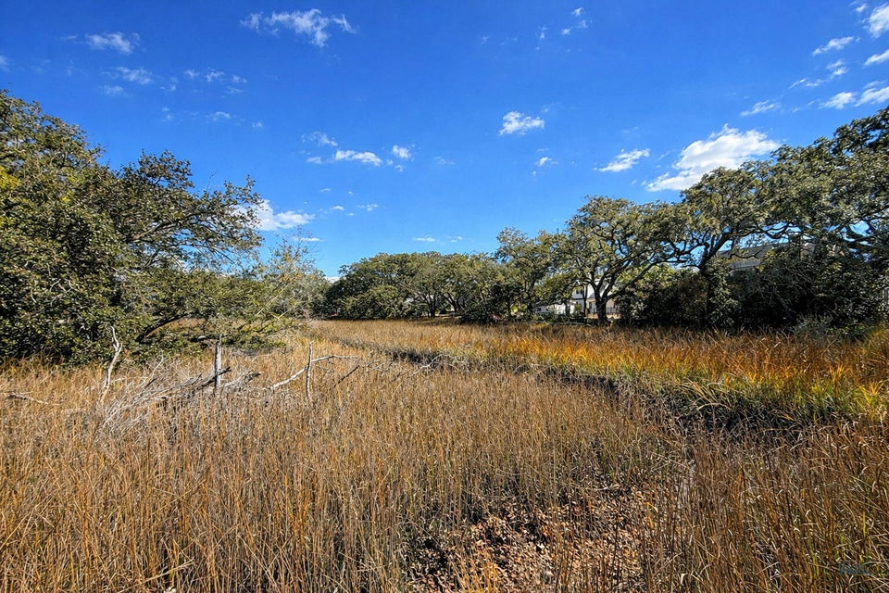
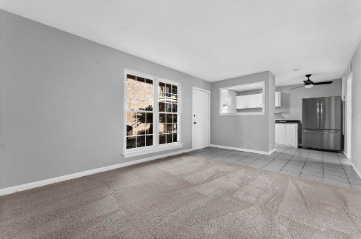
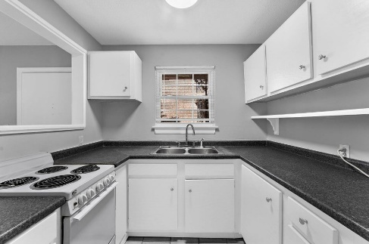
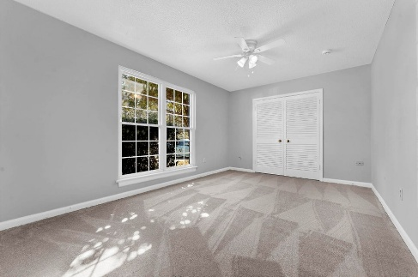
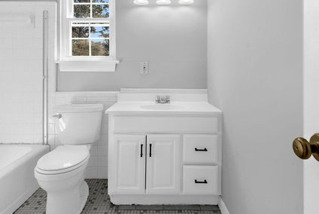
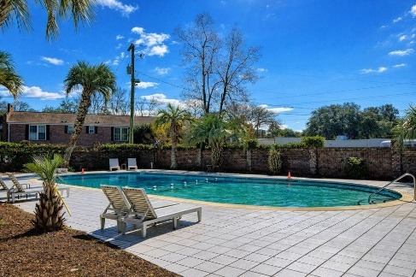

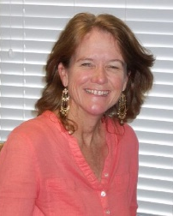
867 Colony Drive #99 Rivers Bend · Charleston, SC 29407 MLS# 26004563 · $190,000
New Price!
Welcome Home!
Wonderful 1 bed 1 bath first floor unit in Rivers Bend on the Ashley. Quick 5 minutes to Charleston, 20 to Folly.
Completely painted throughout, including kitchen cabinets and fixtures. Brand new carpet in Living room and bedroom.
Great open living ready to move in! Quick walk to the pool and a great marsh look from the parking lot.
Incredible spot! Won't last long! Easy to show.
Saturday, May 5th At 11:00a
ANN EVANS
Carolina One Real Estate
843-452-4605
aevans@carolinaone.com
www.charlestonluxuryrealestate.com
Carolina One Real Estate
195 W Coleman Blvd
Mt Pleasant, SC 29464-3495

