Slide 1
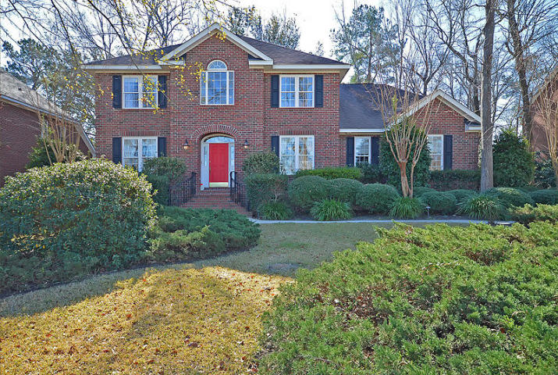
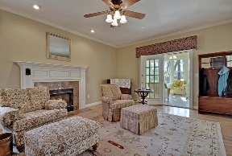
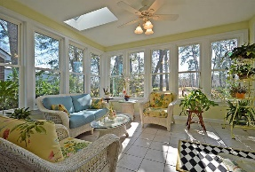
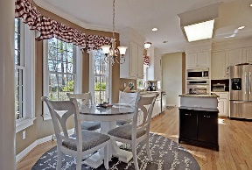
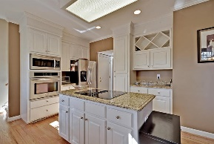
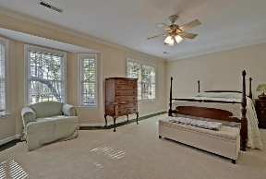
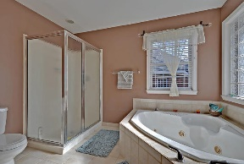
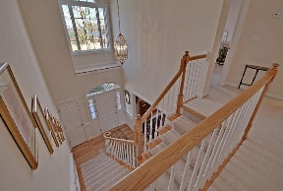
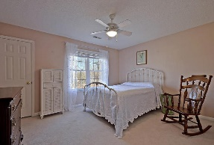
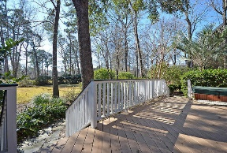
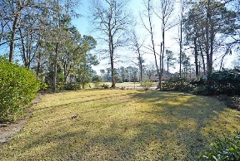
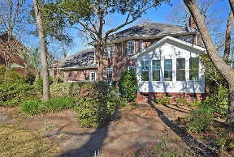



On Golf Course in Gated Community under $400k!
8680 W Fairway Woods Dr
Coosaw Creek Country Club
North Charleston, SC 29420
MLS# 18004604
$374,900
4 Bedrooms | 2½ Baths | 2,984 sf
Ask about assumable 3.75% VA loan available to veterans who qualify!
This beautiful, custom, brick, golf course home offers approx. 3,000 Sq. Ft., 4BR, 2.5BA and is in excellent condition! Upon entry, buyer will notice an office or formal living room to the left and a separate dining room to the right with chair rail and crown molding. Hardwood floors lead to the kitchen which offers granite counter tops, kitchen island, stainless steel appliances, pantry and an eat-in kitchen area. The kitchen opens to the spacious family room with gas fireplace. Buyers will also find French doors leading to a sunroom overlooking the private, wooded, professionally landscaped backyard and golf course. Plus a back deck with hot tub! An oversized 2 car garage with a workshop and extra storage is a bonus! Upstairs buyers will find all 4 bedrooms and two full bathrooms. The large master bedroom offers a master bathroom with jetted tub, shower, dual vanities and a walk in closet as well as great golf course views! 3 more bedrooms can be found upstairs as well as a laundry room with cabinetry. There are front and back stairways, one at the front of the home and one off the kitchen foyer. This home offers ample storage in walk-in attic areas upstairs. Coosaw Creek also offers excellent amenities such as golf, tennis, community pool and a clubhouse with a full restaurant and bar and all in a gated golf course community close to the airport, Boeing and Bosch!
Larry & Kathy Mazalatis
Larry Cell 843-693-0529
Kathy Cell 843-693-0159
Office 843-871-9133
AGENTOWNED PREMIERE GROUP | 1800 TROLLEY RD | SUMMERVILLE, SC 29485

