Slide 1
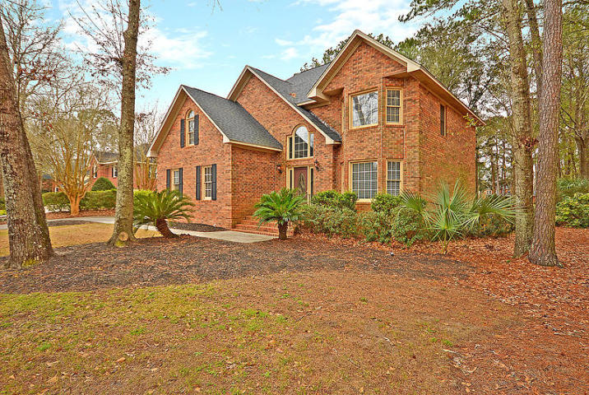
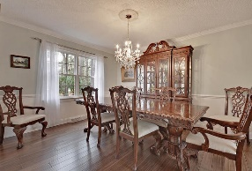
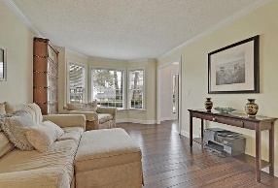
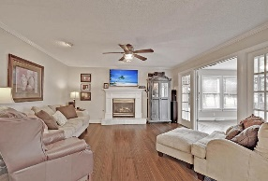
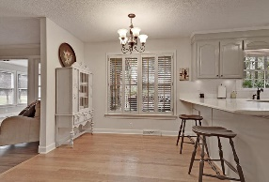
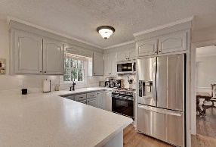
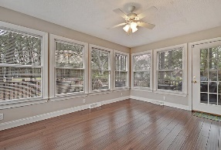
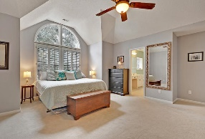
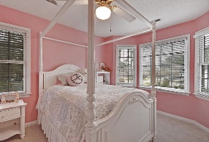
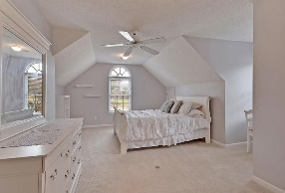
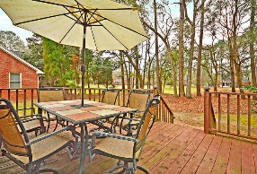
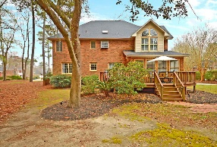



On Golf Course in Gated Community
8684 Arthur Hills Circle
Coosaw Creek Country Club
North Charleston, SC 29420
MLS# 19005475
$345,000
4 Bedrooms | 2 ½ Baths | 2,936 sf
This custom brick, golf course home offers 4BR, 2.5BA and 2,936 Sq. Ft. It is listed BELOW the market for Coosaw Creek homes and features a new roof (2016) and one new HVAC unit (2017). Downstairs buyers will find a dining room and formal living room / office with new hardwood floors, crown and chair rail. The kitchen offers a sitting bar, some new appliances, pantry and is open to the family room. The family room also has new hardwood floors, fireplace and opens to the sunroom which overlooks the backyard and golf course beyond. A deck can be found outside the sunroom as well as a spacious backyard. Upstairs buyers will find all 4 bedrooms, a shared bathroom that has been renovated with granite counters and a laundry room with sink and cabinetry. The master bedroom has vaulted ceilings, walk-in closet, ceiling fan and a master bathroom with dual vanities, garden tub and separate shower. The FROG is the 4th bedroom but could also be used for a playroom, upstairs family room or practically anything else. The neighborhood has 24 hour 7 day a week gated security, unlimited golf for all household members, and the location, wow...close to it all! Boeing, Bosch, AFB, Mercedes are all a short drive away. Come live the good life in a golf course community that has tons of activities and events, great food in the restaurant, great community pool with an award winning swim team, and the most beautiful golf course you'll ever play on!
Larry & Kathy Mazalatis
Larry Cell 843-693-0529
Kathy Cell 843-693-0159
Office 843-871-9133
AGENTOWNED PREMIERE GROUP | 1800 TROLLEY RD | SUMMERVILLE, SC 29485

