Slide 1
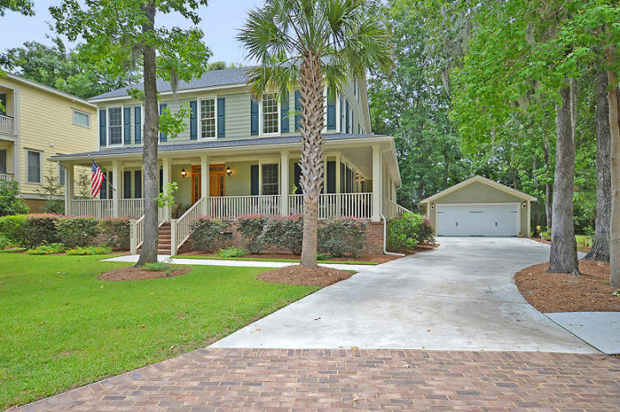
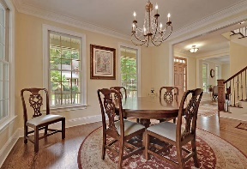
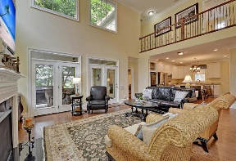
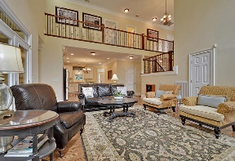
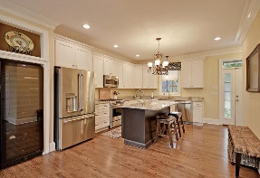
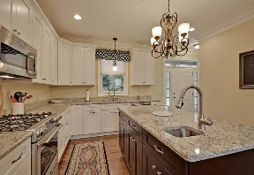
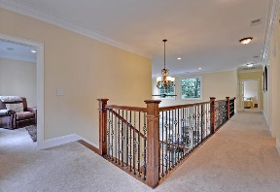
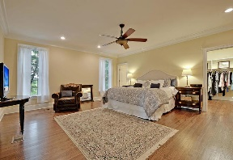
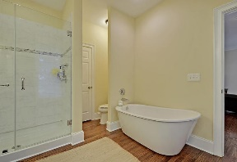
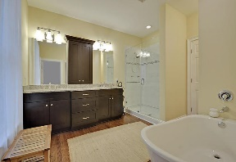
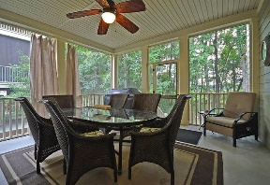
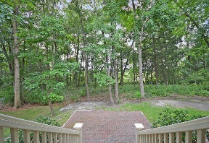
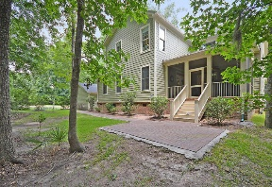


Like New Home with Views of the Ashley
8685 Refuge Point Circle
The Refuge at Whitehall
North Charleston, SC 29420
MLS# 16017429
$479,900
5 Bedrooms | 4½ Baths | 3,315 sf
This 3,315 Sq. Ft. 5BR, 4.5BA custom built home is in IMMACULATE condition and only 2 years old! The home offers absolutely stunning views of the Ashley River and surrounding marsh from nearly every room plus a huge wrap around full front porch! No detail has been overlooked and no expense spared on this beautiful home. Entering the home you are met by gleaming hardwood floors that flow seamlessly throughout the first floor. The floor plan of this home is ideal for entertaining guests. A large vaulted family room is open to a gourmet kitchen with granite counters, island and top line appliances!
Downstairs also offers the master bedroom suite as well as an executive office and dining room. Two sets of french doors open to the screened porch with Ashley River and marsh views. The second floor features three large bedrooms all with their own full bathroom! A bonus room upstairs is the 5th bedroom if needed but can be used as a playroom, exercise room or practically anything. The Refuge has a community dock with access to the Ashley River for fishing, boating... The Refuge also has a community pavilion for cooking out and access to join the Whitehall community pool if desired. This home is a MUST see in this price range!
Larry & Kathy Mazalatis
Larry Cell 843-693-0529
Kathy Cell 843-693-0159
Office 843-871-9133
AGENTOWNED PREMIERE GROUP | 1800 TROLLEY RD | SUMMERVILLE, SC 29485

