Slide 1
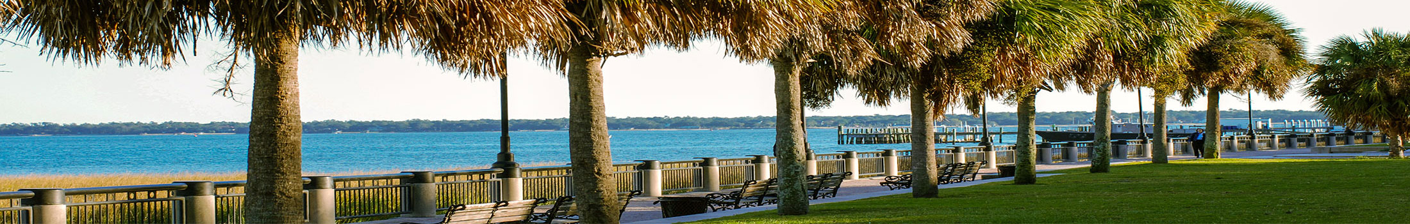



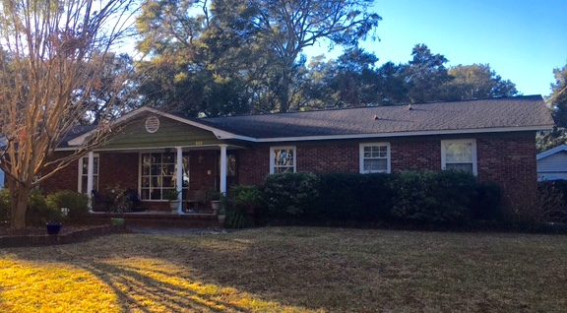
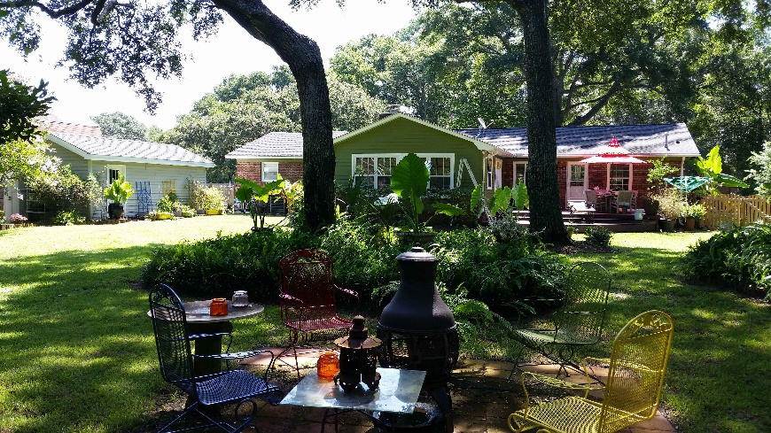
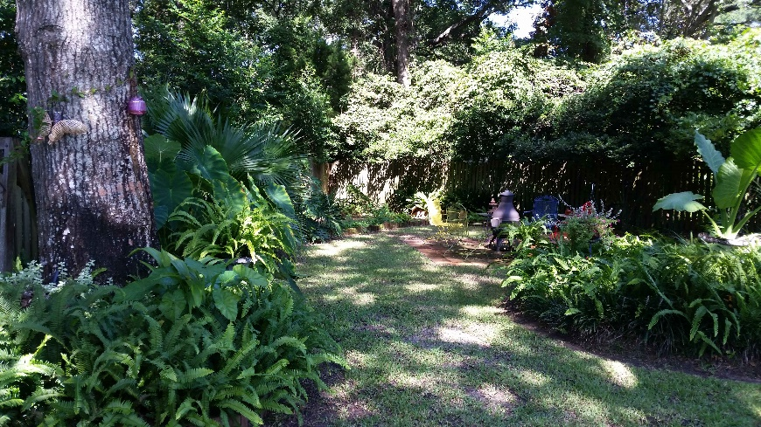
Coming Soon on James Island!
Lennie Woods
843-864-6760 lenniewoods@gmail.com
868 Robert E Lee Blvd
Fort Johnson Estates ~ $449,000
2500+ sq ft
4 bedroom 3 bath
1/3 acre lot
X flood zone
Authentic shiplap detail
Hvac new 2016
Hardwood floors
Thermal Windows
Fireplace
Excellent schools
Optional pool membership available

