Slide 1
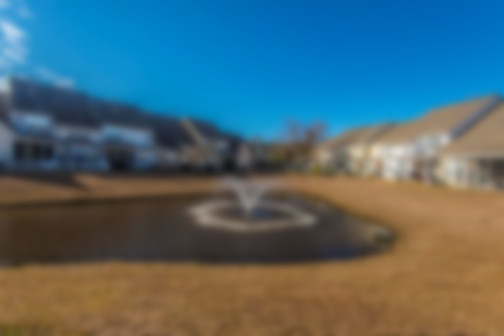
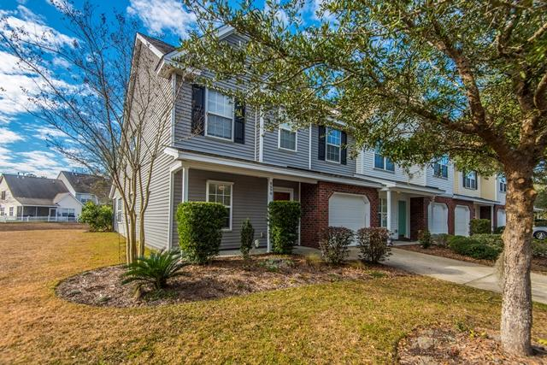
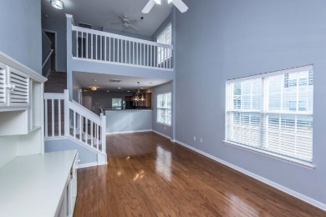
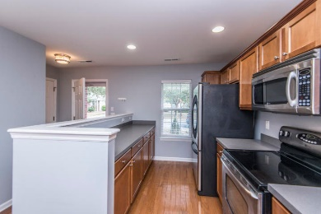
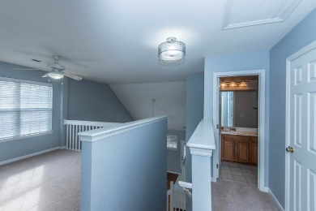
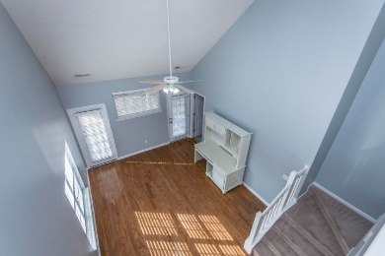
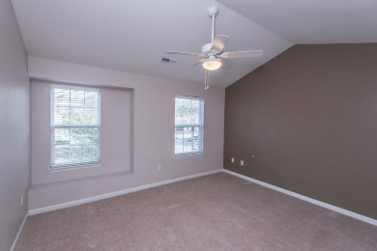
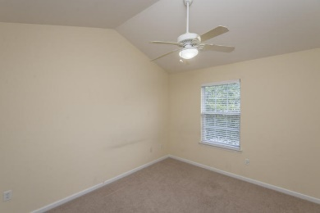
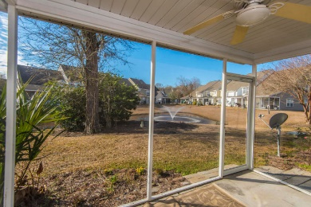



Financing Fell Through…
So It’s Back On The Market!
8690 Grassy Oak Trail
Coosaw Commons ~ North Charleston, SC 29420
MLS# 19002812 ~ $184,500
One person's loss is another person's gain! Financing fell through so this beautiful house is available! Move-in Ready! Brand new hardwood flooring! Freshly painted main living area! New dishwasher! Corner lot! Pond! Master down! DD II schools! Enter this bright and airy home to a welcoming, open plan! Kitchen is open to dining area and family room making it great for entertaining or enjoying family time while preparing meals. The kitchen is spacious with lots of counter space for working and cabinets for storing. Half bath is off entry. This home is light and bright with windows on the side and 2 story family room. Master is off family room with great views of the pond, has double closets. Upstairs find a loft, 2 bedrooms and bath. Loft would make a nice office area or second gathering space. Bedrooms are large and have vaulted ceiling for the added feeling of space. This home has been well kept, inside and out! Enjoy peaceful views of pond and wildlife. from screened porch. Owner was a gardener see pictures of the beautiful landscaping when in bloom. HVAC new in 6/2017. Call today for a private showing.
Laurie Loparo
((843) 442-1290 | laurieloparo@gmail.com
www.lauriesellscharleston.com
Carolina One Real Estate | 873 Orleans Road, Ste 102 | Charleston, SC 29407-5753

