Slide 1
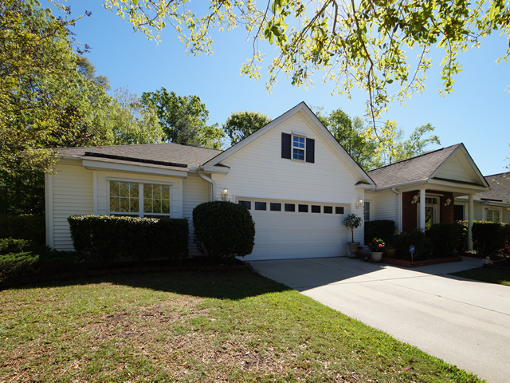
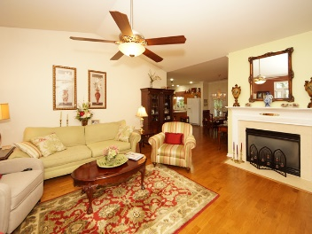
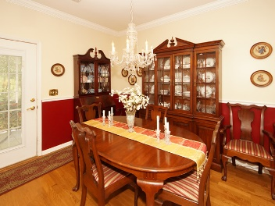
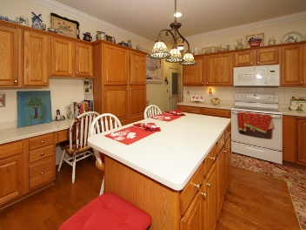
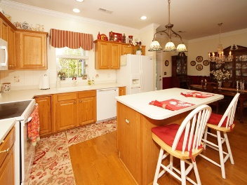
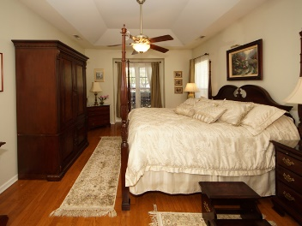
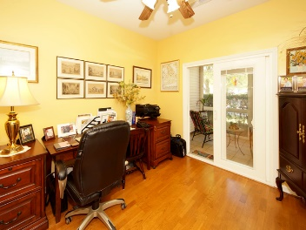
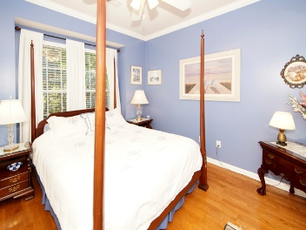
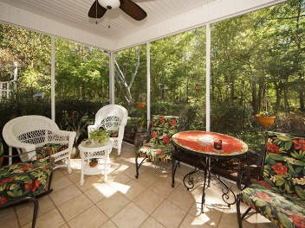
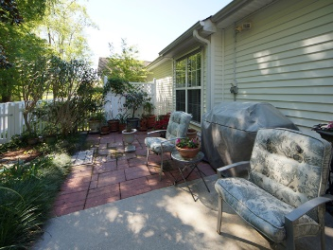
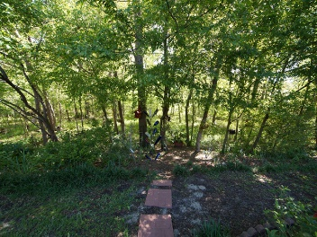

8695 Grassy Oak Trail
North Charleston, SC 29420 | MLS# 17010225 ~ $230,000
New Listing in Coosaw Commons
Open House Sunday April 30th from 2-5pm
This beautiful single family patio home is located in a quiet neighborhood. Very spacious floor plan with hardwood floors throughout the bedrooms, kitchen, living room and dining room. The spacious kitchen with island comes with Corian counter tops and built in appliances. The large master bedroom has plenty of room for a king sized bed. Master bath includes garden tub/shower and ceramic tile floors. The second guest bedroom opens onto a front covered porch with ceramic tile and is enclosed with Carolina Porch panels including screens for year round use. The two guest bedrooms share a full bath with enclosed shower and ceramic floors. The back screened porch has ceramic tile that is accessed from the kitchen and dinning room. Also included is a two car garage.
Chip Streeter
(843) 300-8797
chip.streeter@cbcarolinas.com
Coldwell Banker Residential Brokerage
1127 Queensborough Blvd
Mount Pleasant, SC 29464

