Slide 1
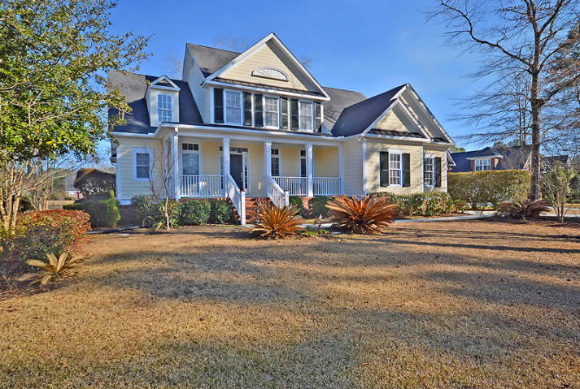
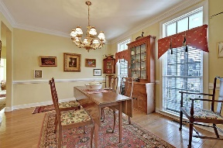
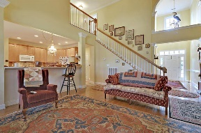
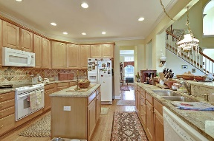
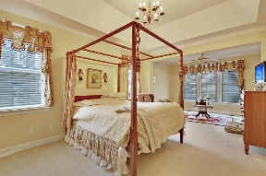
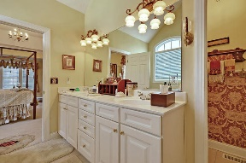
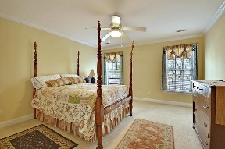
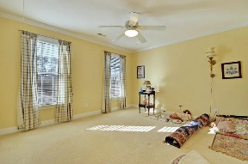
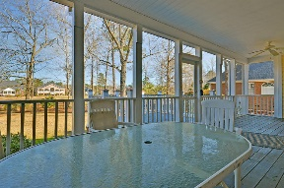
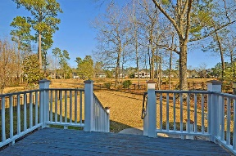
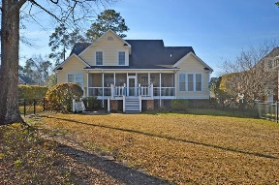
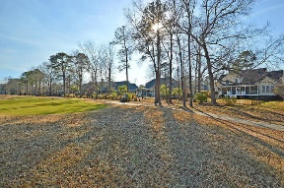



Golf Course Beauty in Gated Community
8709 Herons Walk
Coosaw Creek Country Club
North Charleston, SC 29420
MLS# 18003871
$375,000
5 Bedrooms | 3½ Baths | 2,774 sf
Welcome home to this lovely 5 Bedroom, 3.5 Bathroom home located in the gated community of Coosaw Creek. Upon entering the home, you'll immediately notice the vaulted ceilings and archways. The large dining room is perfect for entertaining and even offers extra storage and serving area on the way to the kitchen. The kitchen offers granite counter tops, an island, abundant cabinet space, pantry and eat in kitchen area. The kitchen overlooks the family room which has vaulted ceilings, a fireplace and great views of the backyard and golf course. The master bedroom is located on the first floor and offers a sitting room with access to the back porch. The master bath has dual vanities, separate shower and tub and large walk in closet. On the other side of the house, there is another very large bedroom that has a full bathroom right in the hall. This is the perfect guest suite or mother in law suite and also has a door accessing the porch. Upstairs you'll find three additional good size bedrooms, a full bath and attic storage. The home sits along the 12th tee box and the wildlife on the golf course and in the pond is abundant with Herons, Egrets, ducks and also fishing in the pond.
This home is a MUST SEE! COOSAW CREEK OFFERS AN EXCELLENT CLUBHOUSE WITH RESTAURANT AND BAR, NEIGHBORHOOD POOL, TENNIS COURTS AS WELL AS AN EXCELLENT GOLF COURSE. PLANNED EVENTS AND MEALS IN THE VERY ACTIVE CLUBHOUSE ARE COMMON AND GOLF MEMBERS ENJOY THE NUMEROUS MONTHLY GOLF EVENTS OFFERED WITHIN THIS PRIVATE GATED COMMUNITY...
Larry & Kathy Mazalatis
Larry Cell 843-693-0529
Kathy Cell 843-693-0159
Office 843-871-9133
AGENTOWNED PREMIERE GROUP | 1800 TROLLEY RD | SUMMERVILLE, SC 29485

