Slide 1
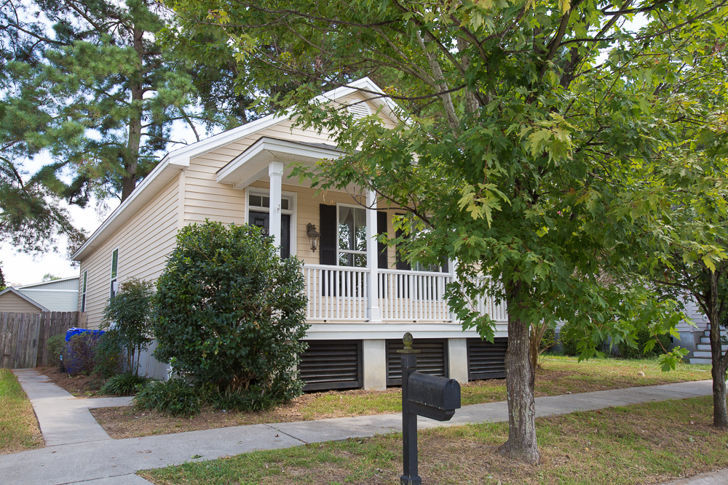
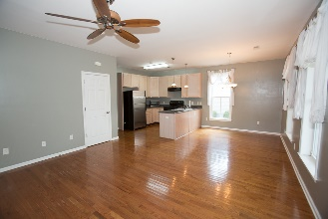
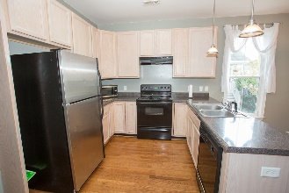
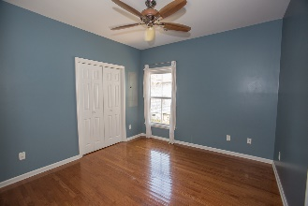
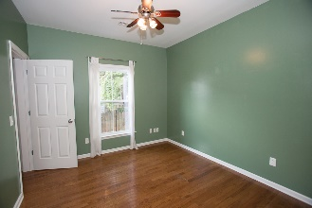
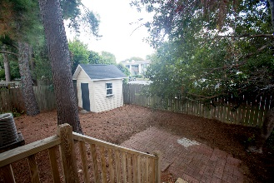


Great Opportunity To Own On James Island!
PRICE REDUCED!!
870 Sedge Court
Dove Run · Charleston · MLS# 16024180 · $234,100
Michael Dew
O (843) 769-5100
M (843) 870-7000
michaeledew@gmail.com
www.michaeldewrealestate.com
Nice 3 bedroom, 2 bath cottage in very convenient area of James Island.
Nice Hardwood Floors throughout, Open Floor Plan, Wide Front Porch and Private Fenced in Backyard with Shed.
AgentOwned Charleston Group
902 Savannah Hwy
Charleston, SC 29407
Real Estate ● Mortgage Insurance ● Business Brokerage

