Slide 1
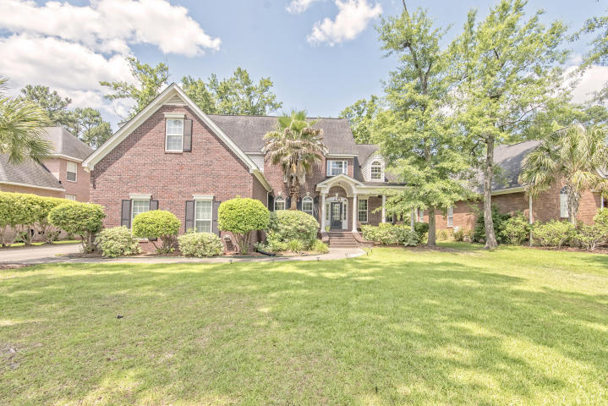
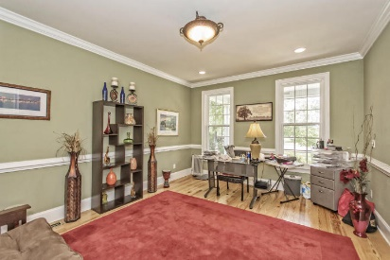
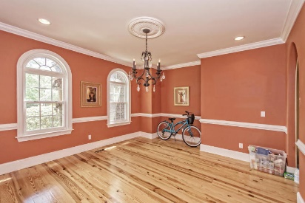
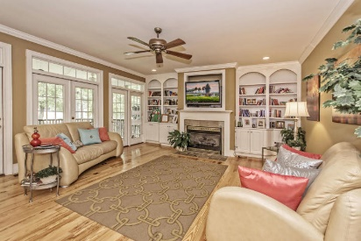
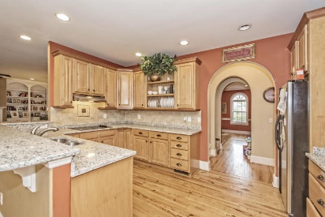
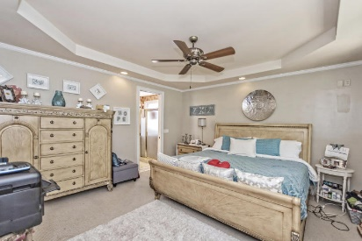
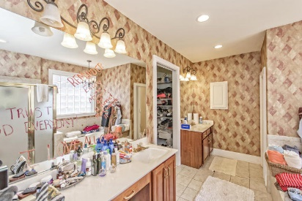
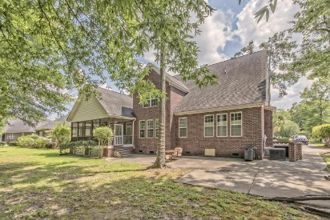
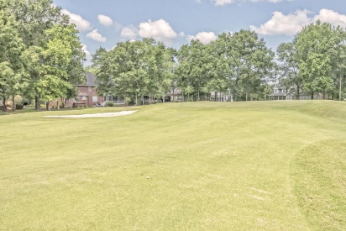

Huge Price Reduction!!
$5,000 Buyer's Agent Bonus at Closing!
8712 Herons Walk
Coosaw Creek Country Club ~ North Charleston
MLS# 16014426 ~ Now offered for $479,900
Just reduced for quick sale!!
Custom Southern Living home designed by Brian Barks of Atlanta is nestled on the 13th green of the Coosaw premier golf course.
Lovely custom appointments include heart of pine floors, new granite counter tops, custom glazed cabinetry, arch entryways, and multiple large closets for storage.
Enjoy outdoor living in the low country from the screened porch overlooking the tranquil golf course. Gated neighborhood close to shopping, DD2 schools, just minutes from Boeing, Bosch and Charleston airport. A must see in Coosaw! New carpet with acceptable offer.
Paul Welsh
(843) 343-9799
paulkwelsh@gmail.com
AgentOwned Charleston Group
902 Savannah Hwy
Charleston, SC 29407

