Slide 1
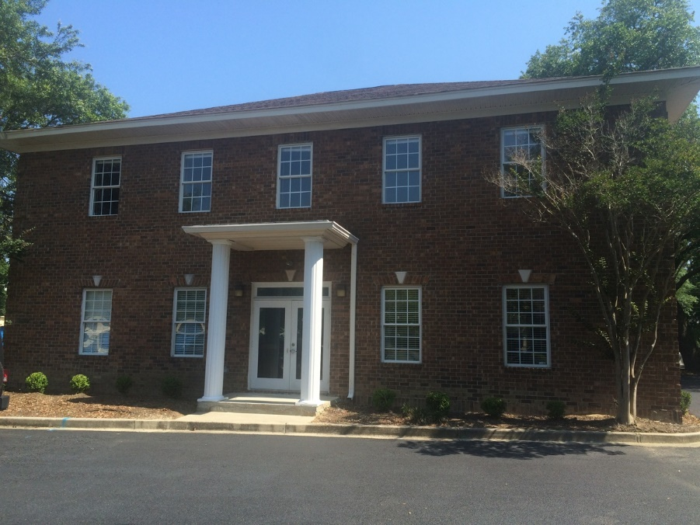
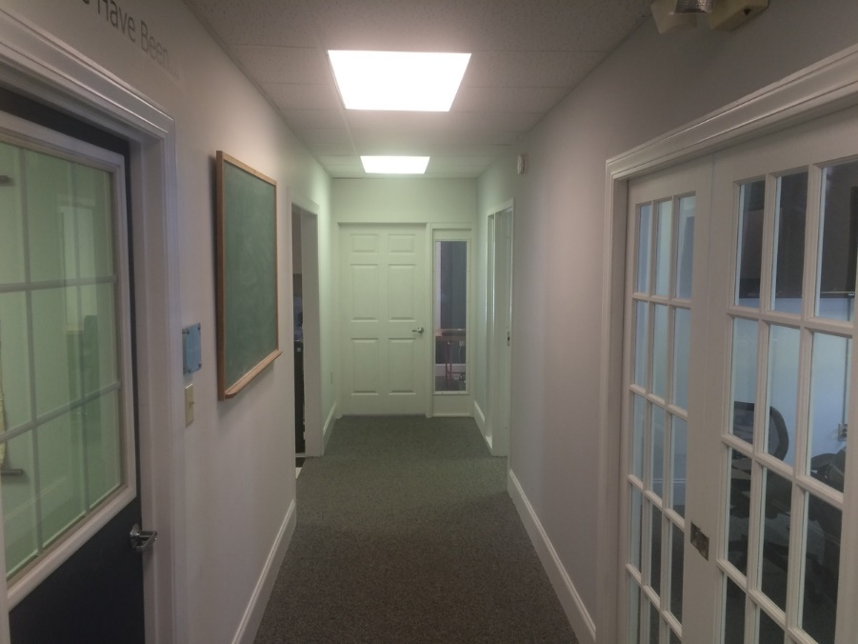
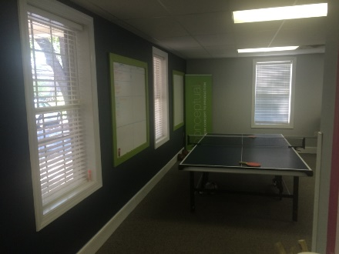
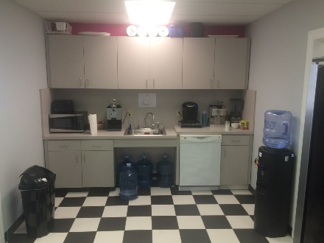
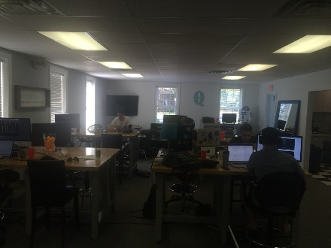


871 Lowcountry Blvd Downstairs Suite
871 Lowcountry Blvd #100
Mount Pleasant, SC 29464
OFFICE FOR LEASE
Ground Floor, with the upstairs also available which could offer 2,000 square feet. A flexible and open floor plan with the privacy of exterior offices. A kitchen, exterior offices and an open collaborative area make this a great space for many user types. The entire property has been improved allowing more parking and new landscaping. The Landlord is willing to offer new paint and carpet for the right user.
Catylist ID: | #29977967
Building Size (RSF): | 2,000 SF
Lease Rate: | $21 PSF (Annual) / $3,500 (Monthly)
Lease Types: | NNN
Class of Space: | Class B
Property Visibility: | Fair
Parking Description: | Shared
County: | Charleston
Tax ID/APN: | 514-00-00-108
David H Seay
CCIM, BIC, CCIM, REALTOR
(843) 364-6720
david@seaydevelopment.com
Seay Development, LLC
3404-202A Salterbeck Street
Mt. Pleasant, SC 29466 www.seaydevelopment.com

