Slide 1
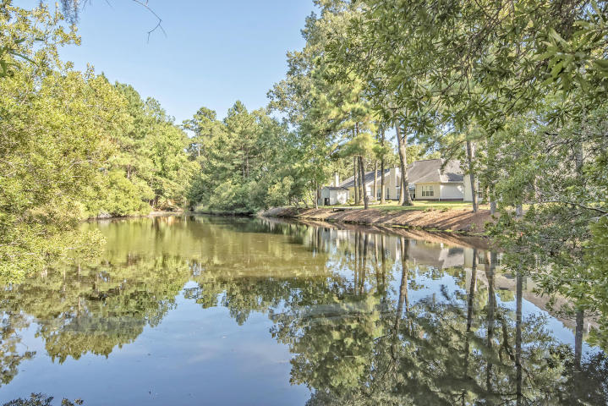
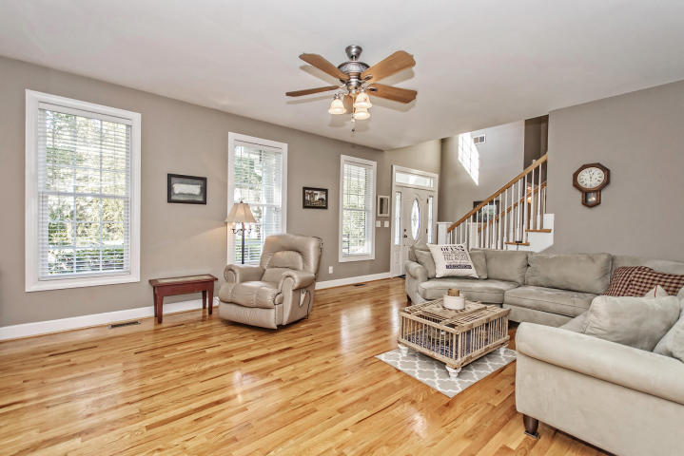
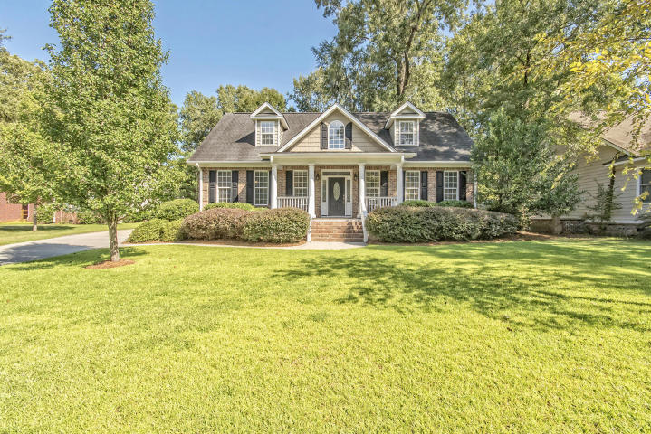
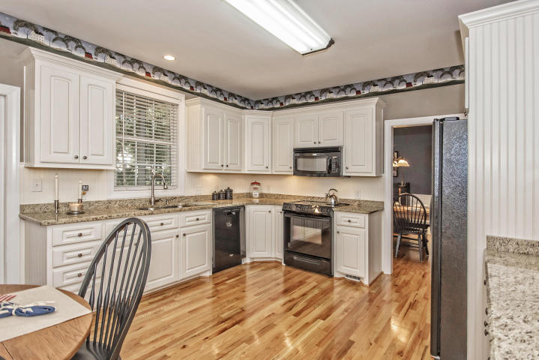
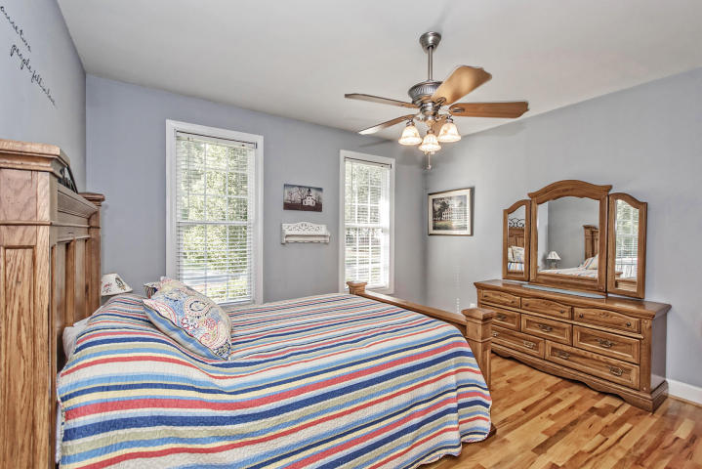
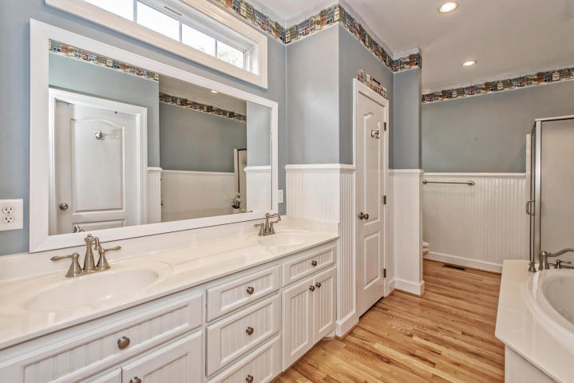
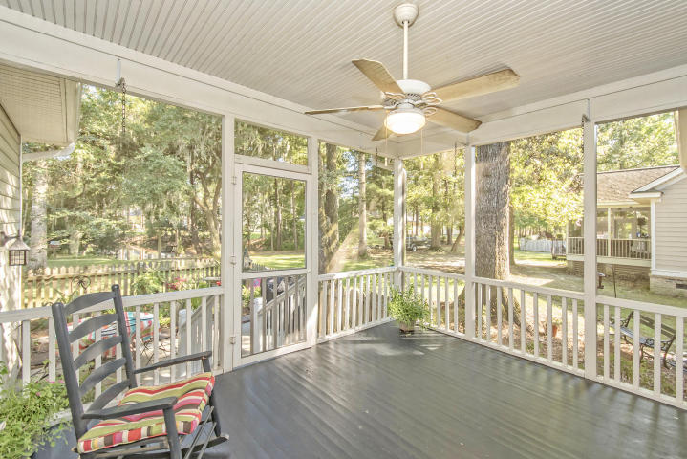

BEST VALUE IN A GREAT LOCATION!
8729 Laurel Grove Lane
MLS# 16022301 ~ $349,900
4 Bedrooms ~ 3½ Bathrooms
ON GOLDEN POND…. Custom-built, pristine, turn-key 4 bedroom, 3.5 bath home on a “little slice of heaven” lot with the most serene and beautiful pond you have ever seen. The “best room in the house” is truly NOT in the house as it is the screened-in back deck that overlooks a fenced-in, courtyard bursting with colorful flowers worthy of an enchanted English Garden with the private back yard and sparkling pond just beyond. The floor-plan combines open spaces with formality. For instance, there is an extra-large eat-in chef’s kitchen with black appliances offset by China White 42-inch cabinets and bead-board backsplash as well as elegant Desert Brown granite countertops. The living room is extra roomy yet feels so very cozy with the huge roaring fireplace. At the same time, however, openness is complemented by formality with the stately formal dining room with the super-sized window overlooking your very own Golden Pond. The entire first floor has glistening red oak floors including in the first-floor Master Bedroom and spa-like bathroom with the bright white beadboard and a massive walk-in closet with custom built-ins. There is a second Master Bedroom suite upstairs with its own private full bath.... along with two other bedrooms. There is also a completely separate over-sized FROG. Other wonderful features of this gorgeous home include its absolutely massive storage space, a central vacuum system throughout the home and in the garage (great for cleaning your automobiles), a complete workshop in the garage, a new Craftsman AssureLink Garage Door Opener that controls and views your garage door (whether opened or closed) from your Smartphone..... and other features too numerous to mention. You just have to come out and see this great home to see the rest of what I'm talking about!!! In addition, the location of this home is absolutely the height of convenience in close proximity to an abundance of dining and shopping opportunities as well as the airport, Boeing and it is only a short 30-minute drive to the world-class, sun-kissed beaches of the Isle of Palms and Sullivan's Island as well as the glorious history of downtown Charleston.
YES...this call all be yours for absolutely the BEST VALUE IN NORTH CHARLESTON!
Chip Walsh
843-822-4663
chipwalsh@gmail.com
Andi Walsh
843-822-4663
myandigirl@gmail.com
Century 21 Properties Plus | 3301 Salterbeck Ct Suite 100 | Mt. Pleasant, SC 29466

