Slide 1
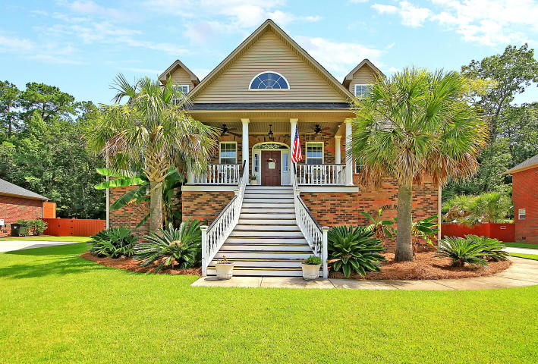

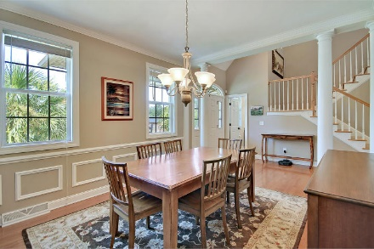
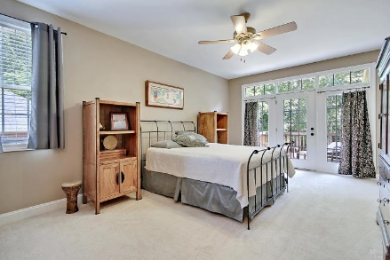
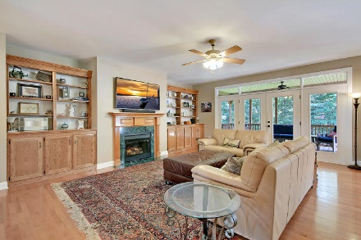
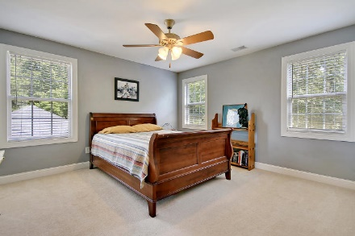
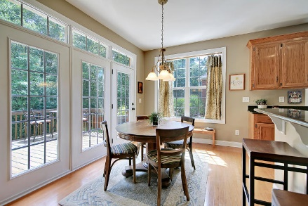
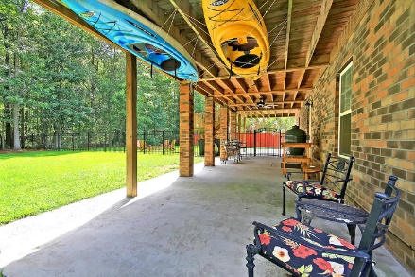
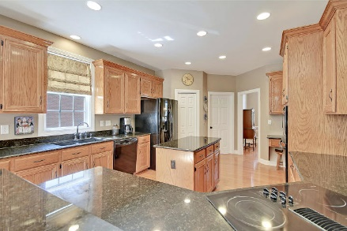
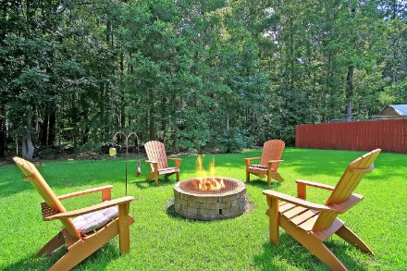
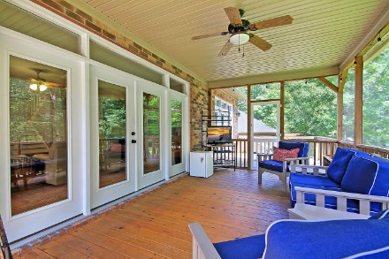
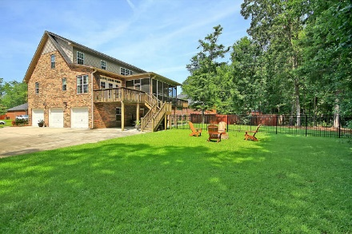
Price Reduced!
Open House
Sunday 2-4
$25.00 gas card giveaway. Chicken Salad Chick lunch provided by Warren Armstrong of Fairway Mortgage
8733 Millerville Drive
Cedar Grove ~ North Charleston, SC 29420 ~ MLS# 19021140 ~ $499,400
Located in the scenic North Charleston community of Cedar Grove, this custom, elevated, brick home is a MUST see! Not only are the outdoor living spaces as beautiful as the indoor ones but there is a bonus, private in-law suite on the ground level complete w/a kitchenette, full BA & BR. The open floor plan boasts hardwood floors, a fireplace w/built-ins in the living room, an eat-in kitchen, formal dining room & a spacious master suite w/2 walk-in closets & an en-suite bath featuring a dual vanity, claw foot tub & tile walk-in shower. You can enjoy the low country beauty from the covered front porch, the back screened-in porch which has decks on either side & the expansive covered porch down below. A fenced portion of the yard is perfect for pets & the towering trees offer great privacy.
Additional features include:
3 car garage
Beautiful oak wood cabinets and built-ins throughout the home
Spacious kitchen with wall oven, glass cooktop, a built-in desk, and a center island with additional storage
Incredible, natural views from the deck and backyard
Community includes a clubhouse and a large pool
Book your showing today!
Angela Miller angela@mattoneillteam.com 404-276-6355

