Slide 1
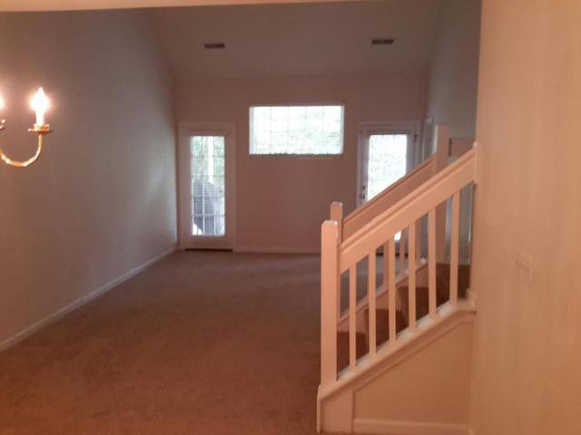
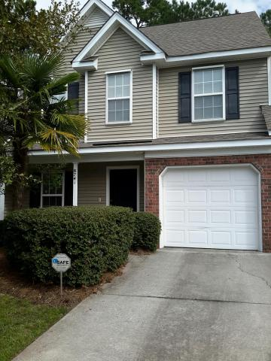
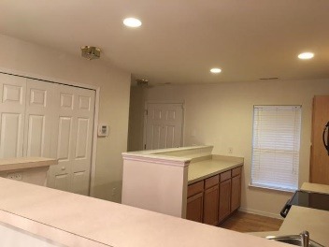
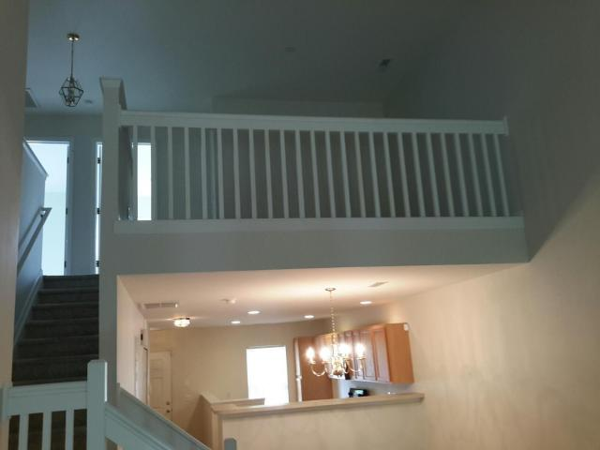
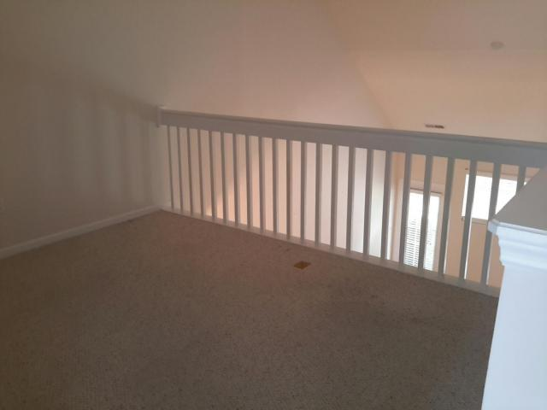
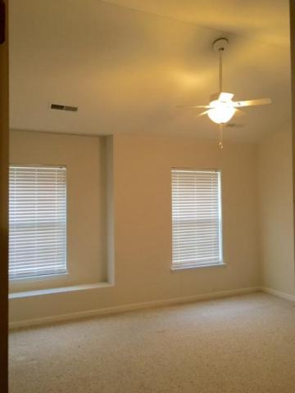
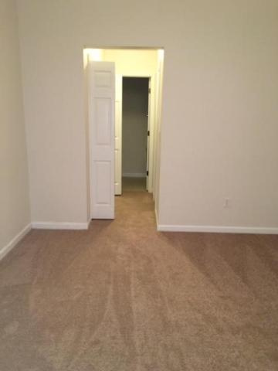
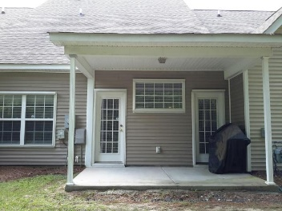
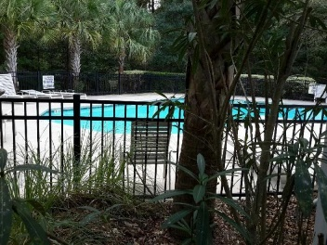


Must See!
Waterfront Historic Home with dock!
REDUCED $20,000
8741 Grassy Oak Trail
Coosaw Commons · North Charleston
MLS# 16026355 · $165,000
3 Bedrooms · 2.5 baths · 1600 sqft
Gorgeous Town-home, Beautiful location. Location, Location, Location!! Dorchester 2 schools. You are close to shopping, dining and services. Bosch, Joint Base Charleston AFB, Boeing and the Charleston International airport are all a short drive away. The home features a downstairs master bedroom and bath, a powder room 1/2 bath. While upstairs you have 2 nice sized additional bedrooms and a full bath. There is a covered back porch for you to enjoy the outside. You will enjoy Low maintenance living, the HOA fee covers insurance, lawn and irrigation, exterior maintenance, termite/pest control,use of pool and pool maintenance. This home is ready to move into now. It is a great time to buy, interest rates are low. Hurry you can be in this Gorgeous home for the Holidays.
James Hopkins
Office - (843) 871-9133
Mobile - (843) 708-5930
rxhop@aol.com
AgentOwned Premiere Group
1800 Trolley Rd
Summerville, SC 29485
Real Estate ● Mortgage
Insurance ● Business Brokerage

