Slide 1
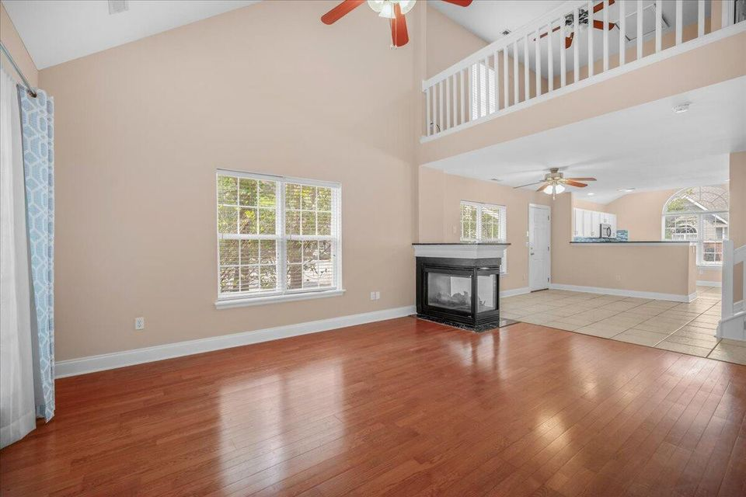
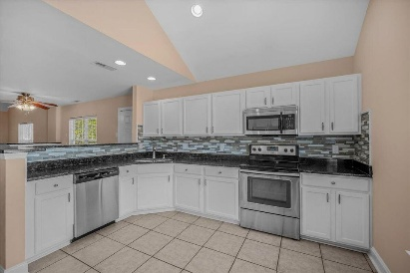
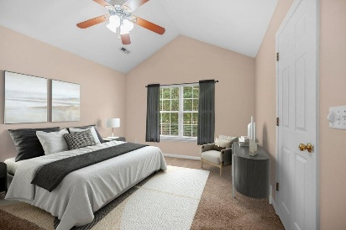
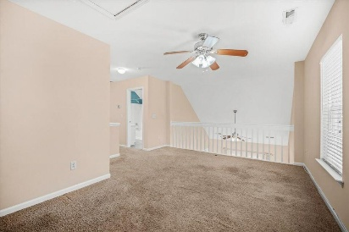
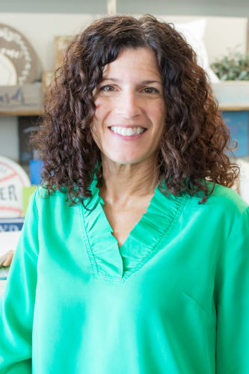

2.5% Buyer's Agent Commission
Hosted by Kathy Ware | 843-830-3804 | kathy.ware@carolinaone.com
8743 Grassy Oak Trail
Coosaw Commons | North Charleston, SC 29420
End Unit Townhome with First-Floor Primary Suite, Across from Pool, and Near Major Employers! Welcome to 8743 Grassy Oak Trail - a beautifully maintained 2-bedroom, 2.5-bath townhome located in the charming Coosaw Commons community. This home features a highly sought-after first floor primary bedroom, offering comfort and convenience for modern living. If your an outdoors person you can enjoy your morning coffee on the private screened-in porch and take advantage of the neighborhood pool just a few steps across the street. The inside features an open-concept living and dining area and the kitchen boasts ample counter space and storage.
Upstairs you'll find an additional bedroom, another full bath, and a huge loft that would be a great office or play area but could easily be closed-in to create a third bedroom if you desire. Take special note of the brand new bathroom counters, roof and paint throughout!
Situated conveniently from Boeing, Bosch, Charleston International Airport, and the new North Charleston Aquatics Center, this home is a prime location for both work and play.
Low-maintenance living at its best - the HOA covers both property and flood insurance, as well as exterior maintenance and termite bond giving you peace of mind and more time to enjoy the Lowcountry lifestyle.
MLS# 25015180 | $258,000
Julie Fanelli
843-513-8319
julie.fanelli@agentownedrealty.com
YourLowcountryHomes.com
AgentOwned Realty Preferred Group | 824 Johnnie Dodds Blvd | Mt Pleasant, SC 29464

