Slide 1
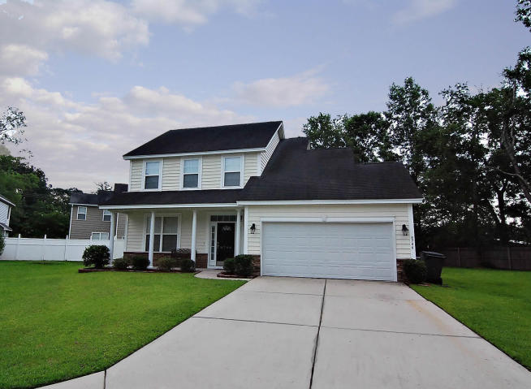
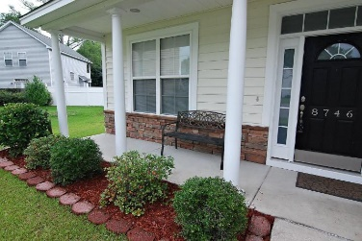
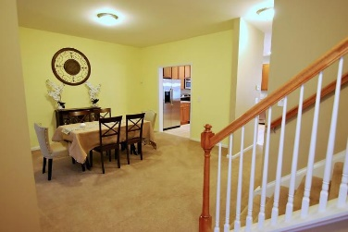
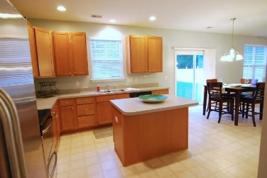
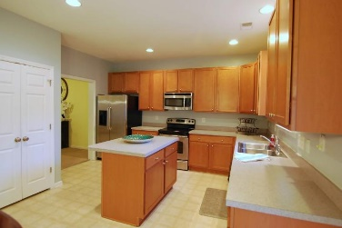
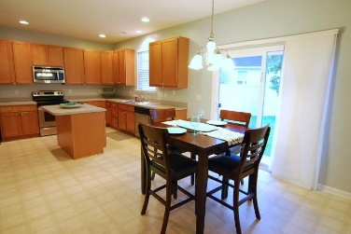
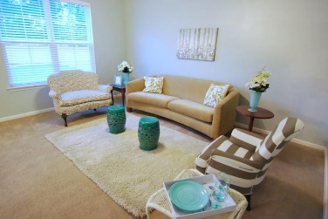
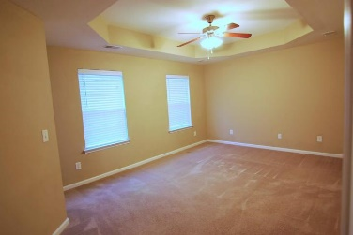
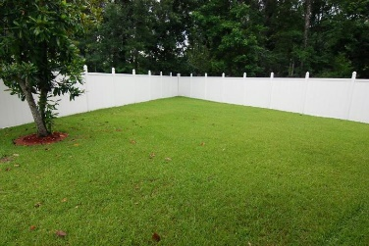


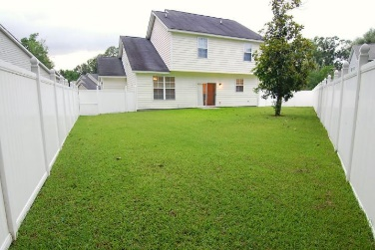

8746 Jessica Court
Deer Wood ~ North Charleston, SC 29406
MLS# 18016524 ~ $199,990
~ The Cul-de-sac Dream ~
Come See
It Today!
Gorgeous two-story home nestled on a low traffic cul-de-sac just moments to Trident Hospital, Northwoods Mall, the interstate, schools, major shopping, restaurants and more! The home has a huge flex space one could use as a dining room, home office, children's play area, formal living room etc. The kitchen is open with a spacious island including storage space and seating. There are maple cabinets with brushed nickel hardware, stainless steel appliances, a double door pantry plus two additional closets (one is walk-in), an enormous eating area, recessed lights and access to the backyard. The family room is a defined space yet open to the kitchen and eating area, making it perfect for gatherings. The three bedrooms are all upstairs, and the master has a deluxe bathroom with double sinks, a garden tub and a separate shower. There's also a large walk-in closet with a window for natural light. The two secondary bedrooms are located on the back of the home, providing privacy for everyone. The laundry area is also upstairs located conveniently near the bedrooms. The backyard is fenced in with low-maintenance white vinyl! Come see it today!
Beth Moore
M (843) 532-4892
bmoore@carolinaone.com
Meg Kandik
M (843) 814-5137 | O (843) 603-4659
Meg@HolyCityRE.com | www.holycityre.com
Bennett Construction & Realty | 804 Tennent Dr | Charleston, SC 29412

