Slide 1
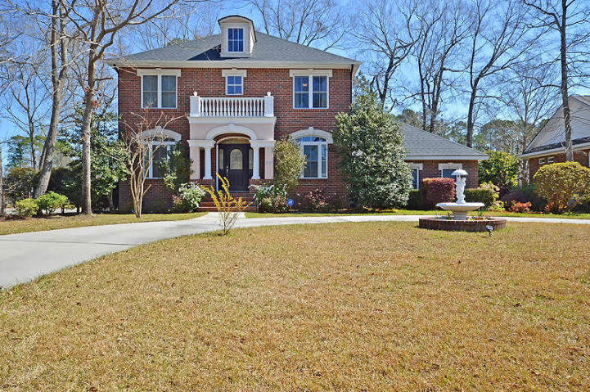
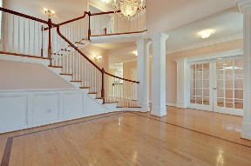
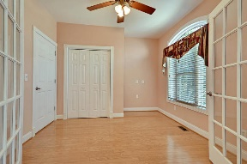
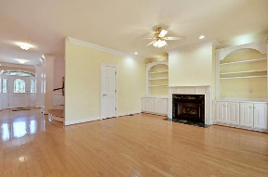
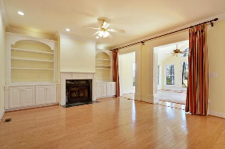
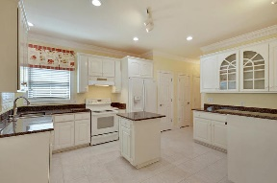
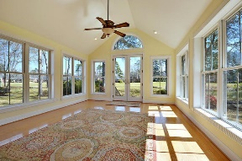
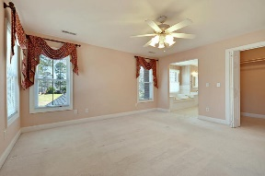
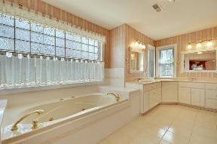
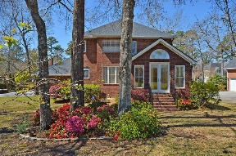
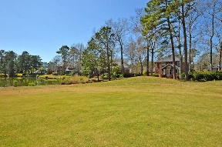
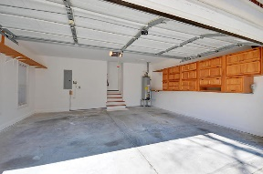



Stunning Gated Community Golf Course Home and Lot!
8749 E Fairway Woods Cir
Coosaw Creek Country Club
North Charleston, SC 29420
MLS# 18007125
$369,000
4 Bedrooms | 2½ Baths | 2,600 sf
This lovely Coosaw Creek home is located on one of the prettiest lots in the neighborhood! Sit and enjoy the pond view with stunning wildlife coming and going all day while also watching the golfers pass by. You'll immediately love the curb appeal of this home with its circular drive, plush landscaping and sidewalk lined street. Upon entering, you'll immediately notice the gorgeous wood floors throughout the first floor. To your left is a large dining room, with extensive trim work and vaulted ceiling. The grand staircase will catch your eye as well. To your right when walking in, is a flex type room. This room has many possibilities. It can be used as a 4th bedroom, as it has a large closet, it can be an office or a formal living room. The kitchen offers tons of storage. Two pantries, ample cabinets, island, new granite countertops, white cabinetry, large eat in area, all over looking the family room which offers built in cabinetry, large storage closet and lovely gas fireplace. Off the family room is the stunning sunroom. Tons of natural light, amazing views from every window, this room is ideal for relaxing after a long day. Head back inside and upstairs to the large master suite. The master bath offers dual vanities, separate newer jacuzzi tub and shower. Back in the hall, which is large enough to have a small office or play area, you'll find another full bath and two more large bedrooms. This home has been well maintained and has a new roof in 2017. Come live the good life of Coosaw Creek! Gated, golf course community which offers every new home owner the opportunity to be full country club member which includes unlimited golf to every household member. All of that and being centrally located only minutes to the airport, Bosch, Boeing, Mercedes as well as only 30 mins from downtown Charleston. Excellent Dorchester District 2 schools and an award winning swim team are waiting for you in Coosaw Creek. Come see this home today!
Larry & Kathy Mazalatis
Larry Cell 843-693-0529
Kathy Cell 843-693-0159
Office 843-871-9133
AGENTOWNED PREMIERE GROUP | 1800 TROLLEY RD | SUMMERVILLE, SC 29485

