Slide 1
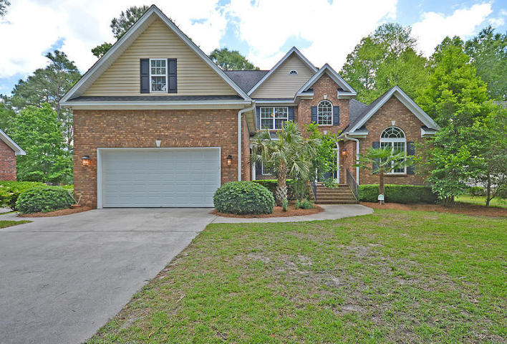
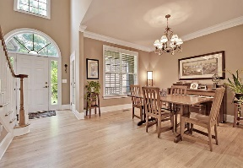
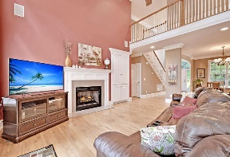
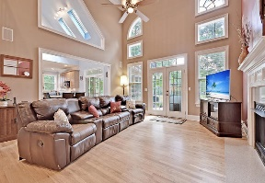
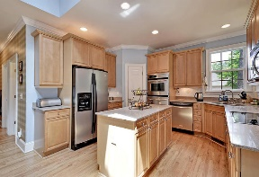
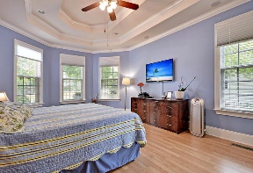
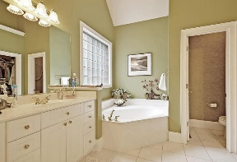
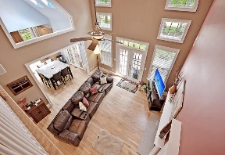
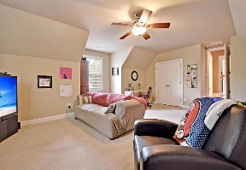
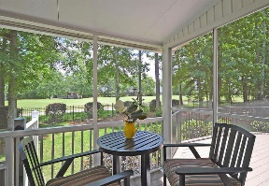
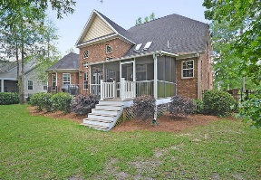
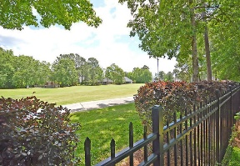
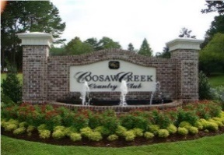


Golf Course Beauty ~ Just Reduced!
8749 Herons Walk
Coosaw Creek Country Club
North Charleston, SC 29420
MLS# 16012099
NEW LOW PRICE! $415,000
5 Bedrooms | 3 Baths | 3,200 sf
This lovely Coosaw Creek home is located on the golf course and offers a fenced in yard and sidewalk lined streets! This 3200 sq ft beauty has curb appeal galore! Walk in and immediately notice the gorgeous wood floors through out and the bright, open floor plan. To your right is an office or den with french doors for added privacy. The dining room is large and perfect for entertaining. The living room has vaulted ceilings, ton of natural light, built in cabinets and a gas fireplace. Lovely views of the golf course from this room! You can also step out to the large deck from here. The kitchen is a cook's delight! There is a butlers pantry with glass front cabinetry, custom tiled backsplash, large pantry, island and ample cabinet space. Step out of the kitchen in to the screened in porch which overlooks the backyard and golf course. The wooded backyard offers plenty of privacy! The first floor offers a guest bedroom with a full bath located right outside. Also, the master bedroom is located on the first floor. This room has lovely tray ceilings, views of the golf course and a large master bath. Upstairs, you'll find an amazing amount of storage in a large walk in attic! Also upstairs are two very good sized bedrooms, another full bathroom as well as a bonus room that can be used as a 5th Bedroom. This home has tons of storage!! This home and this neighborhood have so much to offer. Coosaw Creek is close to it all! Boeing, Bosch, AFB,...great location if you are looking for a short commute to work! In addition, the club offers many great events and activities as well as unlimited golf for all household members with membership. Come see this home today!
Larry & Kathy Mazalatis
Larry Cell 843-693-0529
Kathy Cell 843-693-0159
Office 843-871-9133
AGENTOWNED PREMIERE GROUP | 1800 TROLLEY RD | SUMMERVILLE, SC 29485

