Slide 1
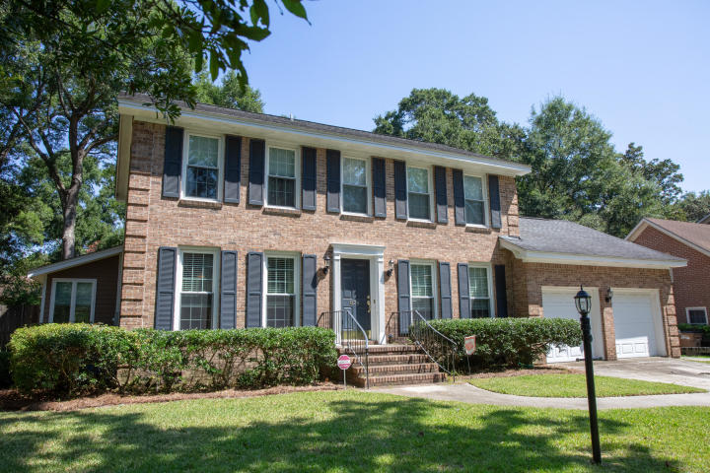
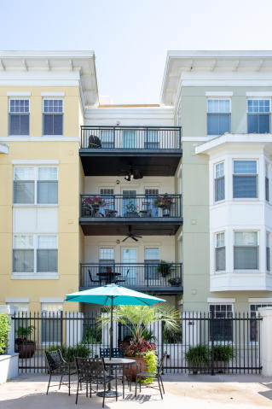
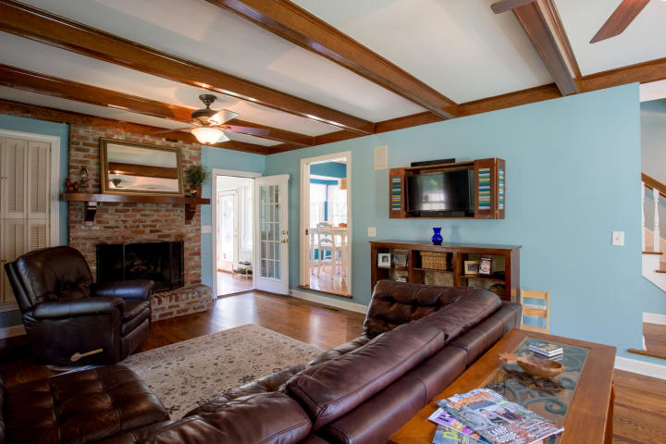
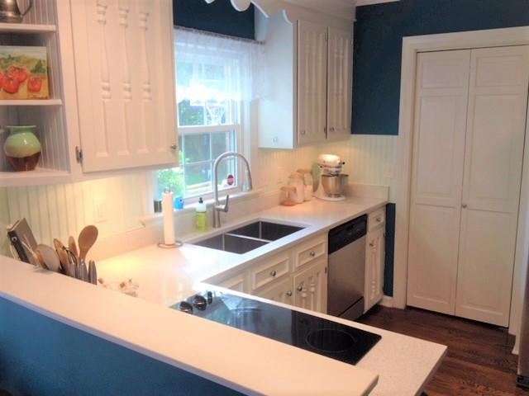
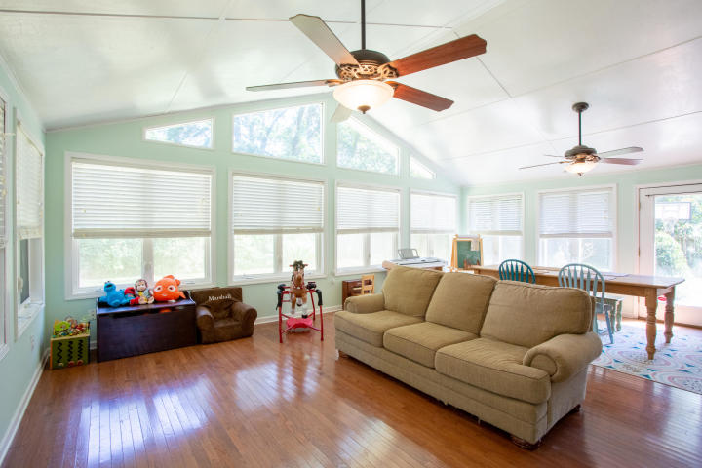
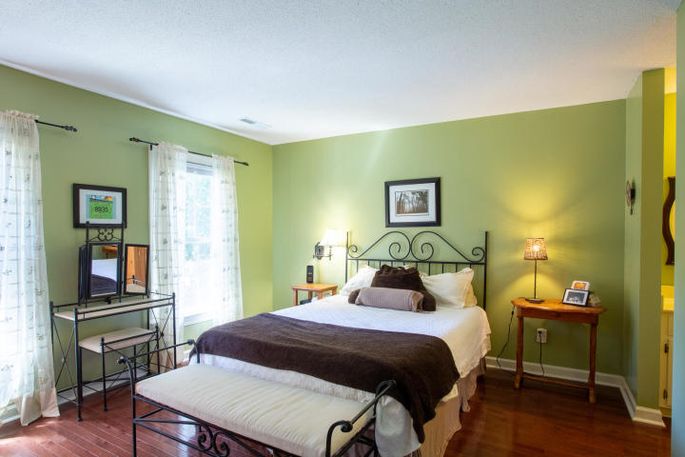
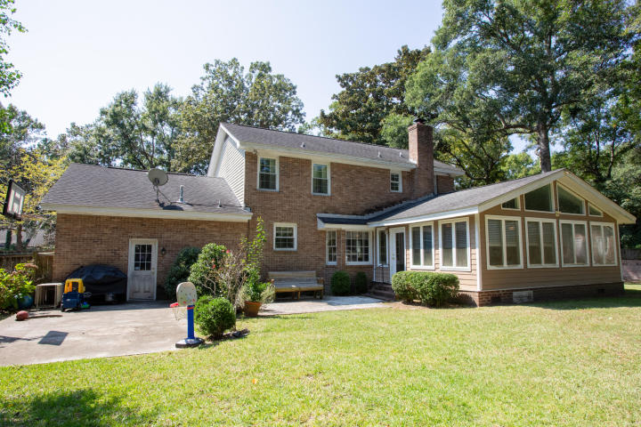


DRAFT
Price Improvement In Harbor Woods
874 Seafarer Way
Charleston, SC 29412 | MLS# 18026118 | $489,000
Stunning brick home in the highly sought after Harbor Woods neighborhood. The spacious first floor w/ hardwoods throughout has a large living room with a beautiful gas log fireplace, formal dining room, recently renovated kitchen with an eat-in area overlooking the backyard, and a huge sun-room off of the back of the house. The upstairs has a master suite with double vanities, a walk-in shower, and a large closet. There are two additional bedrooms upstairs along with a full bathroom off of the hallway. There's also a FROG that could easily serve as a fourth bedroom. The large backyard is entirely fenced in and has a patio for grilling and entertaining. Zoned for Stiles Point Elementary which is only a short walk away. Perfect for a family with young kids. Minutes to the beach and downtown.
82 Sans Souci Street
Charleston, SC 29403
Greg Gelber
(843) 494-2354
greg.gelber@agentownedrealty.com
AgentOwned Charleston Group | 902 Savannah Hwy | Charleston, SC 29407-7802

