Slide 1
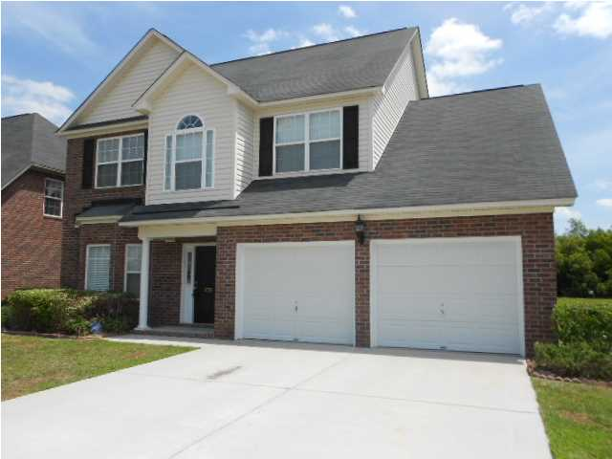
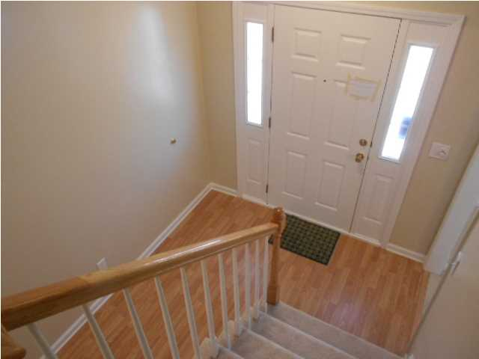
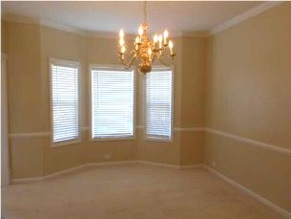
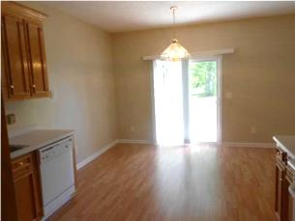
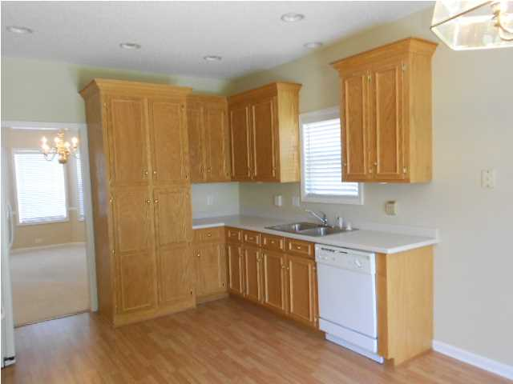
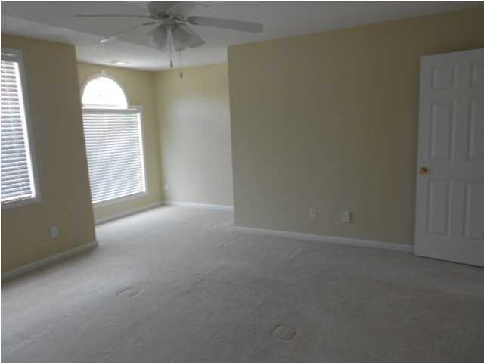
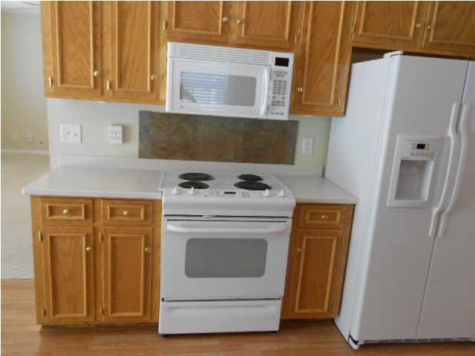
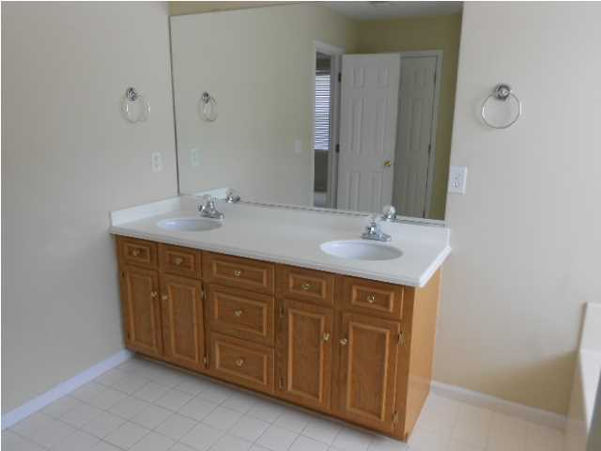
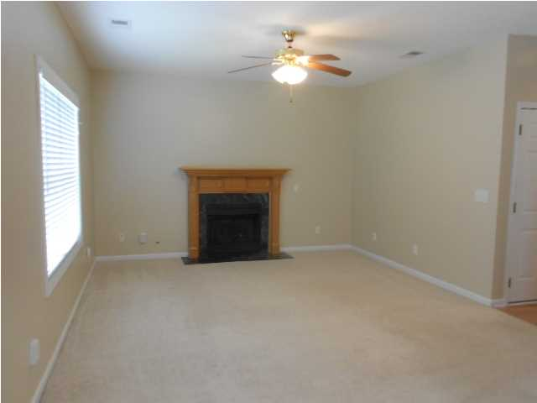
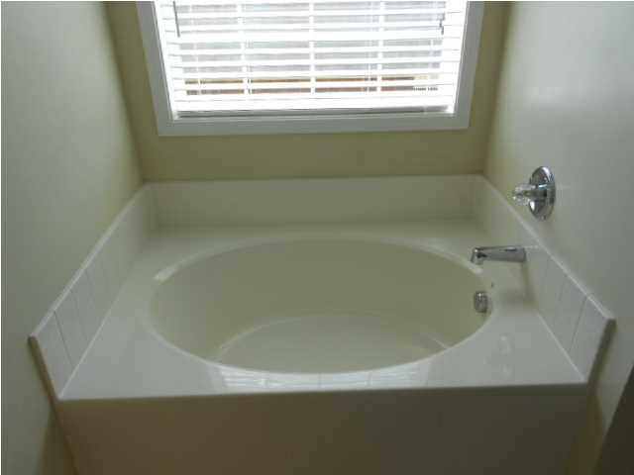
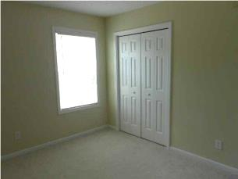
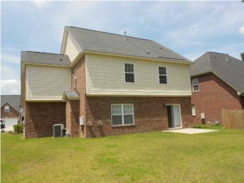
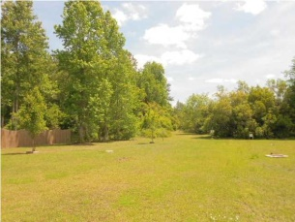


8756 Evangeline Dr Cedar Grove North Charleston MLS# 1410602 $229,999 4 Bedrooms | 2½ Baths | 1,991 Sq Ft
Move-in Ready…Come See This Lovely Home Today!
BEAUTIFUL Home in desirable Cedar Grove. This IMMACULATE Two story, 4 Bedroom, 2.5 Bath, home built by Vaughn, on a BEAUTIFULLY LANDSCAPED LOT with spectacular Pond in back, freshly painted.
LOCATION LOCATION LOCATION DORCHESTER DISTRICT II SCHOOLS close to the park on Dorchester Rd, the new Harris Teeter shopping center and restaurants. The floor plan includes a separate dining room; eat in kitchen and sliding patio door. The electric range, dishwasher, built-in microwave and refrigerator will all convey. There is a gas fireplace in the cozy Family Room with wall-to-wall carpet. The pantry has plenty of storage.
The master bedroom on the second floor has ample closet and storage space. The three additional bedrooms on the second floor are a nice size. The 2 car garage is attached. This is a MUST SEE and will not last. Please schedule your appointment through Showing Time to see it now!
Catherine Marshall
843-991-1898 M
843-873-0722 O
cathymarshall@carolinaoneplus.com
Carolina One Real Estate
900 N Main St.
Summerville, SC 29483

