Slide 1
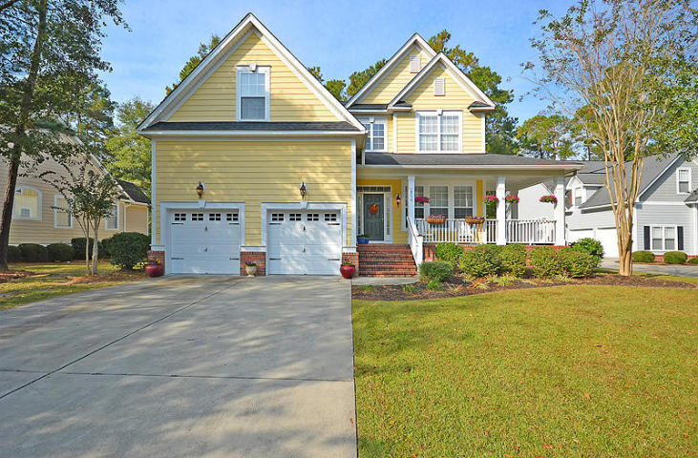
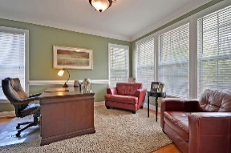
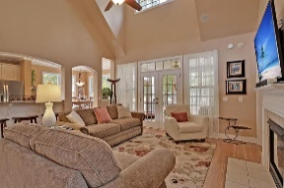
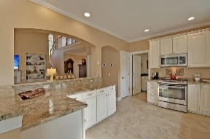
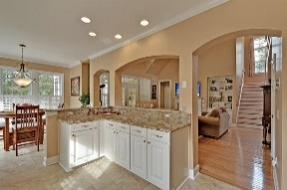
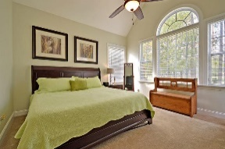
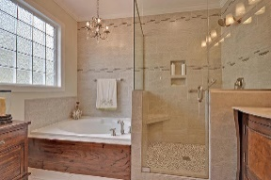
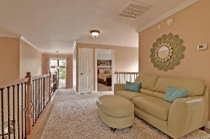
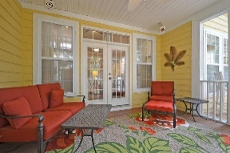
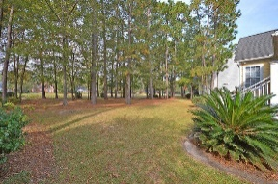
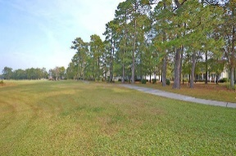
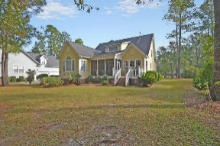



Gated Community - On the Golf Course!
8756 Herons Walk
Coosaw Creek Country Club
North Charleston, SC 29420
MLS# 17016410
$399,000
4 Bedrooms | 2½ Baths | 2,800 sf
Get ready to be WOWED!
This beautiful 2,800 sq.ft. custom built home is in IMMACULATE condition! Buyers can move right in with NO work or updating needed. Everything has been done for you! This home features 4 bedrooms and 2.5 bathrooms with a master bedroom on the 1st floor and an incredible golf course setting with views of the golf course and pond! Upon entering, you will see an office or formal living room with French doors. The gourmet kitchen offers a large sitting bar, granite counters, stainless steel appliances, gas stove and eat-in kitchen area with great pond and golf course views. Off the kitchen is your laundry room and garage access. The family room features a gas fireplace, beautiful hardwood floors, vaulted ceilings and built in cabinetry as well as plantation shutters.
The master bedroom, on the first floor, offers a completely renovated bathroom with gorgeous tile work and beautiful double vanity sink, two walk-in closets, vaulted ceilings, great views of the golf course and pond. The screened porch and deck overlook a beautifully landscaped backyard with great views! Upstairs buyers will find a loft area, two large bedrooms, a full bathroom and a large FROG which can serve as a 4th bedroom or fit practically any other purpose (playroom, entertainment area...) Off the FROG is tons of storage! There is crown molding throughout much of the home, brand new carpeting and fresh paint! TWO BRAND NEW HVAC units!! The owners of this home have taken excellent care of their home, it's like new and is a must see!
COOSAW CREEK OFFERS AN EXCELLENT CLUBHOUSE WITH RESTAURANT AND BAR, NEIGHBORHOOD POOL, TENNIS COURTS AS WELL AS AN EXCELLENT GOLF COURSE. PLANNED EVENTS AND MEALS IN THE VERY ACTIVE CLUBHOUSE ARE COMMON AND GOLF MEMBERS ENJOY THE NUMEROUS MONTHLY GOLF EVENTS OFFERED WITHIN THIS PRIVATE GATED COMMUNITY...
Larry & Kathy Mazalatis
Larry Cell 843-693-0529
Kathy Cell 843-693-0159
Office 843-871-9133
AGENTOWNED PREMIERE GROUP | 1800 TROLLEY RD | SUMMERVILLE, SC 29485

