Slide 1
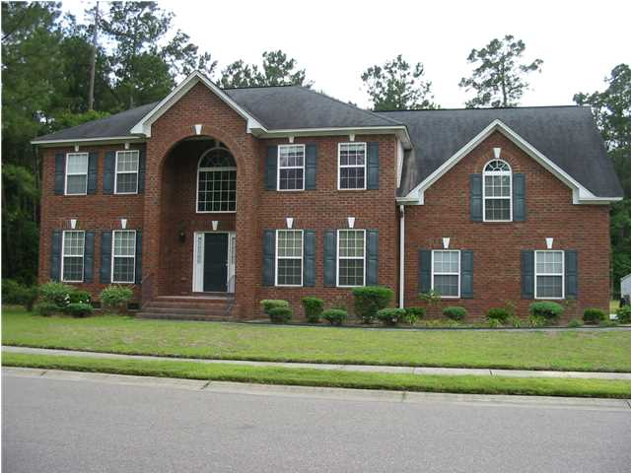
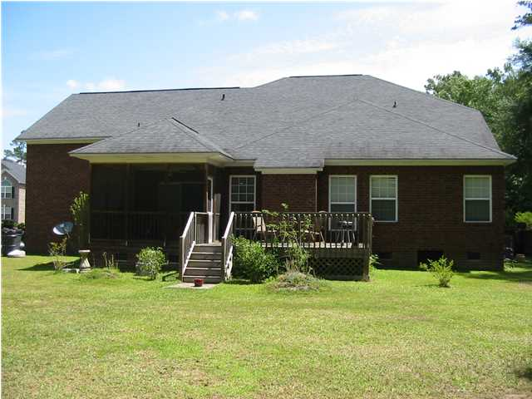
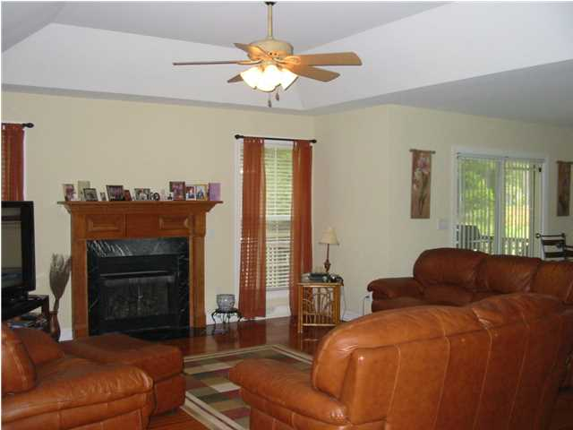
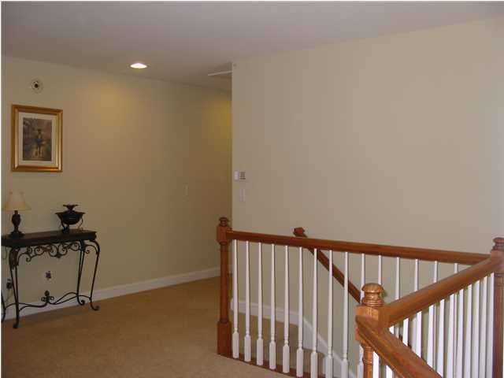
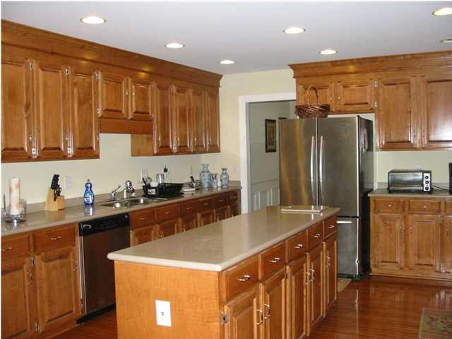
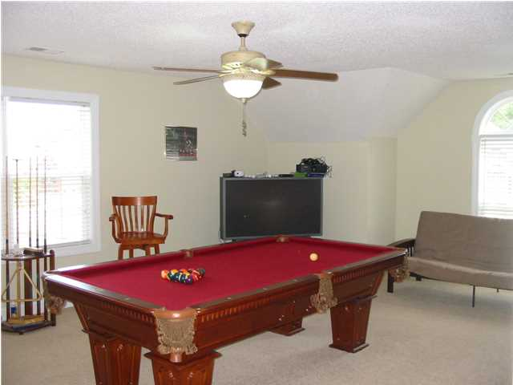
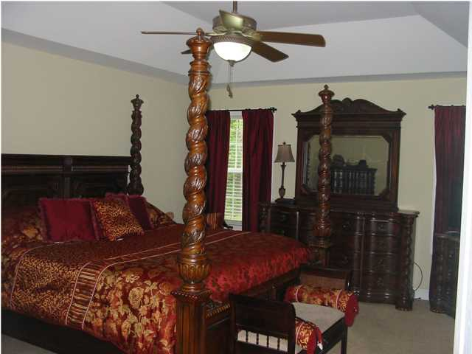
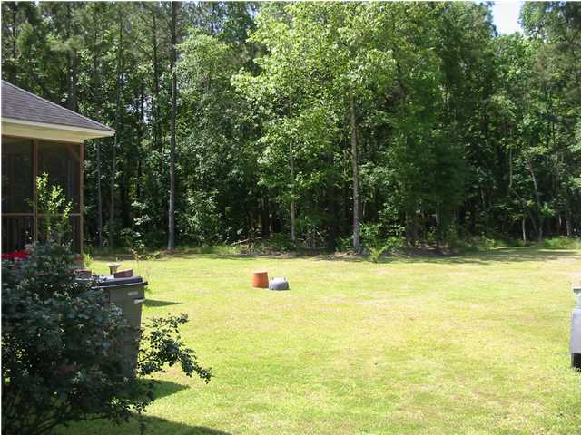

Agent Open House ~ Tuesday, September 2nd ~ 11a-2p
8760 Alexandria Drive
Cedar Grove
Charleston, SC
MLS# 1422118
$469,900
5 Bedrooms / 3½ Baths / 3,231 sf
ALL AGENT ARE INVITED TO COME OUT TO 8760 ALEXANDRIA DR IN NORTH CHARLESTON
DIRECTIONS: Ashley Phosphate Rd to RIGHT on Dorchester Rd, LEFT onto River Bluff Parkway and 2nd right onto Alexandria. First house on left.
IF YOU ARE IN THE AREA ON TUESDAY, COME JOIN US FOR A LIGHT LUNCH AND A CHANCE TO SEE A GREAT HOME IN THE CEDAR GROVE COMMUNITY IN NORTH CHARLESTON!
We would love for you to come out and see this great TWO STORY traditional home with 5 Bedroom, 3.5 Bath ALL BRICK home on .49 acre wooded corner lot. Master suite is on the main level. Large bedrooms on the upper level. Cedar Grove is a great family community with a beautiful amenity center. Conveniently located off Dorchester Rd.
Hope to see you there on Tuesday!!
Keller Williams Realty Charleston
496 Bramson Ct, Ste 200
Mt. Pleasant, SC 29464
Jeff Lackey
843-364-5149
lackeyb54@yahoo.com

