Slide 1
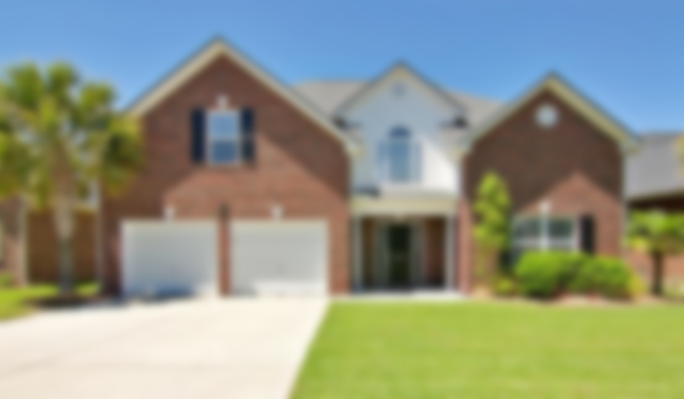




Walk Through Beautiful Home in Cedar Grove
8763 Evangeline Drive ~ North Charleston ~ MLS# 20011313 ~ $389,000
This stunning home located in convenient Cedar Grove is a must see with 5 spacious bedrooms and 3 full bathrooms.
❖ New interior paint throughout home ❖ New wood propeller ceiling fan ❖ New lighting fixtures throughout home ❖ New Acacia engineered wood flooring ❖ New garage door openers ❖ New wood blinds throughout home ❖ Refrigerator conveys with home ❖ New built-ins in laundry and washer/dryer included ❖ New gutter system ❖ New drainage system for yard❖ Re-tiled both guest baths ❖ Brand new spa-style master bath retreat ❖ New master bath custom barn door ❖ New custom built-ins for master closet ❖ Guest closets updated ❖ Replaced roof architectural 2017 ❖ Outdoor lighting replaced ❖ New microwave in kitchen ❖ Nest thermostat ❖ Well maintained, beautifully landscaped yard on pond
Video Walkthrough: https://www.youtube.com/watch?v=TJ-sr3koaUY
Handsome Properties, Inc 53 Broad St Charleston, SC 29401
Elizabeth Shirley
843-276-2970
lizshirleyrealestate@gmail.com
Suzanne Conway
843-814-6778
s.conway@bhhssun.com

