Slide 1
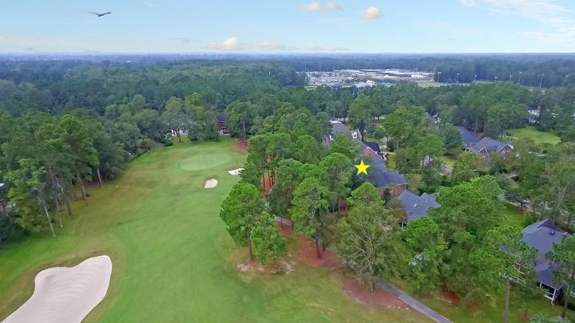
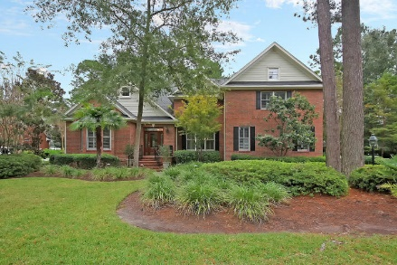
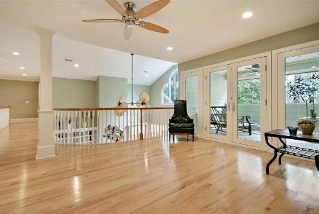
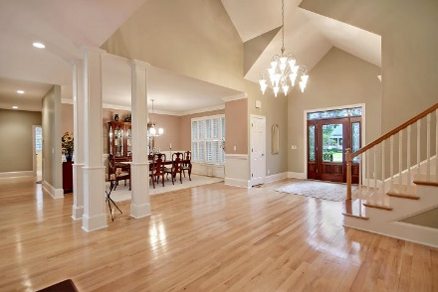
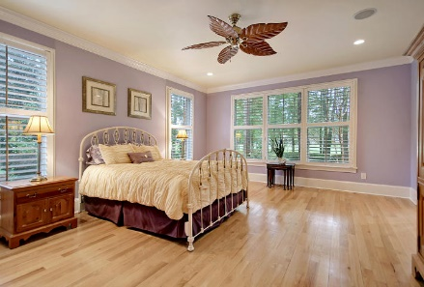
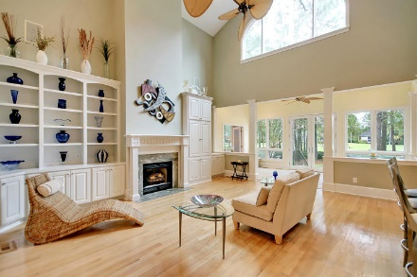
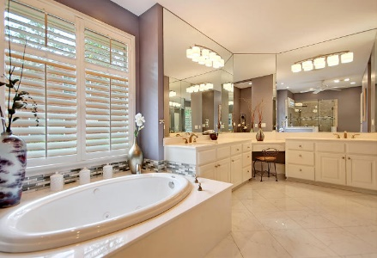
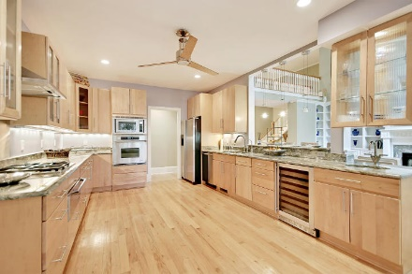
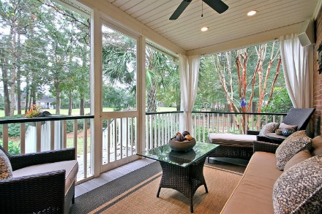
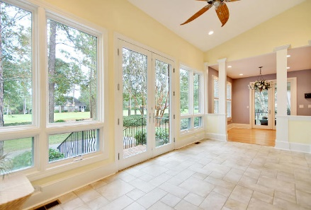
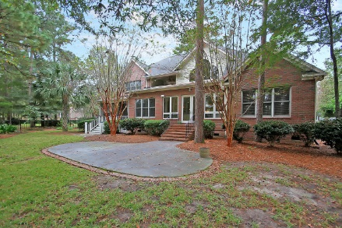

Open House! Sunday 12:00-2:00
8769 Herons Walk
Coosaw Creek Country Club ~ North Charleston
MLS# 17028302 ~ $619,000
One of the most amazing floor plans in the gated community of Coosaw Creek Country Club that backs up to one of the pristinely manicured greens of the golf course! Memorable highlights of the home include an amazing two-story family room with a fireplace, beautiful built-ins on either side & a tropical leaf fan fixture that makes everyday feel like a vacation, a gourmet eat-in kitchen with two sinks, solid surface counters & high-end Dacor appliances, a bright & airy sunroom, an office & a loft with a wet bar & access to one of two balconies. The first floor master has a huge walk-in closet & en-suite bath with dual vanities, a walk-in tile shower & jacuzzi tub with custom tile work. This spacious, luxurious & open floor plan lends itself to comfortable living inside & out!
Additional features include:
Screened-in porch
Hardwood floors
Crown molding, baseboard molding
Formal living room and dining room
French doors lead to the office
Book your showing soon!
Ben Laaper ben@mattoneillteam.com 843-642-3546

