Slide 1
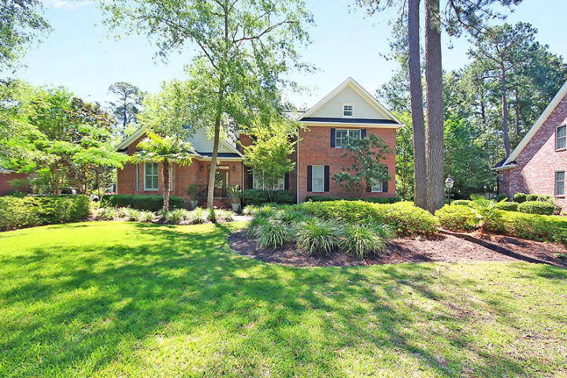
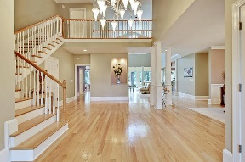
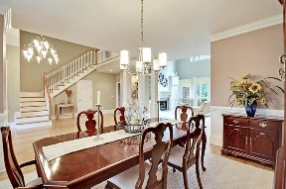
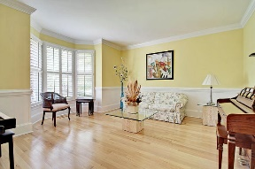
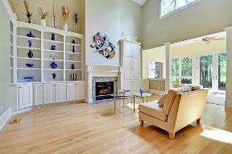
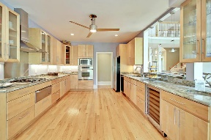
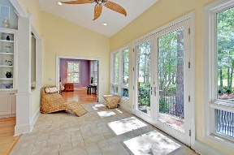
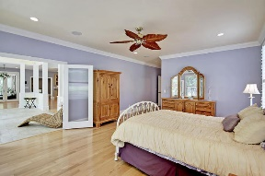
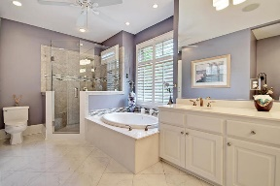
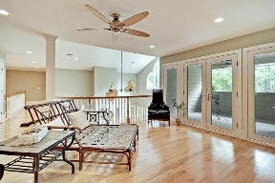
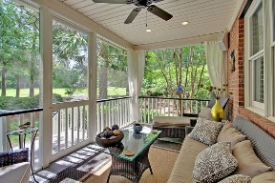
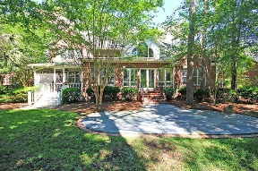



Gorgeous Golf Course Home in Gated Community!
8769 Herons Walk
Coosaw Creek Country Club
North Charleston, SC 29420
MLS# 17015100
$650,000
4 Bedrooms | 3½ Baths | 4,864 sf
Get ready to be WOWED by this gorgeous home located on the golf course in Coosaw Creek Country Club! Beautiful upgrades of light fixtures, tile work, wood flooring, surround sound in LR, master and patio, plantation shutters and gorgeous granite! This home is sure to impress! The grand foyer welcomes you upon entering. You'll immediately notice the open flow of the home the natural light. To your left you have a formal living room which could be used as an office. To your right a very large dining room, perfect for entertaining. The stunning kitchen is a chef's delight! Top end appliances, vegetable sink, gas cooktop, warming drawer, a wine cooler, breakfast bar, and great layout overlooking the living room. The eat in kitchen area has great views of the golf course. Off the kitchen is an office area as well as a butler's pantry, and large laundry room. The living room has a gas fireplace and built in cabinetry, stunning vaulted ceilings adding to the open feel of the home. Off the living room is a sunroom that's perfect for relaxing with great views of the backyard and golf course. The master suite is huge! Very large walk in closet and master bath. Upstairs, you'll find a large bonus room, perfect for a media room! The other side of the upstairs boasts two very large bedrooms, a full bath in the hall as well as another huge bedroom that could be another master suite with its own bath. This bedroom also offers a balcony for added privacy. Back in the hall you'll find another washer and dryer, wet bar, sitting area and another balcony overlooking the golf course. A second staircase to this area gives you to an opportunity to make this area an entire separate living space for guests, teens, in laws, you name it! Outside, you'll find extensive landscaping including a patio with a cabana and a lily pond. This home has it all and is a must see! The neighborhood has 24 hour 7 day a week gated security, unlimited golf for all household members, and the location, wow...close to it all! Boeing, Bosch, AFB, Mercedes are all a short drive away. Come live the good life in a golf course community that has tons of activities and events, great food in the restaurant, great community pool with an award winning swim team, and the most beautiful golf course you'll ever play on!
Larry & Kathy Mazalatis
Larry Cell 843-693-0529
Kathy Cell 843-693-0159
Office 843-871-9133
AGENTOWNED PREMIERE GROUP | 1800 TROLLEY RD | SUMMERVILLE, SC 29485

