Slide 1
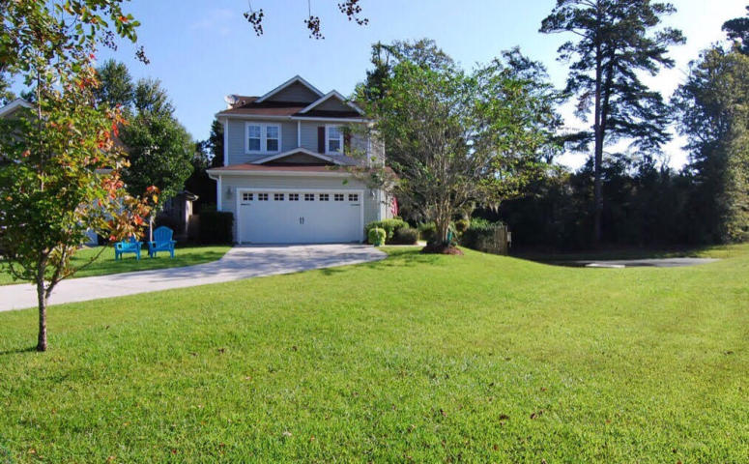
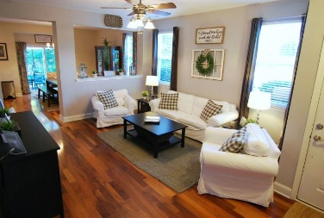
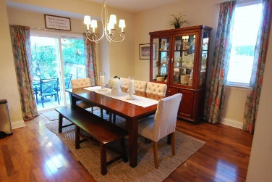
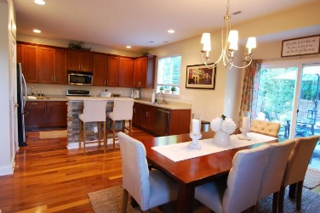
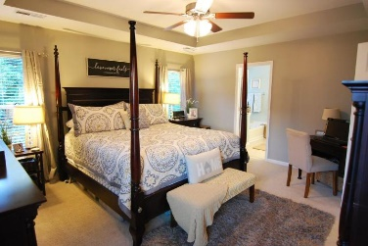
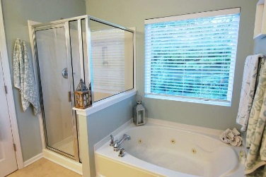
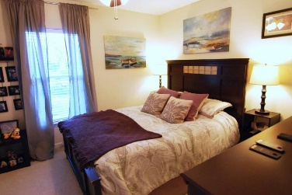
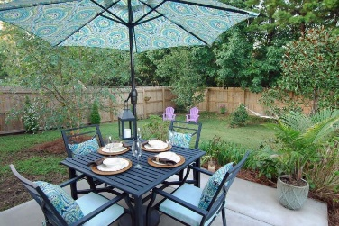
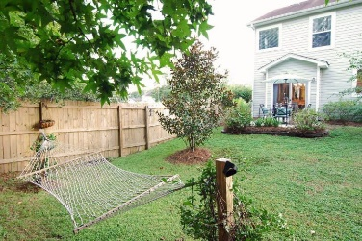


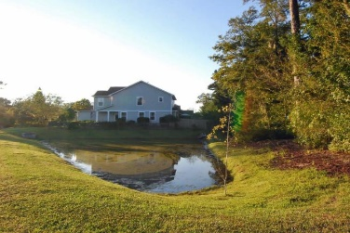

8772 Shadowglen Drive
Charleston Park ~ North Charleston, SC 29420
MLS# 18026306 ~ $227,500
Just Listed!
Open House
Sat 11am-1pm
Original owner home in Dorchester II schools in a beautifully established community on the cusp of Summerville yet moments to Charleston! This home is situated on the most private lot with the best views in the entire community ~ double pond views and it backs up to a wooded HOA space! The owners have taken meticulous care of this 4 bedroom home, and it is loaded with all of the best upgrades ~ *Gleaming Hardwood Flooring *Gourmet Kitchen with Double Edge Quartz Countertops, Stainless Steel Appliances, Gas Range, Island with Custom Detail, Maple Cabinets with Crown Molding and Hardware, Upgraded Faucet, Recessed Lighting and More *Enormous Master Suite with a Tray Ceiling and Huge Walk-In Closet *Deluxe Master Bathroom with Double Sinks, Jetted Tub and Separate Shower (Tile Flooring)
Secondary Bath with Double Sinks (Tile Flooring)
Two Linen Closets
Wrought Iron Balusters on Staircase
New Windows
New HVAC Components
Gutters
Two-Car Garage with Automatic Opener
Carriage Lights
Extended Driveway to Accommodate 6+ Cars
Large Private Homesite with Privacy Fence
Double Pond View
One of the Largest Homesites in the Entire Community
Move In Ready!
Beth Moore
M (843) 532-4892
bmoore@carolinaone.com
Meg Kandik
M (843) 814-5137 | O (843) 603-4659
Meg@HolyCityRE.com | www.holycityre.com
Bennett Construction & Realty | 804 Tennent Dr | Charleston, SC 29412

