Slide 1
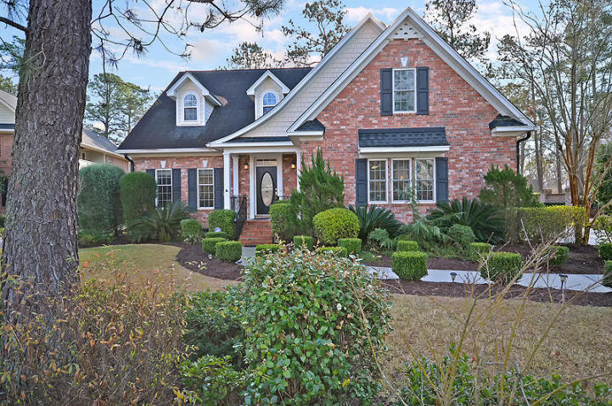
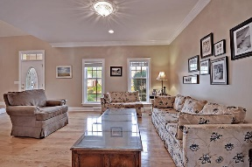
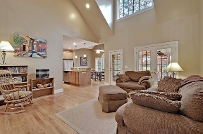
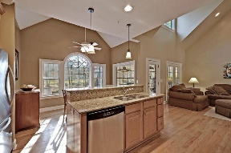
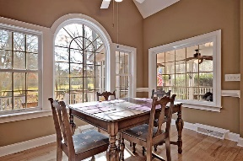
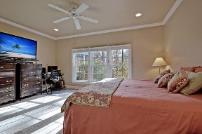
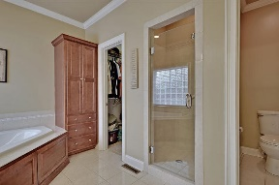
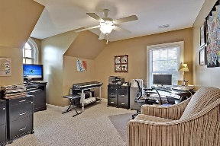
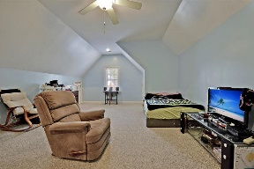
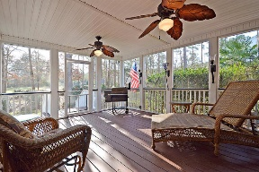
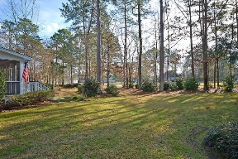
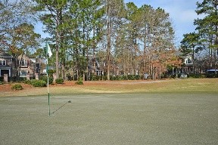



Gated Community Golf Course Beauty!
8773 Herons Walk
Coosaw Creek Country Club
North Charleston, SC 29420
MLS# 17003100
$399,900
4 Bedrooms | 2½ Baths | 3,129 sf
You'll be eager to see inside once pulling up to this home! It has curb appeal galore! Extensive landscaping, on the golf course on a sidewalk lined street!! This Coosaw Creek beauty is sure to catch your eye! Upon entering the home, you'll immediately notice the wood floors throughout the first floor. The formal living room is open to the dining room which makes it a perfect area for entertaining. The kitchen has the perfect layout - you can do dishes while looking out over the beautiful golf course! There is plenty of cabinets, a pantry, stainless steel appliances, granite countertops, an island and a large eat in area. While in the kitchen you can still be a part of what's going on in the family room as the two are open to each other. The family room has vaulted ceiling, built in cabinetry and shelving and a gas fireplace. Easily access the screened in porch and deck both with great views of the wooded backyard and golf course. The master bedroom of this home is located on the first floor. This bedroom also has great views of the golf course! The master bath offers a jetted tub, separate shower and a walk in closet. Head upstairs and you'll find a very large FROG that can be used as a 5th bedroom if needed! Three other bedrooms all with ample closet space and attic storage are upstairs as well as a full bath. The neighborhood has 24 hour 7 day a week gated security, unlimited golf for all household members, and the location, wow...close to it all! Boeing, Bosch, AFB, Mercedes are all a short drive away. Come live the good life in a golf course community that has tons of activities and events, great food in the restaurant, great community pool with an award winning swim team, and the most beautiful golf course you'll every play on!
Larry & Kathy Mazalatis
Larry Cell 843-693-0529
Kathy Cell 843-693-0159
Office 843-871-9133
AGENTOWNED PREMIERE GROUP | 1800 TROLLEY RD | SUMMERVILLE, SC 29485

