Slide 1
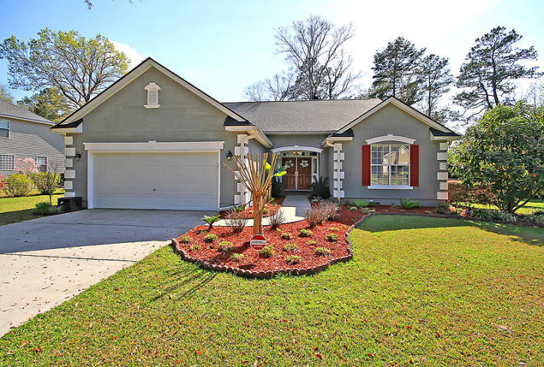
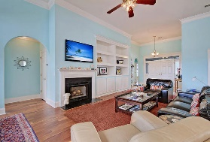
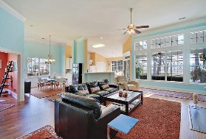
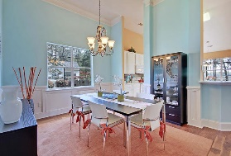
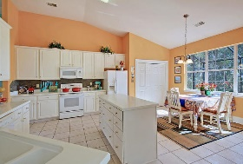
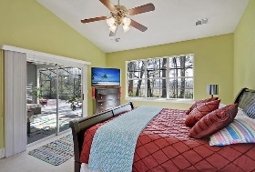
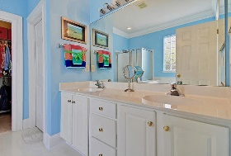
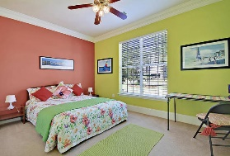
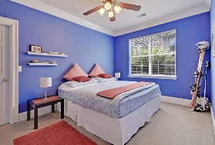
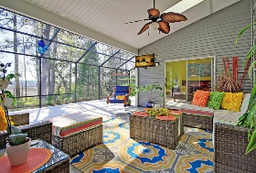
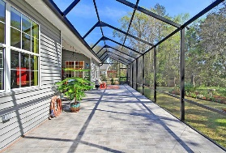
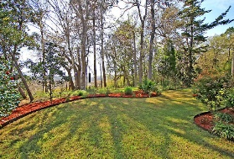
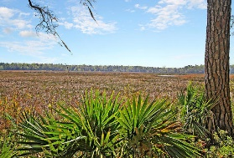


Views of Ashley River & Middleton Plantation!
8788 Laurel Grove Lane
Whitehall
North Charleston, SC 29420
MLS# 20008430
$359,000
3 Bedrooms | 2 Baths | 2,182 sf
Looking for a million dollar view? Then this is the home for you! Sweeping views of the Ashley River with Middleton Plantation in the distance! Sit inside your huge screened in porch while watching the boats go by. This one story home is move in ready! Upon entering the double front door, you'll immediately notice the open floor plan and the views! To your right are two good sized bedrooms with a full bath in the hall. To the left is an office as well as the laundry room which leads to the two car garage. It's an open flow from the dining room and the kitchen which both overlook the living room. The kitchen has a large eat in area as well as a pantry. The living room has built in shelving and cabinetry and a fireplace. The master bedroom also boasts great views of the river and plantation. The master bathroom has dual vanities, separate tub and shower and walk in closet. Head out to the backyard to enjoy relaxing in your own little paradise. The backyard is very private and is landscaped beautifully. The neighborhood has a great neighborhood pool, playground and tennis courts. Whitehall is centrally located and is serviced by Dorchester District 2 schools. Just a short drive away from Bosch, the airport and Palmetto Commerce parkway. This home is a dream come true! Come see it today!!
Larry & Kathy Mazalatis
Larry Cell 843-693-0529
Kathy Cell 843-693-0159
Office 843-871-9133
AGENTOWNED PREMIERE GROUP | 1800 TROLLEY RD | SUMMERVILLE, SC 29485

