Slide 1
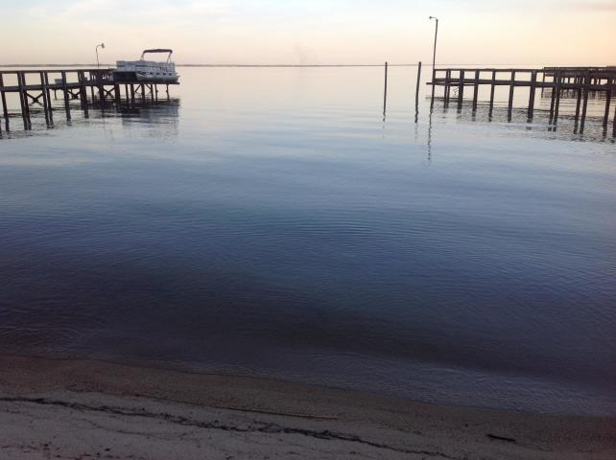
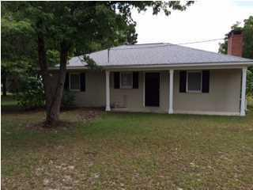
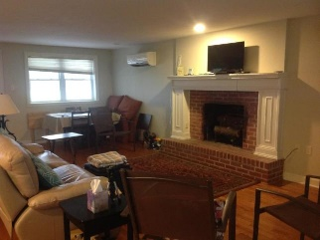
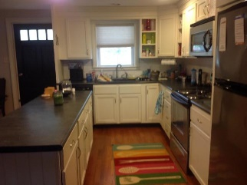
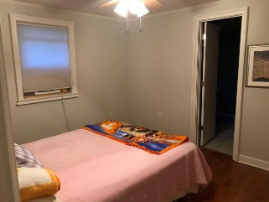
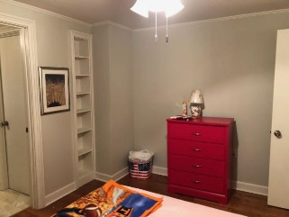
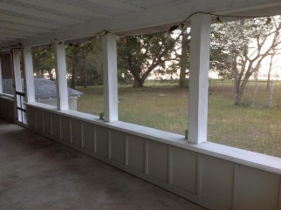
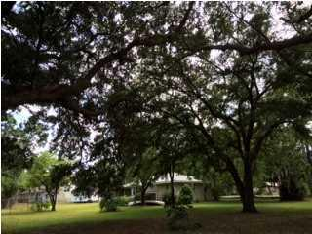
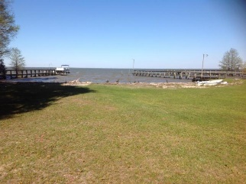

Waterfront Property On Lake Marion!!
This 2 bed/2 bath home is a great vacation or weekend getaway home
878 Miracle Drive
Saint Julien | Eutawville, SC 29048
MLS# 19008852 | $300,000
Most recent update was insulating the roof. In 2012 the exterior was painted, screened porch added, as well as a new boat ramp. In 2011 the new easy water system was added as well as the architectural roof. New oak flooring, new kitchen cabinets, counter tops, appliances new insulation, sheet rock, interior paint and windows in 2009. The sandy beach is great for sitting by the water and playing in the sand. You have your own boat ramp for taking the water craft in and out. Amazing views. Come to see this one today!!! Santee Cooper marginal lease is 350. Per year.
Carla C Davis
Mobile - (843) 437-4873
gaweber@tds.net
AgentOwned Premiere Group
141 A N. Main Street
Summerville, SC 29483

